Slide 1
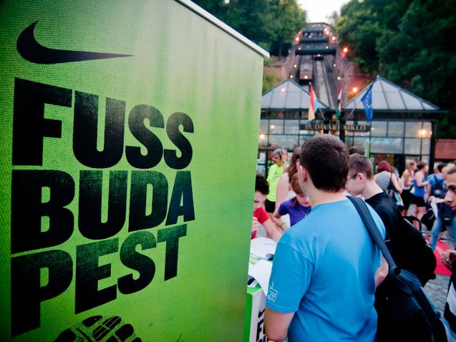
Nike Run Budapest events

Slide 2
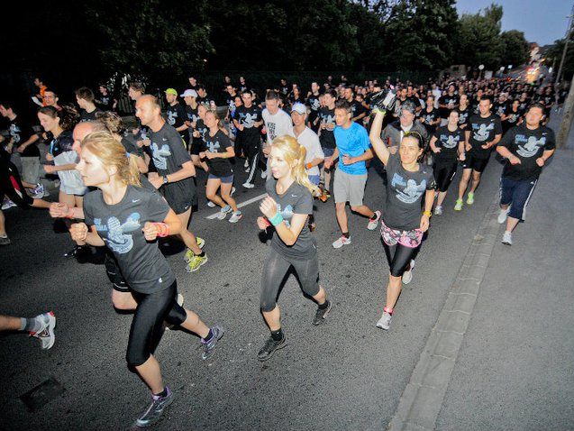
Brief:
Let more non active university or college students experience the joy of running.

Slide 3
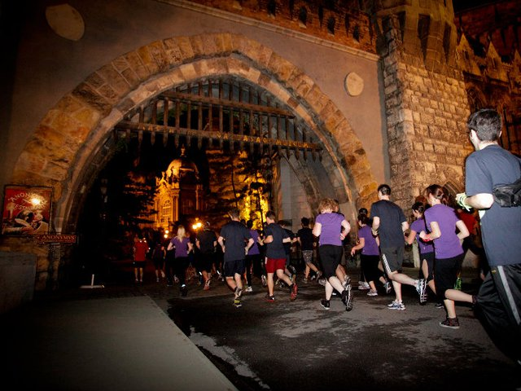
Idea:
There are 2 things every college student likes:
partying and surprises.
Let's invite them to a running party which is far from ordinary.

Slide 4
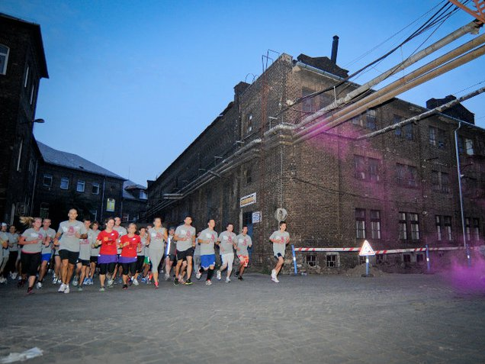
Execution:
Fun-runs were organized on extraordinary locations. The exact route and destination of every run was a surprise. At the finish line a huge party awaited the runners in accordance with the concept of the given fun run.

Slide 5
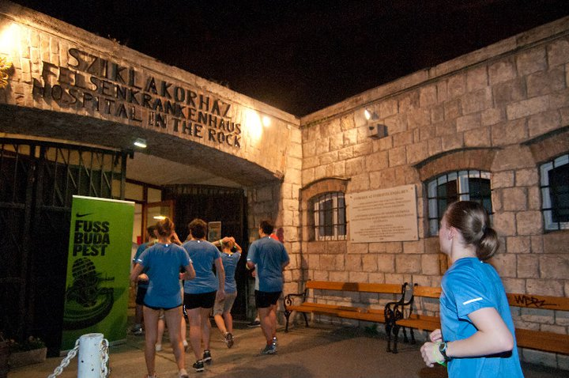
Extras:
Brand Ambassador Program in several universities to reach the target group more effectively.
Involving celebrities in the events.
Continuous cost-effective and target-relevant communication on Facebook.

Slide 6
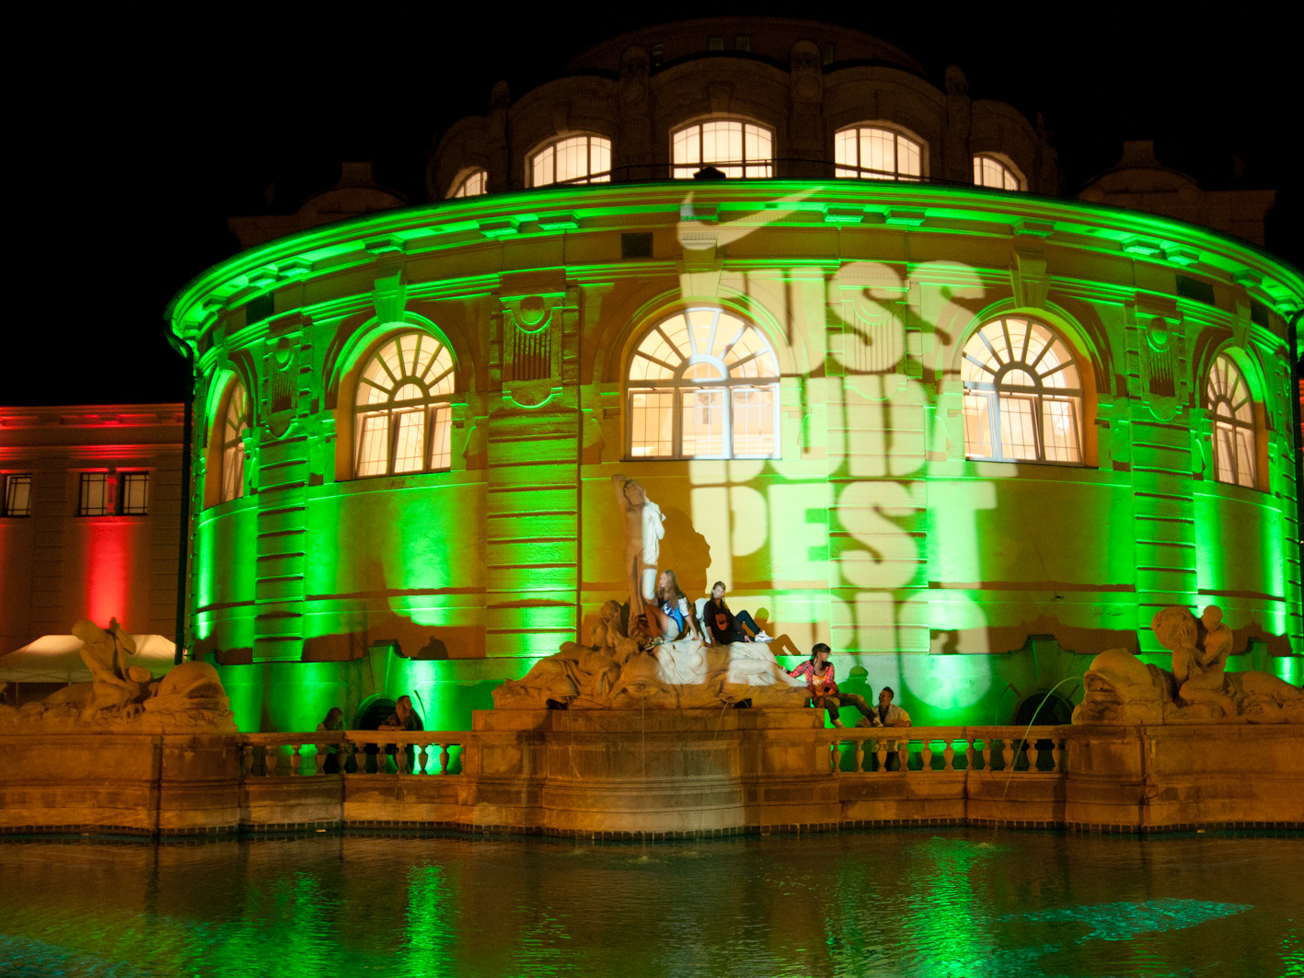
The Fun Runs

Slide 7
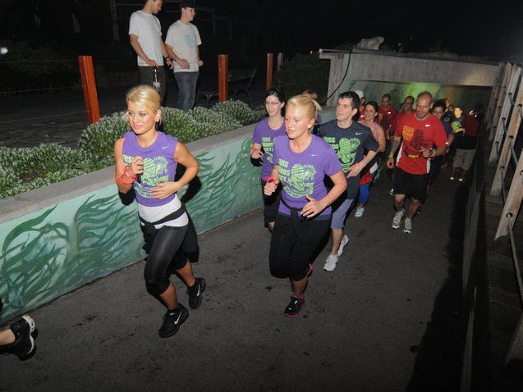
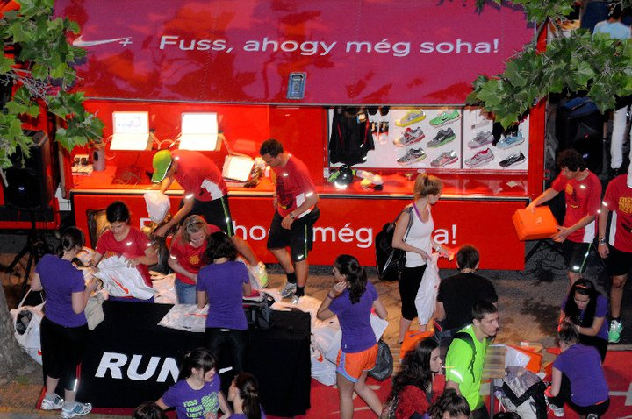
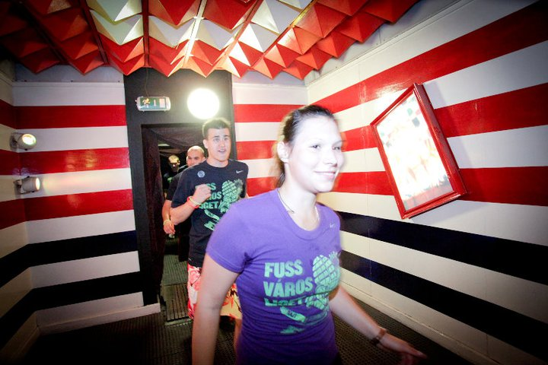
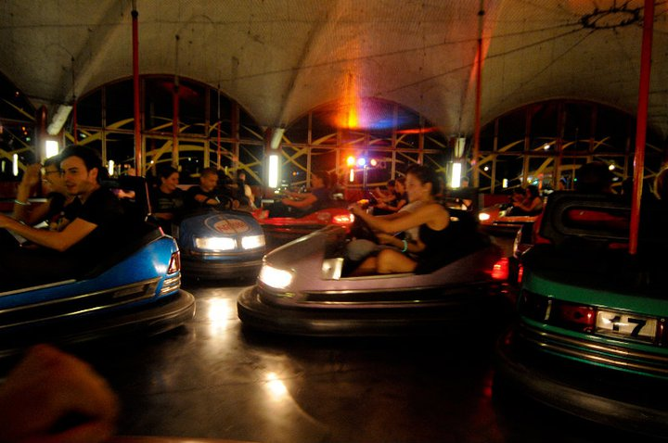
Run City Park
The start line was at Széchenyi Spa, in the center of Budapest.
We run through Budapest Zoo, the Amusement Park and Palace of Miracles (a regular interactive science exhibition).
At the finish line dodgem riding and a huge party waited for the participants.

Slide 8
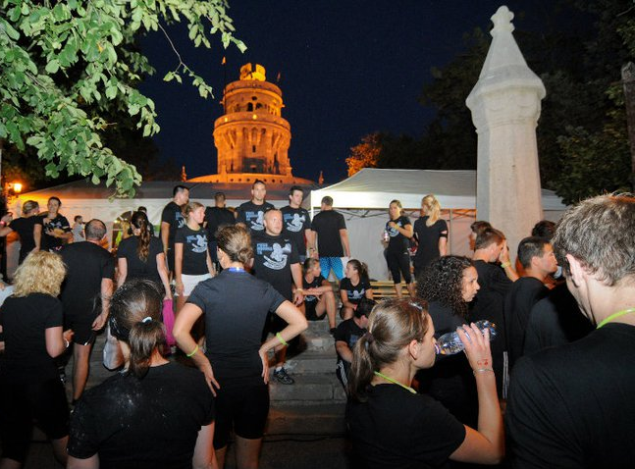
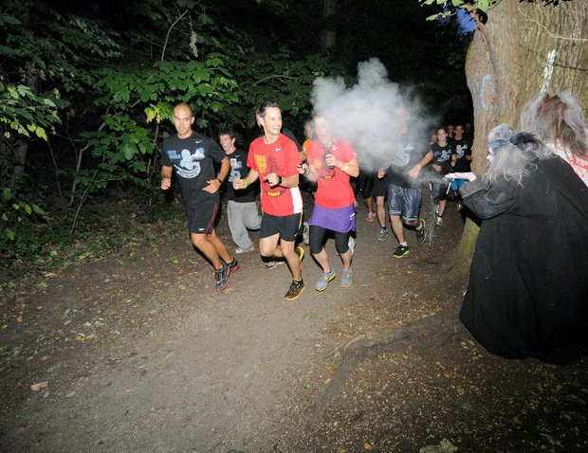
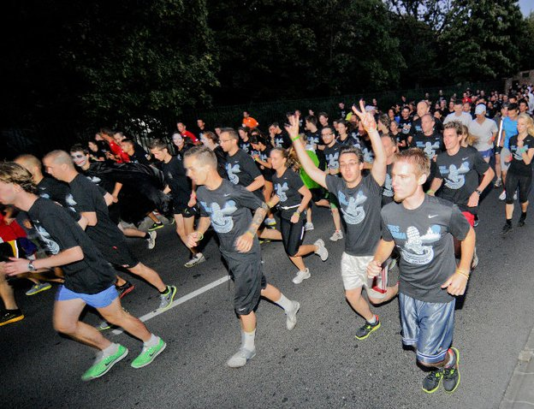
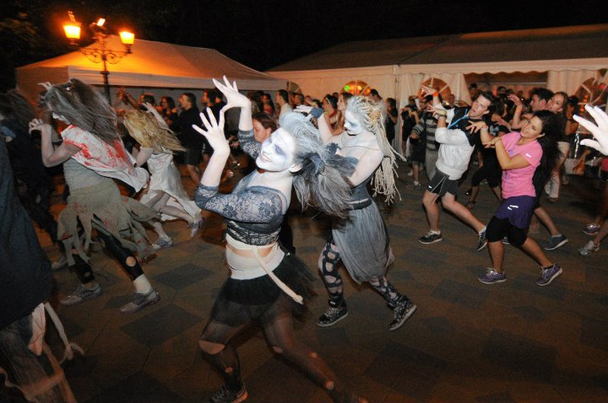
Run Normafa
Runners were transported with 5 buses to the start line at Normafa, one of Budapest favorite hiking spot in the near mountain area.
The concept of the run was a Full Moon courage test in the woods abounding with ghosts and werewolves (animators in scary costumes).
Music, dancing and a flash mob waited for the runners at Erzsébet look out tower.
The party came to an end at dawn.

Slide 9
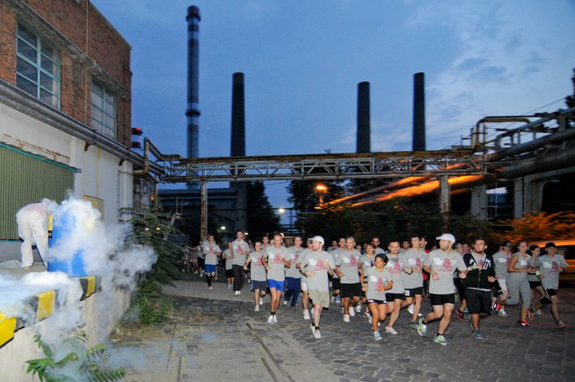
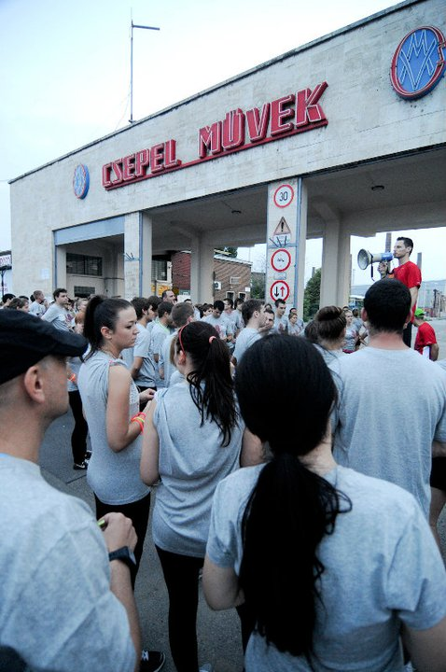
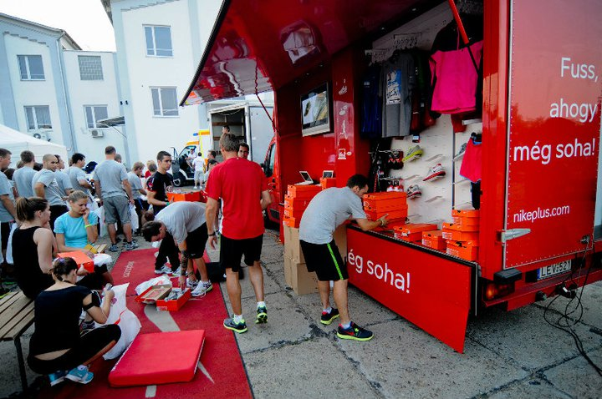
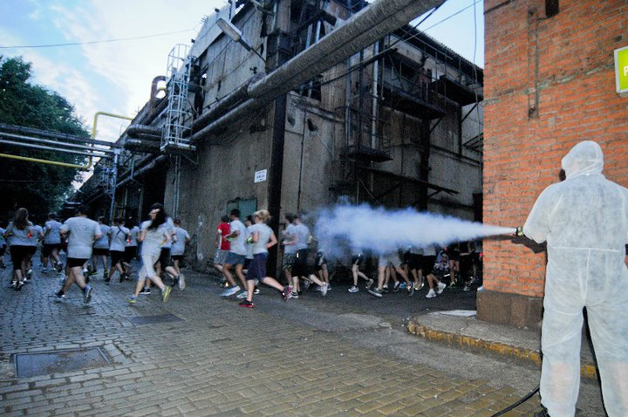
Run Csepel
Runners arrived at the start line by an exclusive train.
The running took place in industrial environment in an old factory.
Runners were accompanied by free runners, jumping and backfliping around all the way.
Due to the concept a "Ghetto-party" waited for the runners at the finish line.

Slide 10
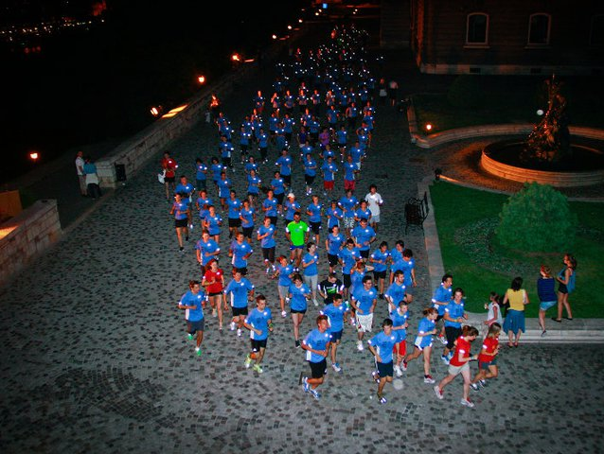
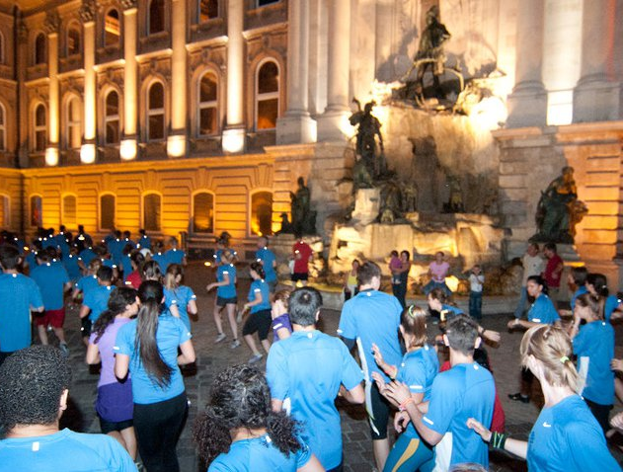
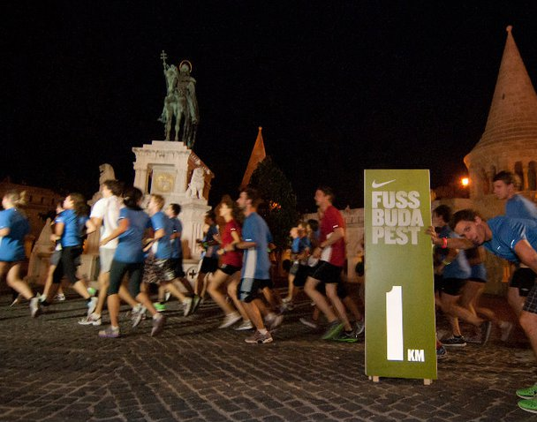
Run Castle Buda
The start line was at Sándor Palace in Castle Buda, where runners arrived by the Castle Hill Funicular.
Runners „occupy the castle", run through the famous Hospital in the Rock Museum and the Buda Castle Labyrinth.
At the finish line we organized an inauguration ceremony, so the runners became „Lords of Running" from then on.

Slide 11
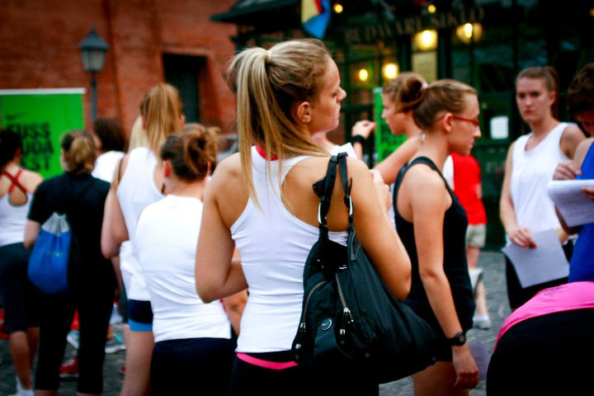
Due to the intense interests and the high number of participants (more than 800 students)...
… NIKE Fun Run events continue in 2012.

