Slide 1

MIXGAR
social jukebox

Slide 2

Notes:
Talk about what is the problem what we resolve

Slide 3
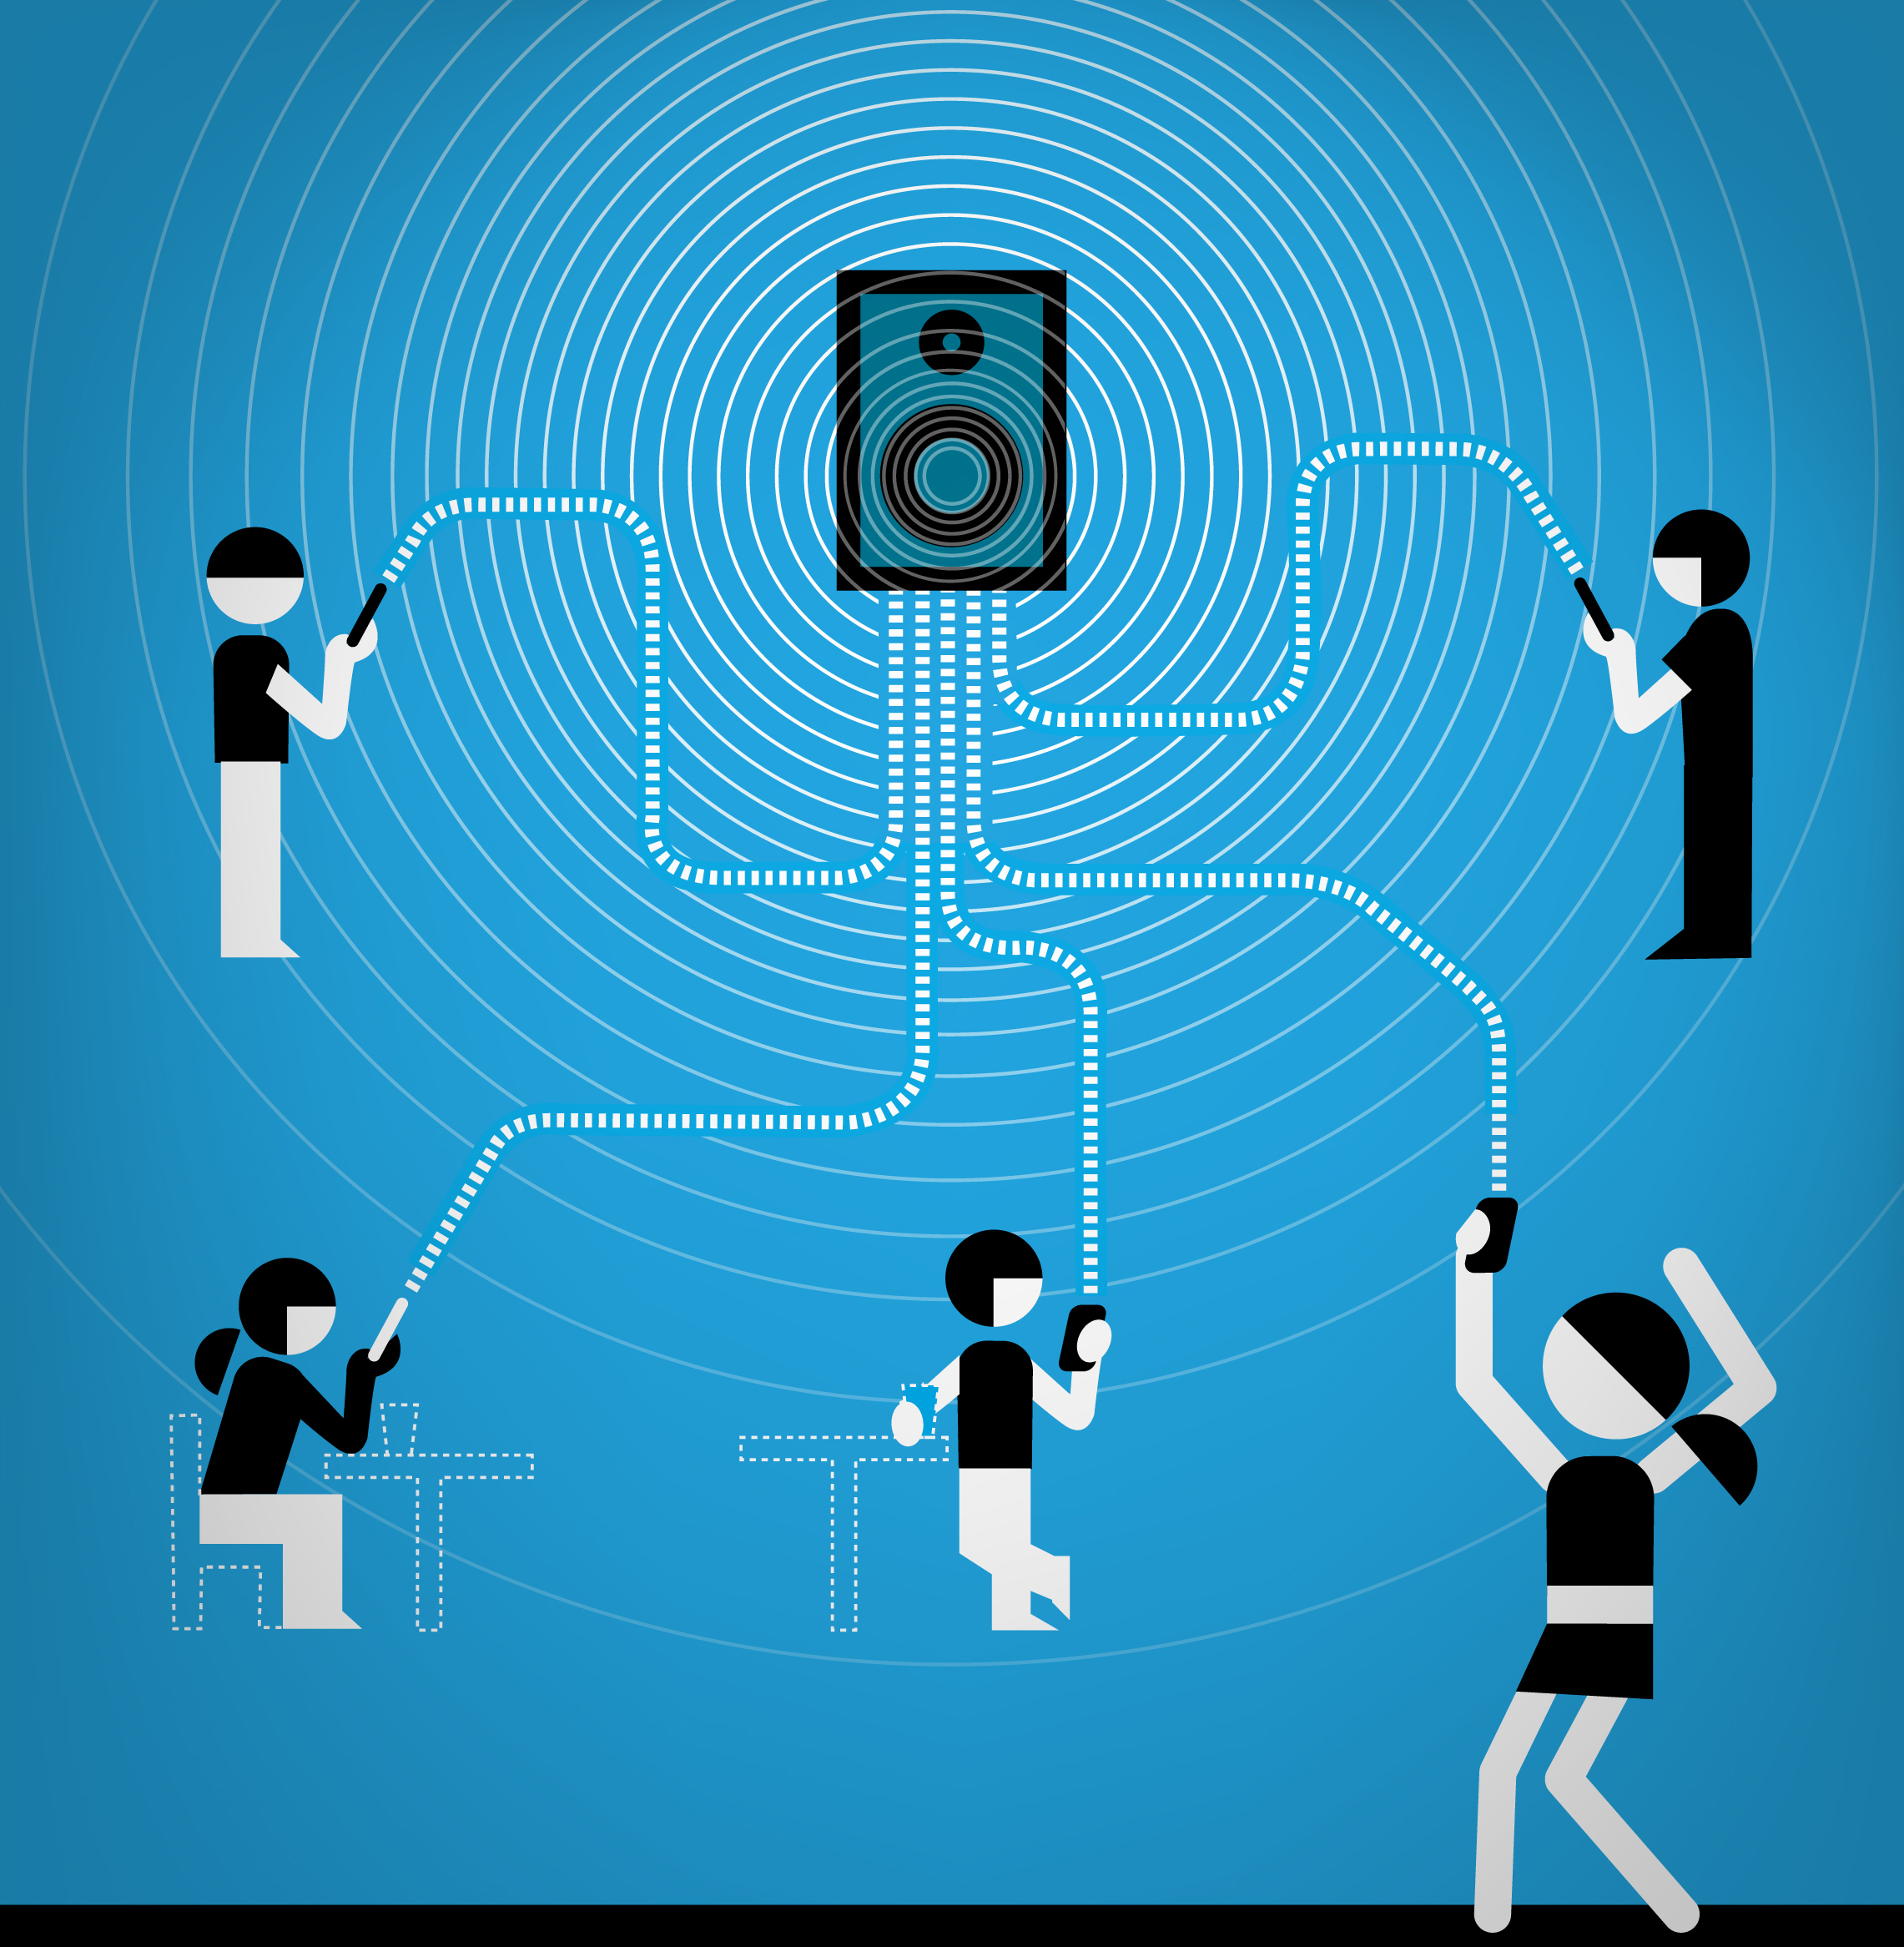
Social
Interactive
Democratic
Notes:
Solution and history of Mixgar

Slide 4
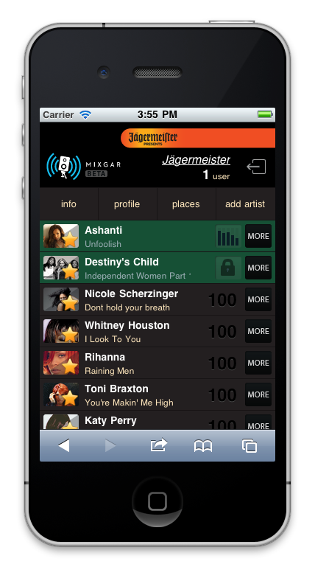
=
social jukebox
Notes:
Solution and history of Mixgar

Slide 5
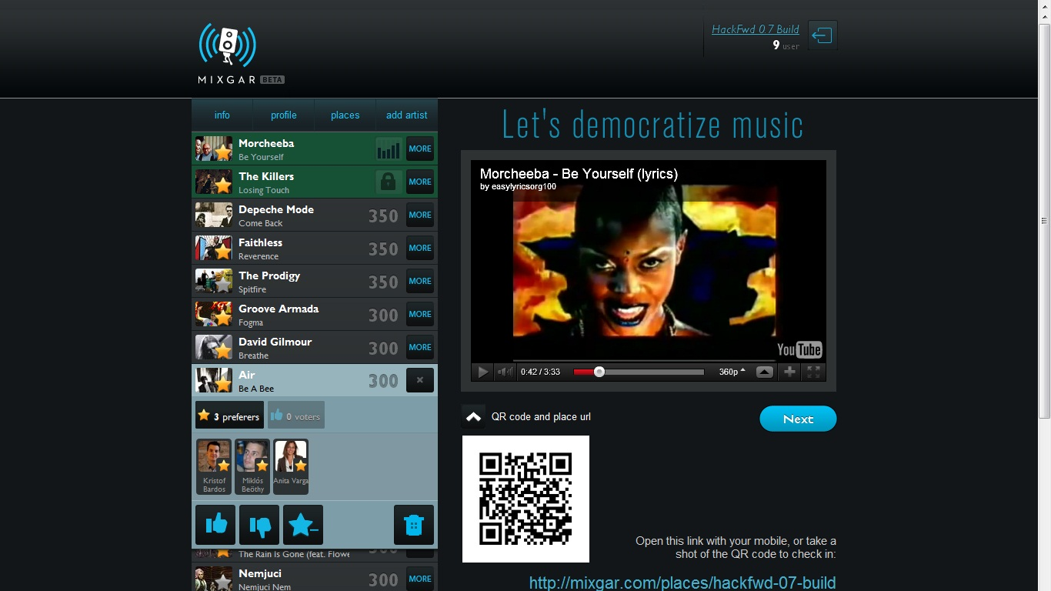
Notes:
How Mixgar works

Slide 6
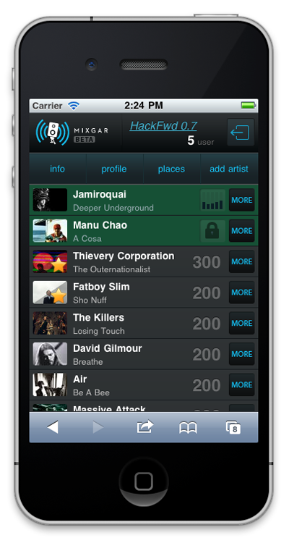
Technology
100% web based (no app, no need to install)
high quality music stream
integrated with Facebook and last.fm
magic algorithm

Slide 7
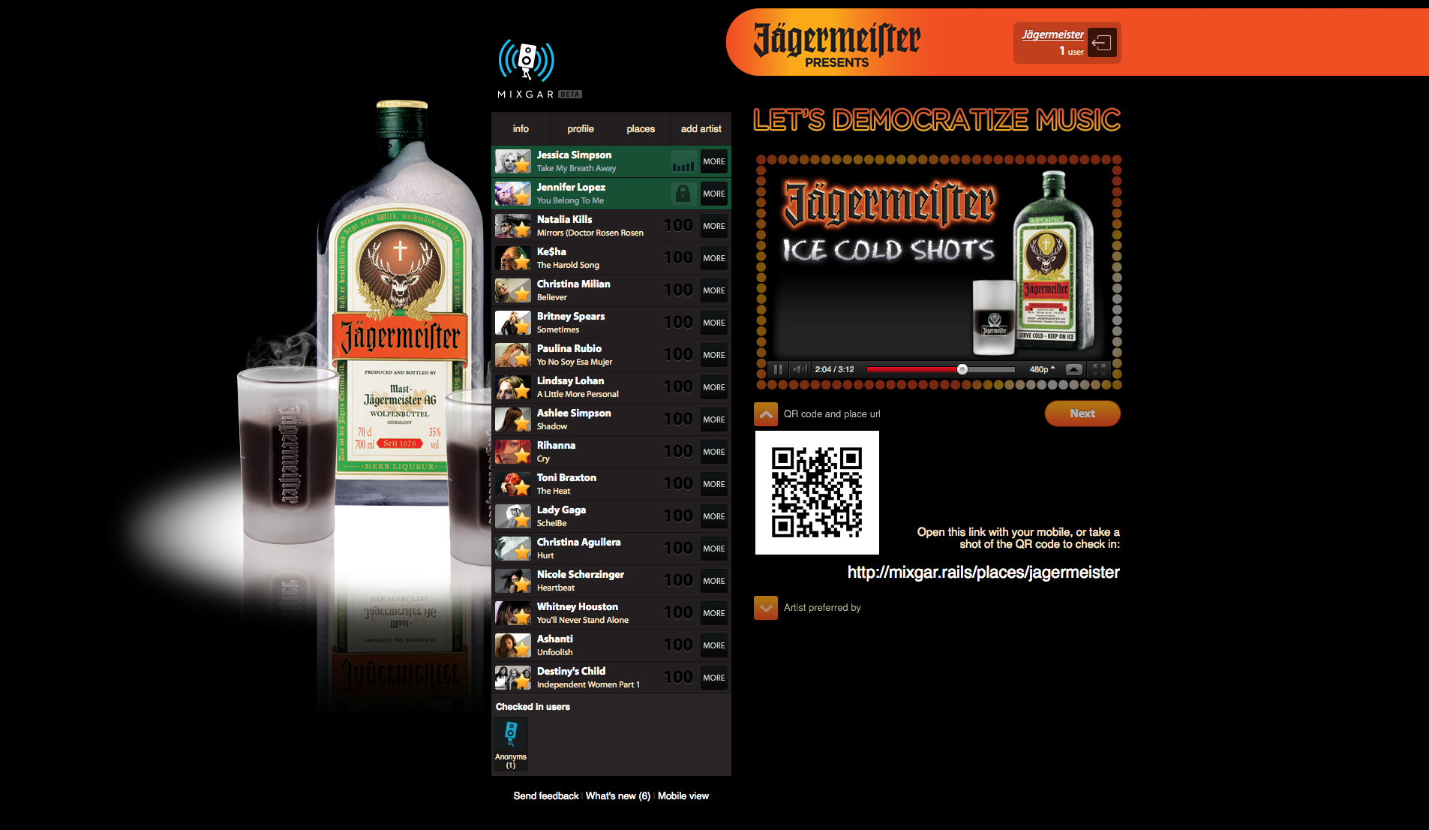
Notes:
How Mixgar works

Slide 8
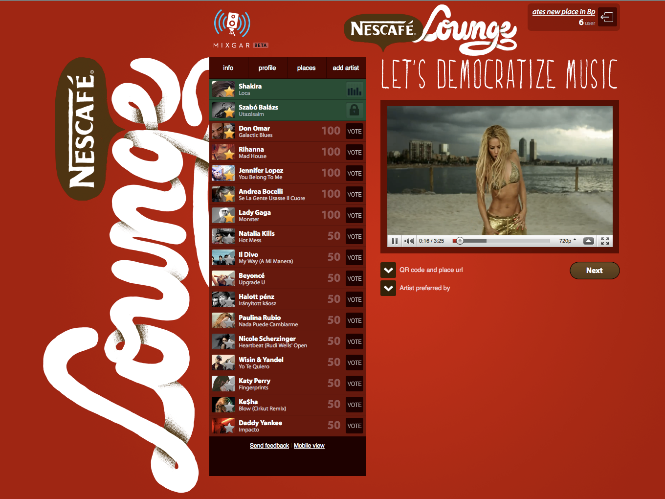
Notes:
B2B solution

Slide 9
mixgar.com
Thank You!
Gerzson Huszar
gerzson@mixgar.com

