Slide 1

Design for innovation in Europe
– a vision for the next three years
Claire Fennelow, Programme Lead, EDIP, Design Council
Creative Budapest, 29 May 2014

Slide 2
Agenda
Background to the Design Council
The value of design
European design 2014: How we got here
2014 and beyond: European Design Innovation Platform (EDIP)
  Concept
  Consortium
  Delivery
  What next

Slide 3


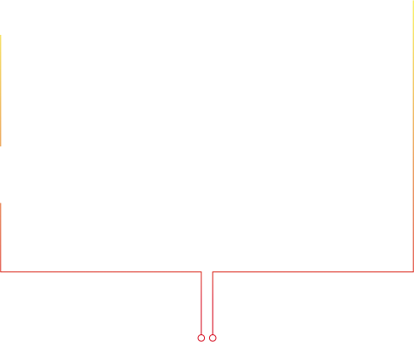


Our history
2011
Design Council
(inc Cabe)

Slide 4


Our operating model
We are supported by the Department for Business, Innovation and Skills and the Department for Communities and Local Government.
Our services and private funding partnerships also generate income.

Slide 5
Policy and advocacy
We support government to use design more actively and strategically.
We also lobby government to integrate design into national policies and have had success in areas such as innovation and growth, the built environment and education.
Developing a National Design Strategy is a key strand of our advocacy work to ensure a comprehensive government approach to design.

Slide 6
Championing great design to improve lives

Slide 7
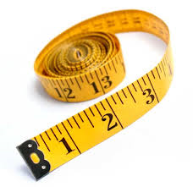
What is design worth?
And to whom?

Slide 8

Starting with “to whom”…
And why does it matter now?

Slide 9


Slide 10
The underlying principle
UK and European policy makers are recognising value of design and creativity: why?
“Creativity is the generation of new ideas. Innovation is the successful exploitation of new ideas. Design is what links creativityand innovation. It shapes ideas to become practical and attractive propositions for users or customers.”
Sir George Cox, former Chairman of the Design Council and author of Government Review of Creativity in Business

Slide 11












What did we do?
Leadership by Design

Slide 12
What did we find?
Design can add value to any organisation
Design is customer-centered
Design is most powerful when culturally embedded
Consensus emerged from interviews with business leaders from world–class companies and from little-known SMEs.

Slide 13
Design can add value by
Driving innovation and opening up uncontested market spaces
Differentiating products and services to
attract customers
Strengthening branding, embodying a company’s values and improving recognition

Slide 14
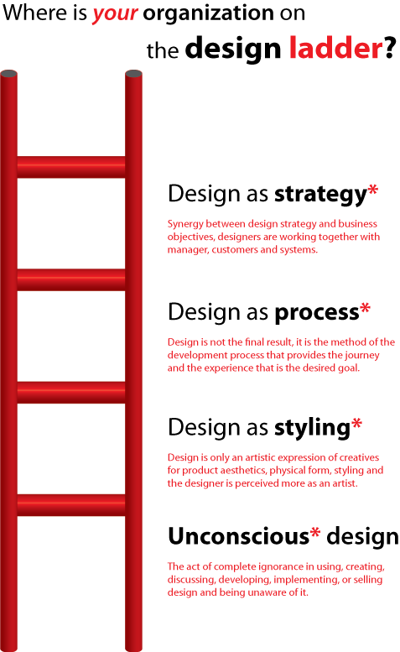
Embedding Design
Danish Design Ladder
Used in UK and across Scandinavia
Shows the benefits of embedding design

Slide 15
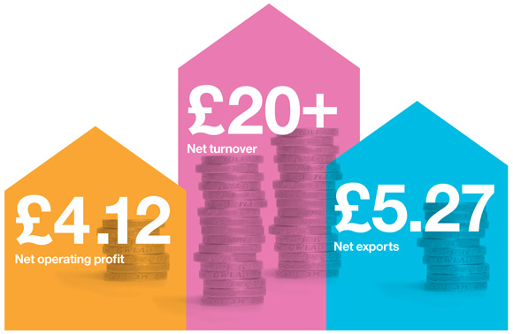
And the difference it makes?
Economic evaluation of the impact on the businesses… direct return for every £1 spent on design:

Slide 16
Enhanced…
Financial
Sales
Market share
Operations cost (reductions)
Customer
Consistency in the company’s portfolio
Brand recognition
Customer satisfaction and advocacy
Product launch success
Process
Consistent approach to product / service development
Project failure (lower)
Time to market
People
Interdepartmental collaboration
Teamwork
Working practices

Slide 17
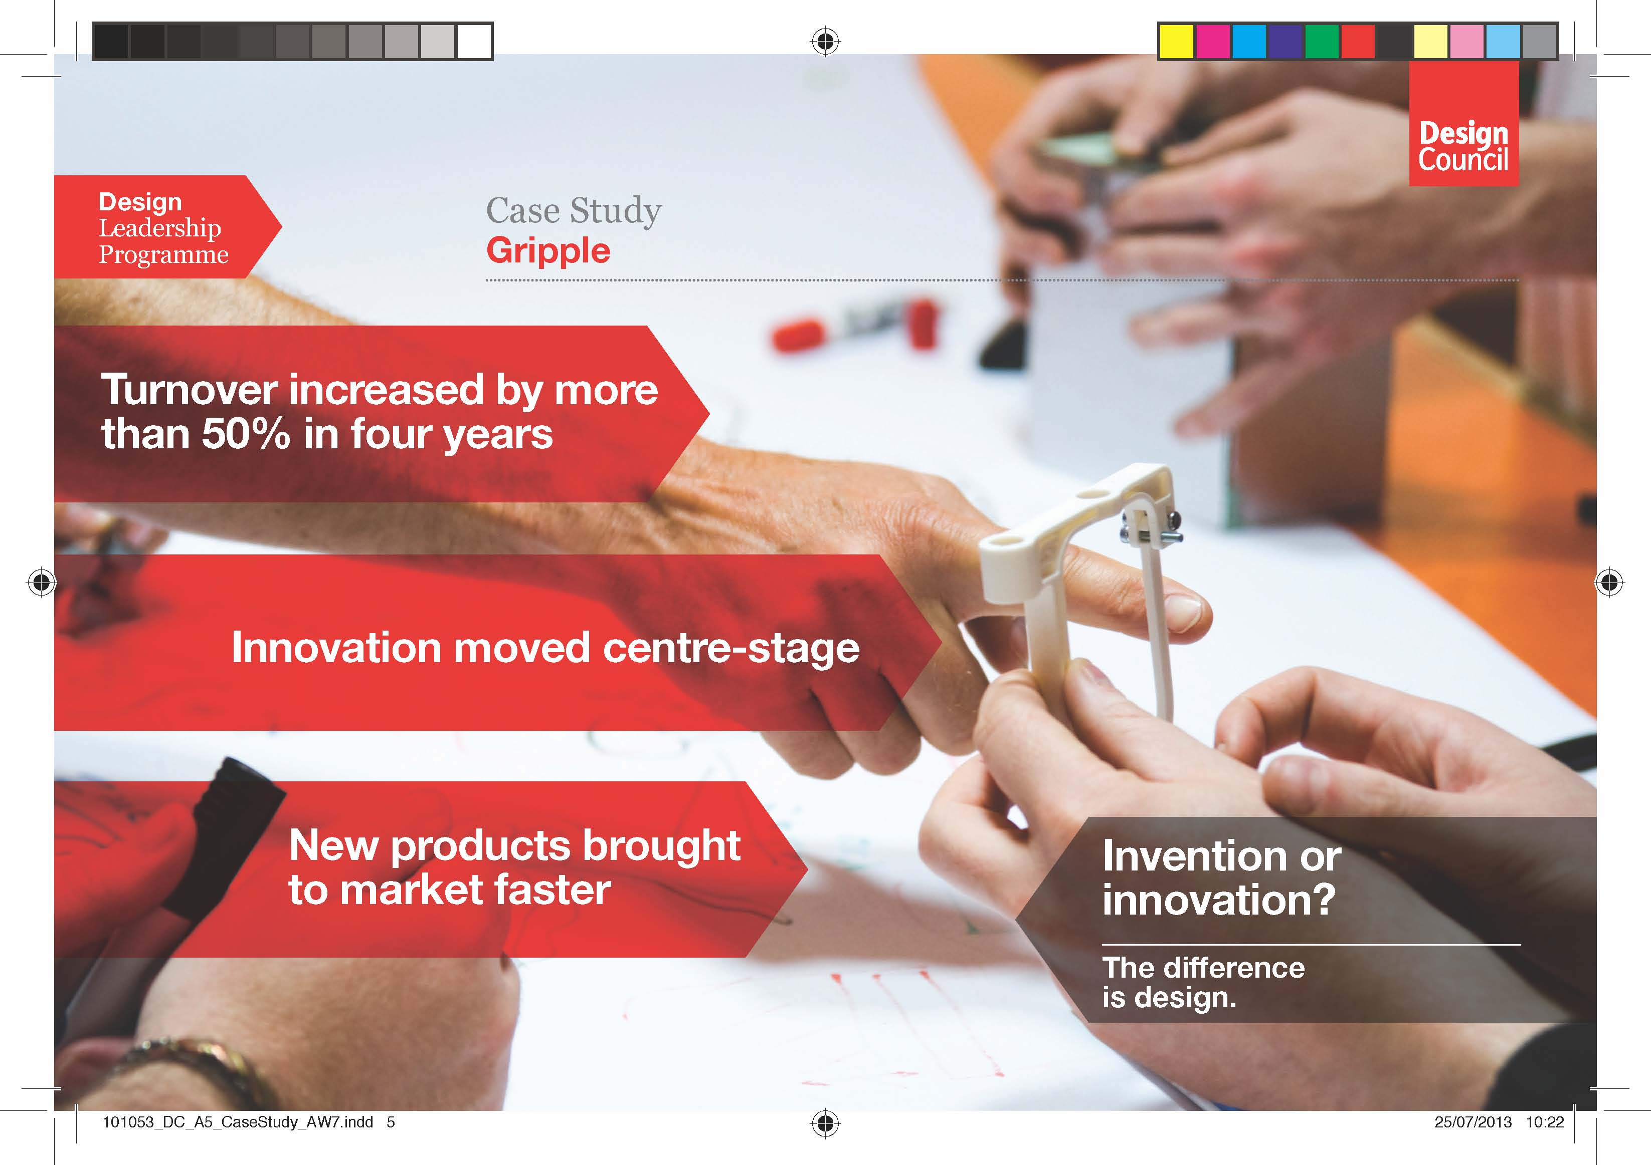

Slide 18
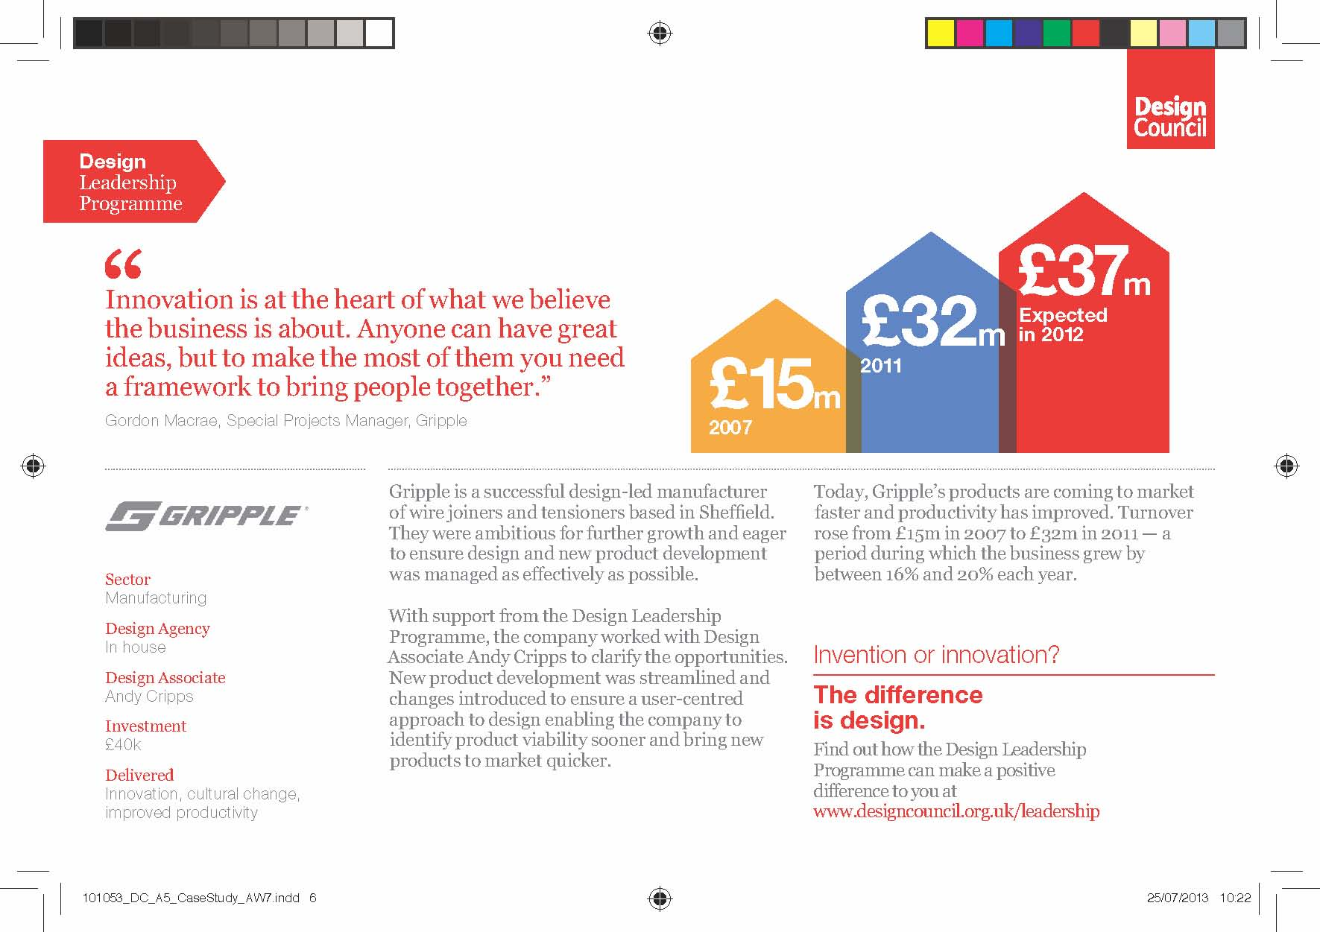

Slide 19
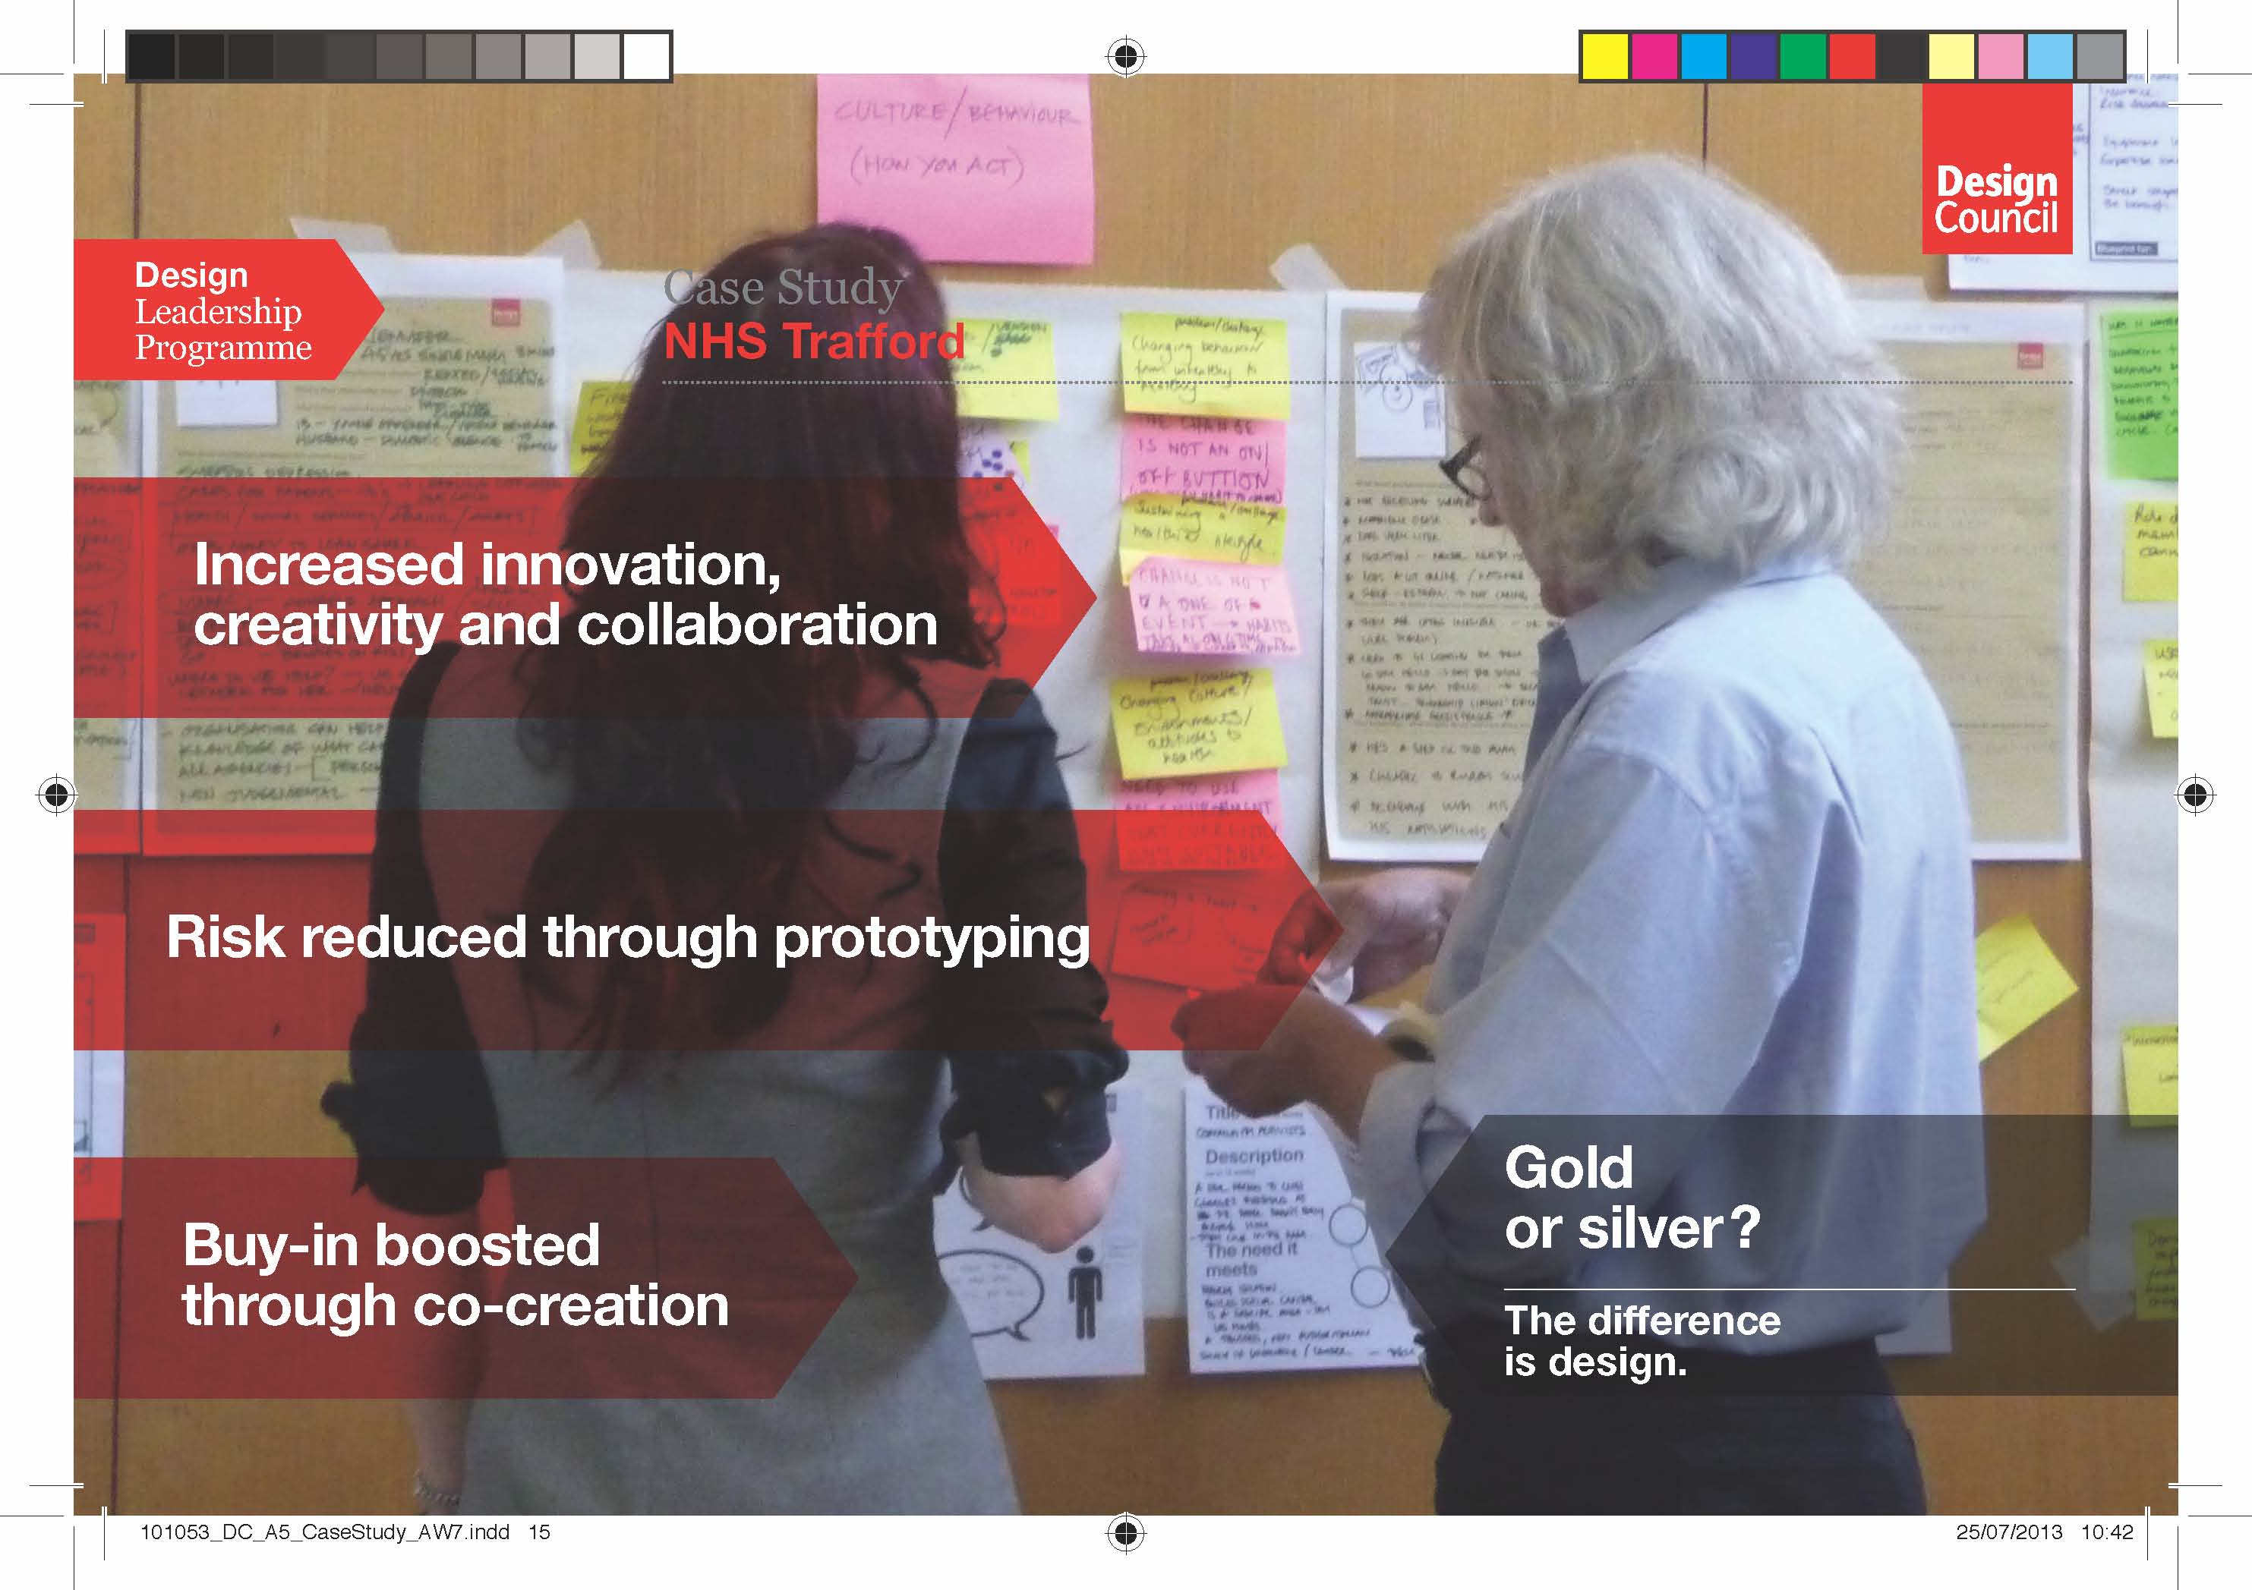

Slide 20
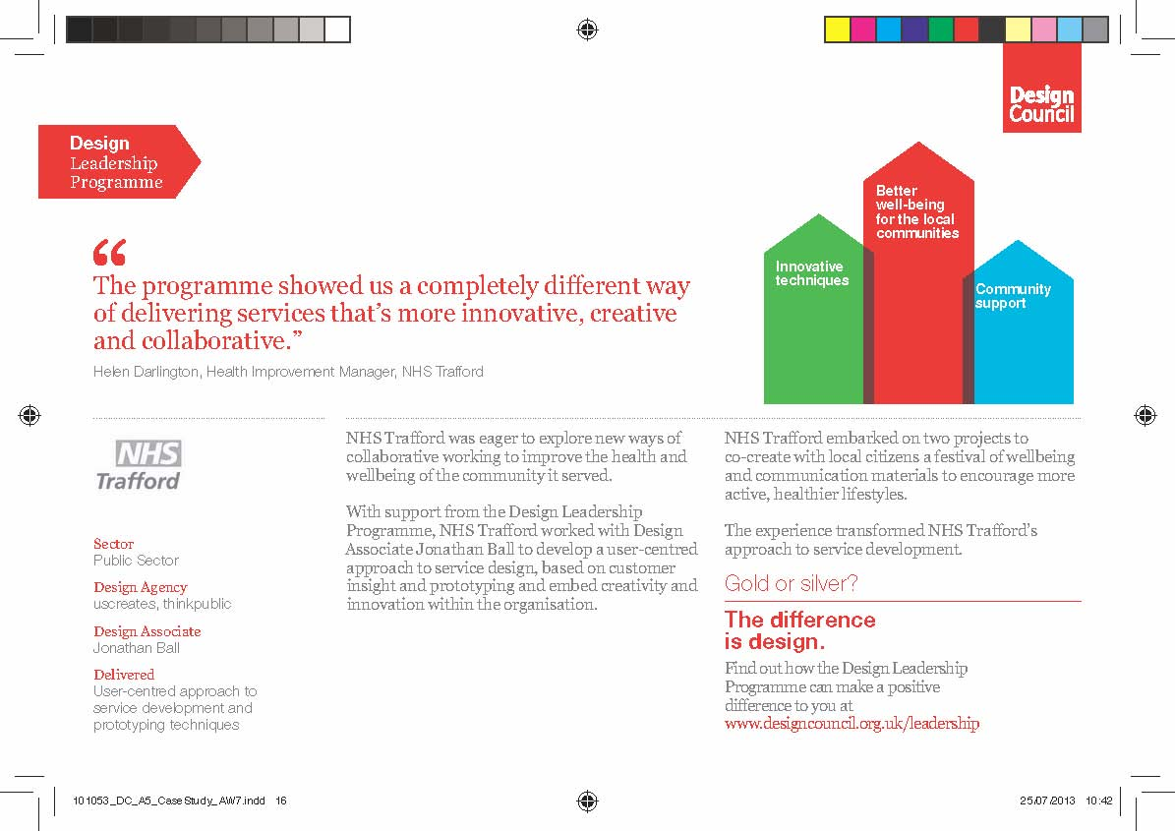

Slide 21
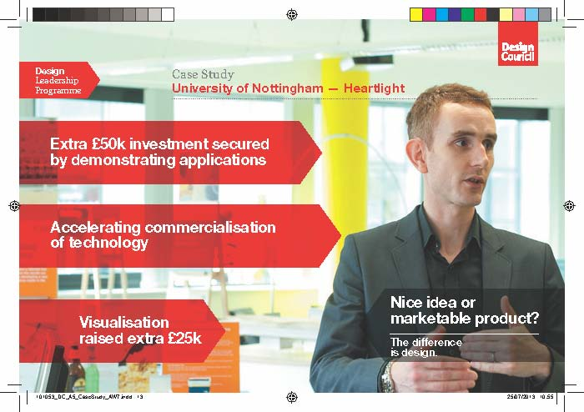

Slide 22
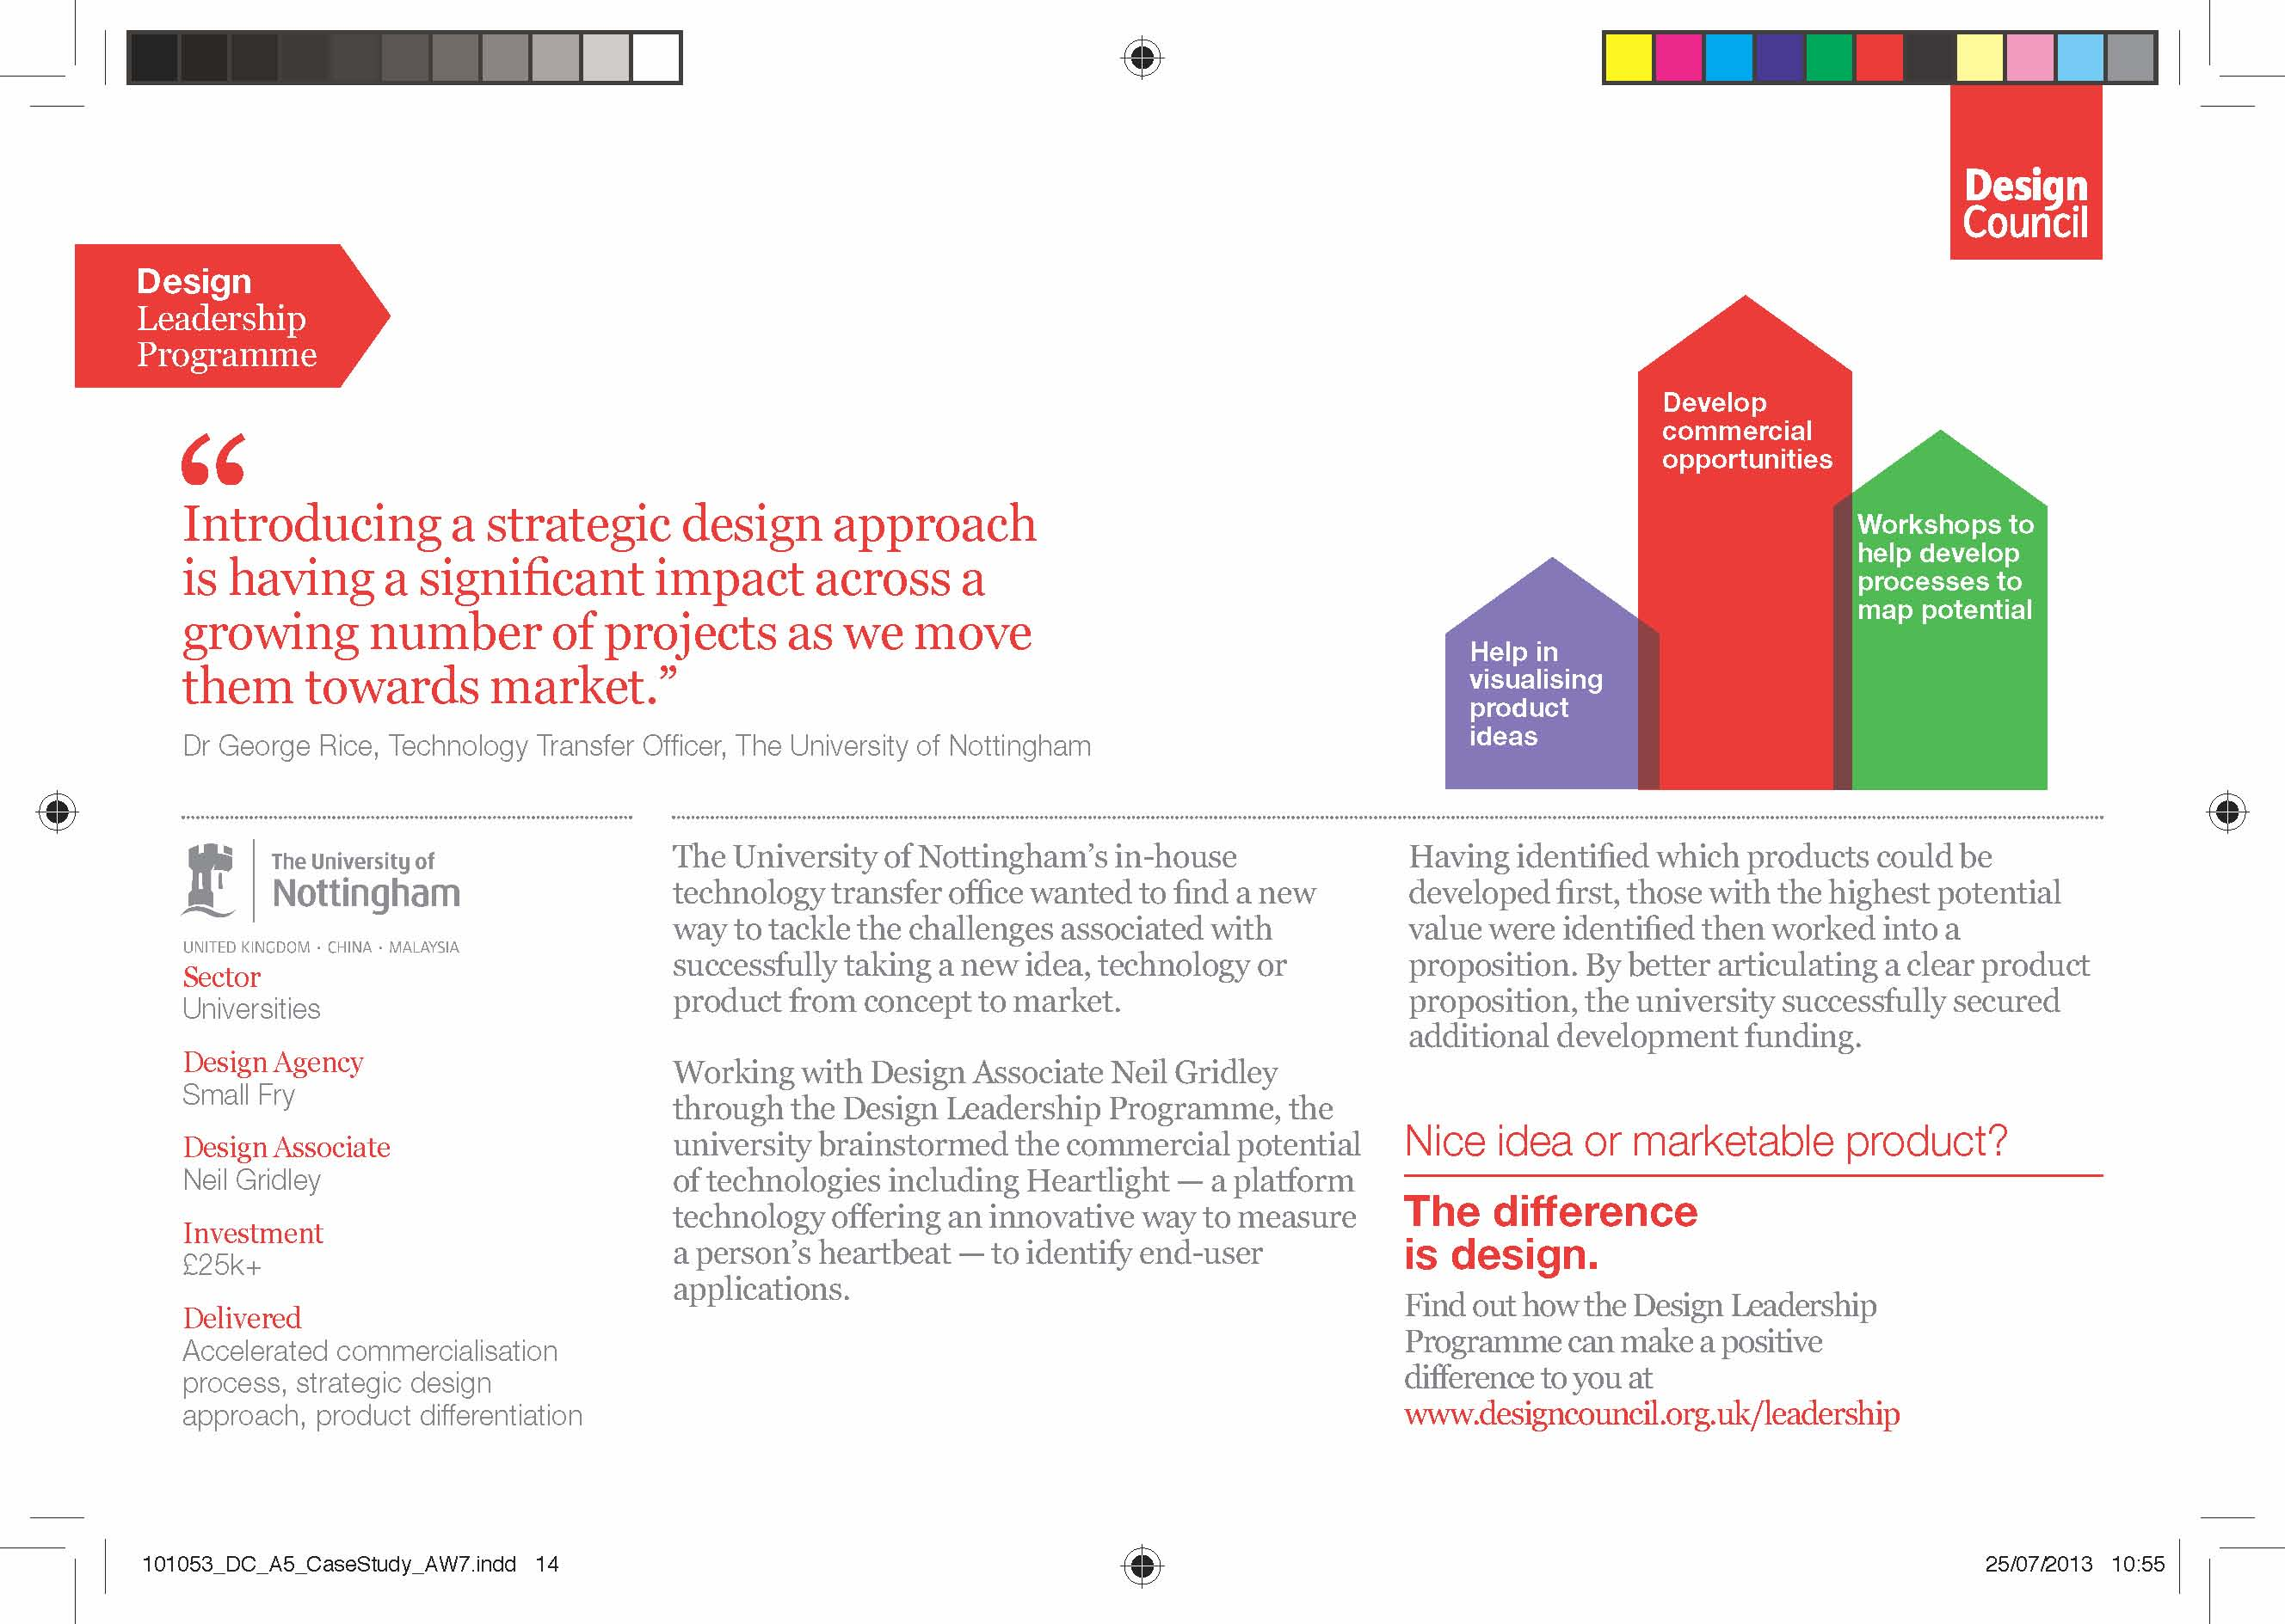

Slide 23
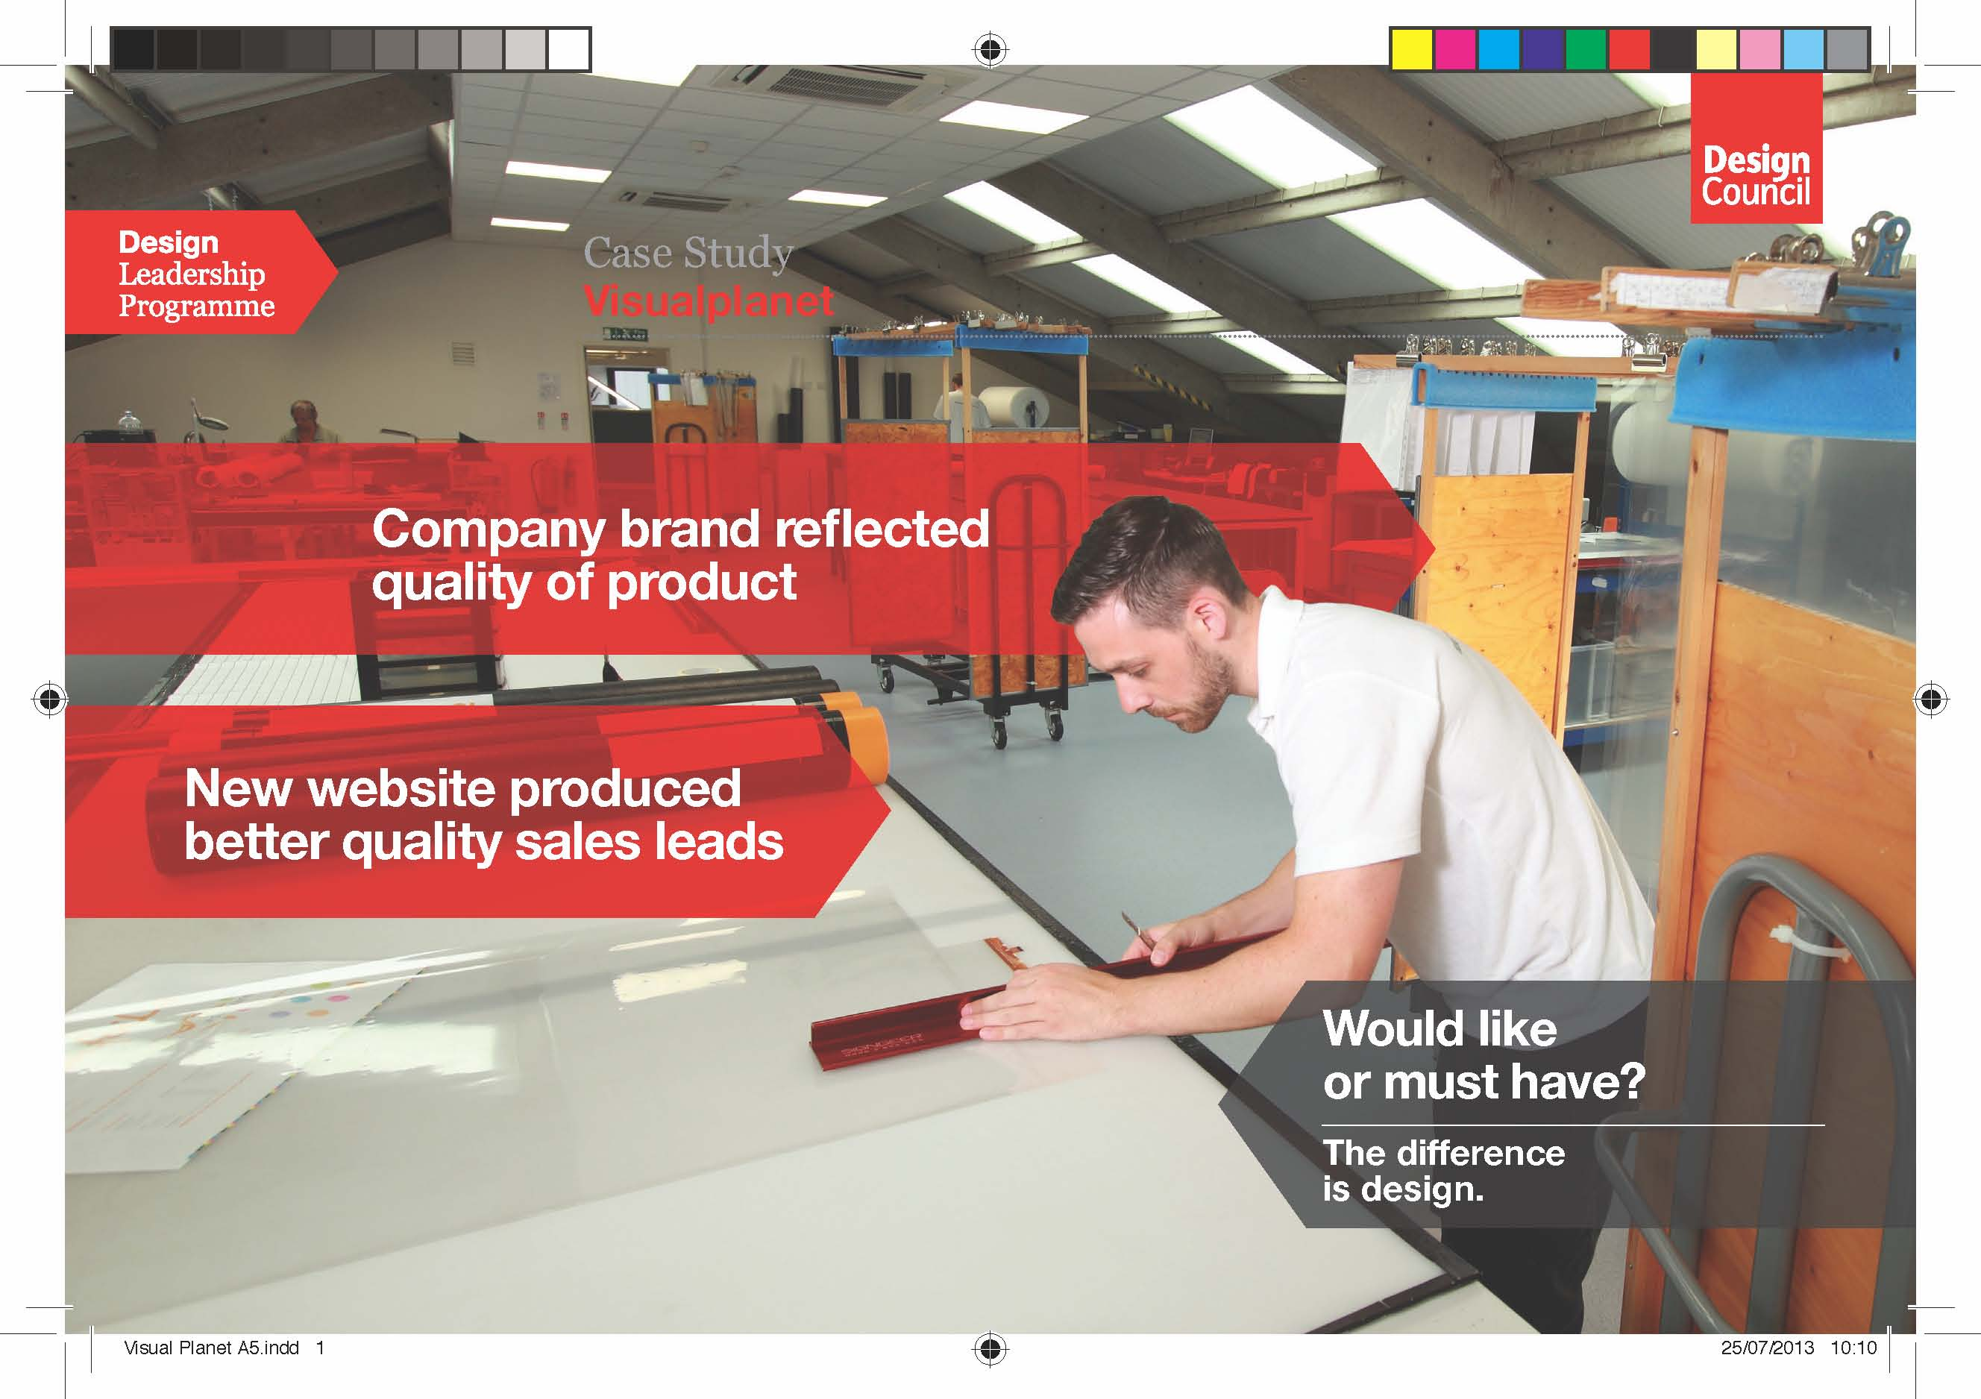

Slide 24
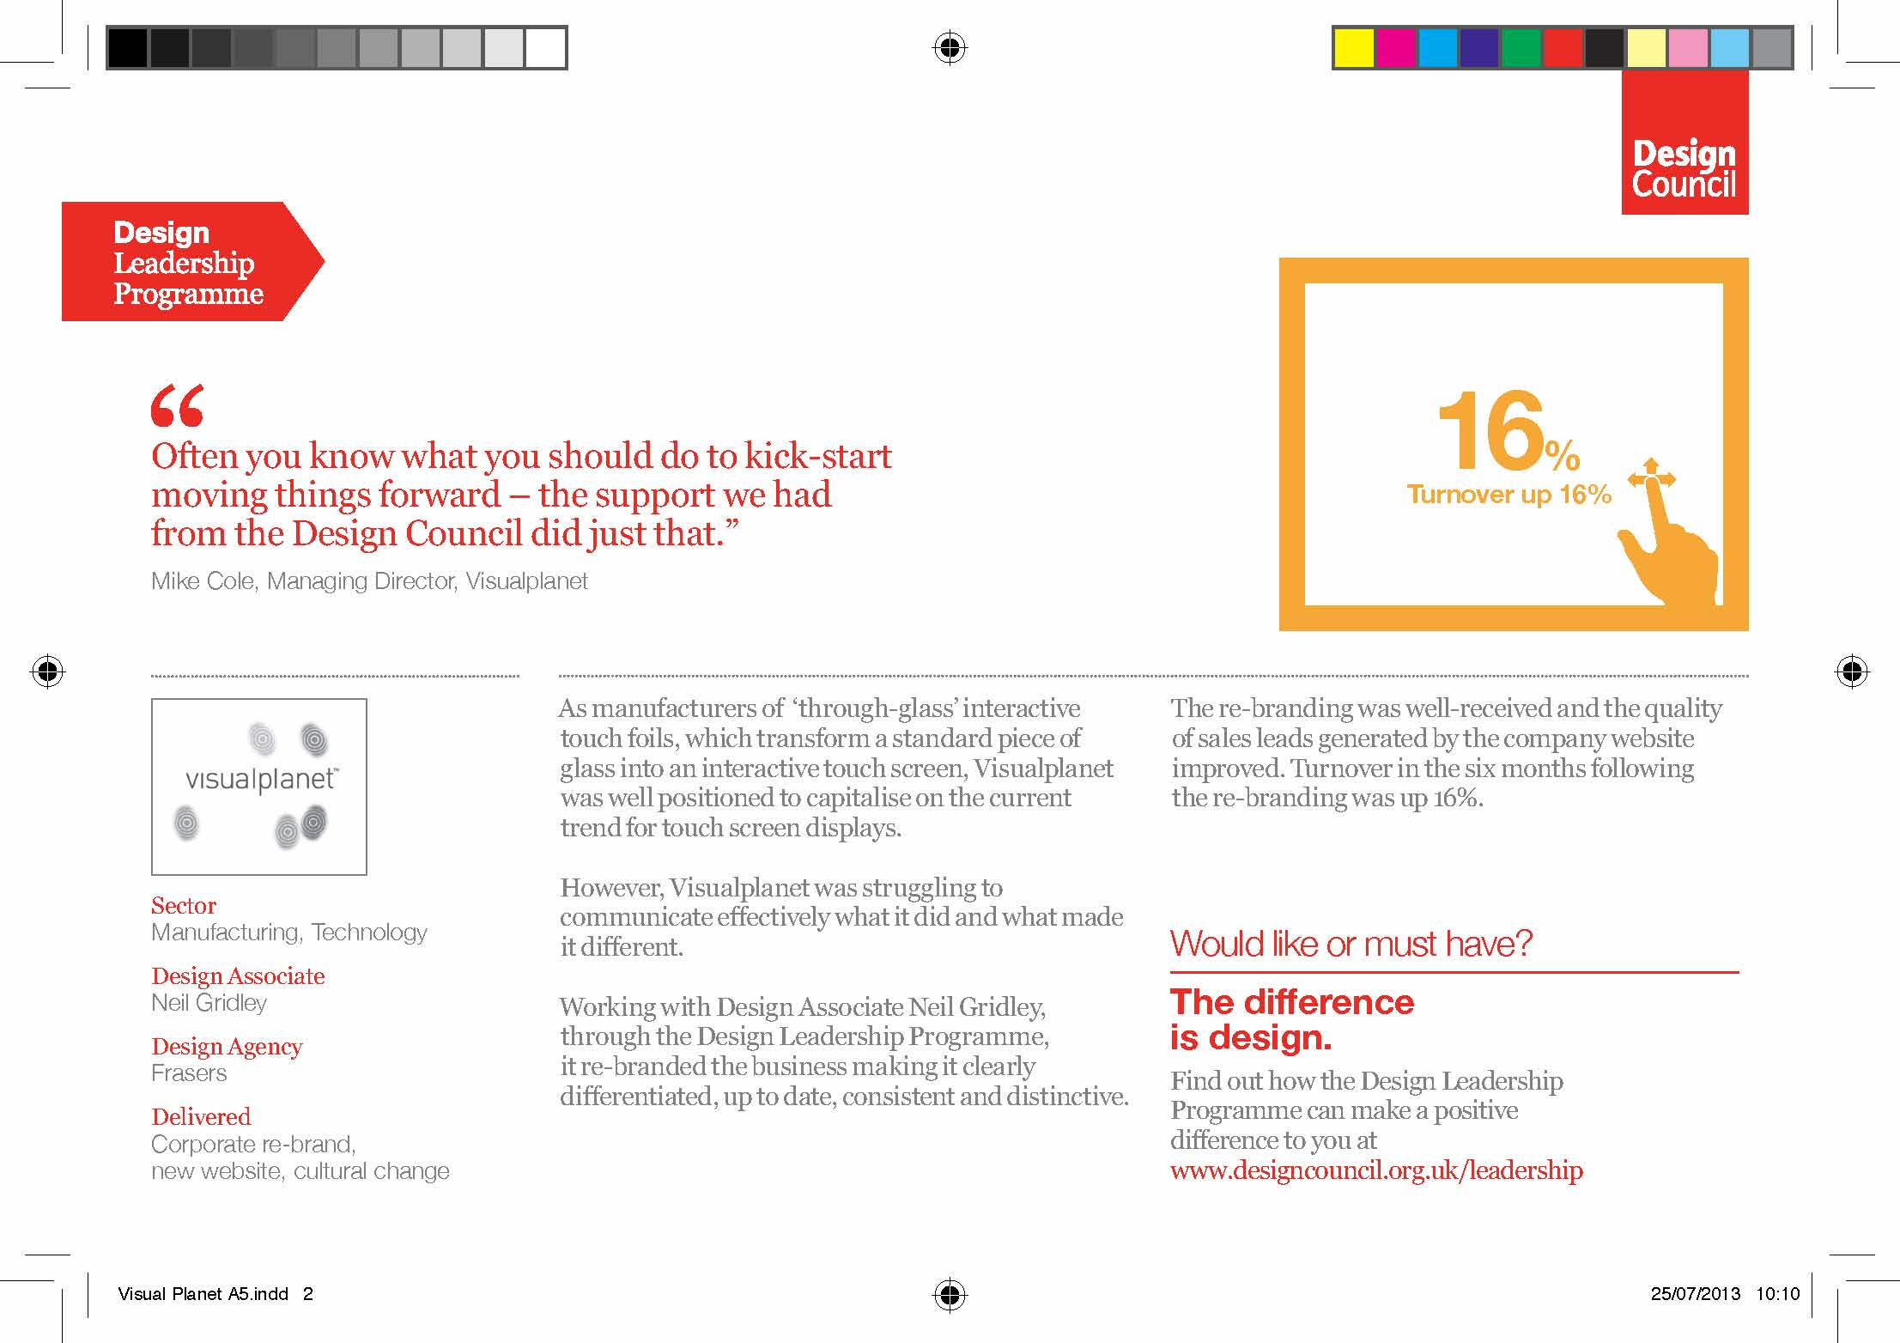

Slide 25
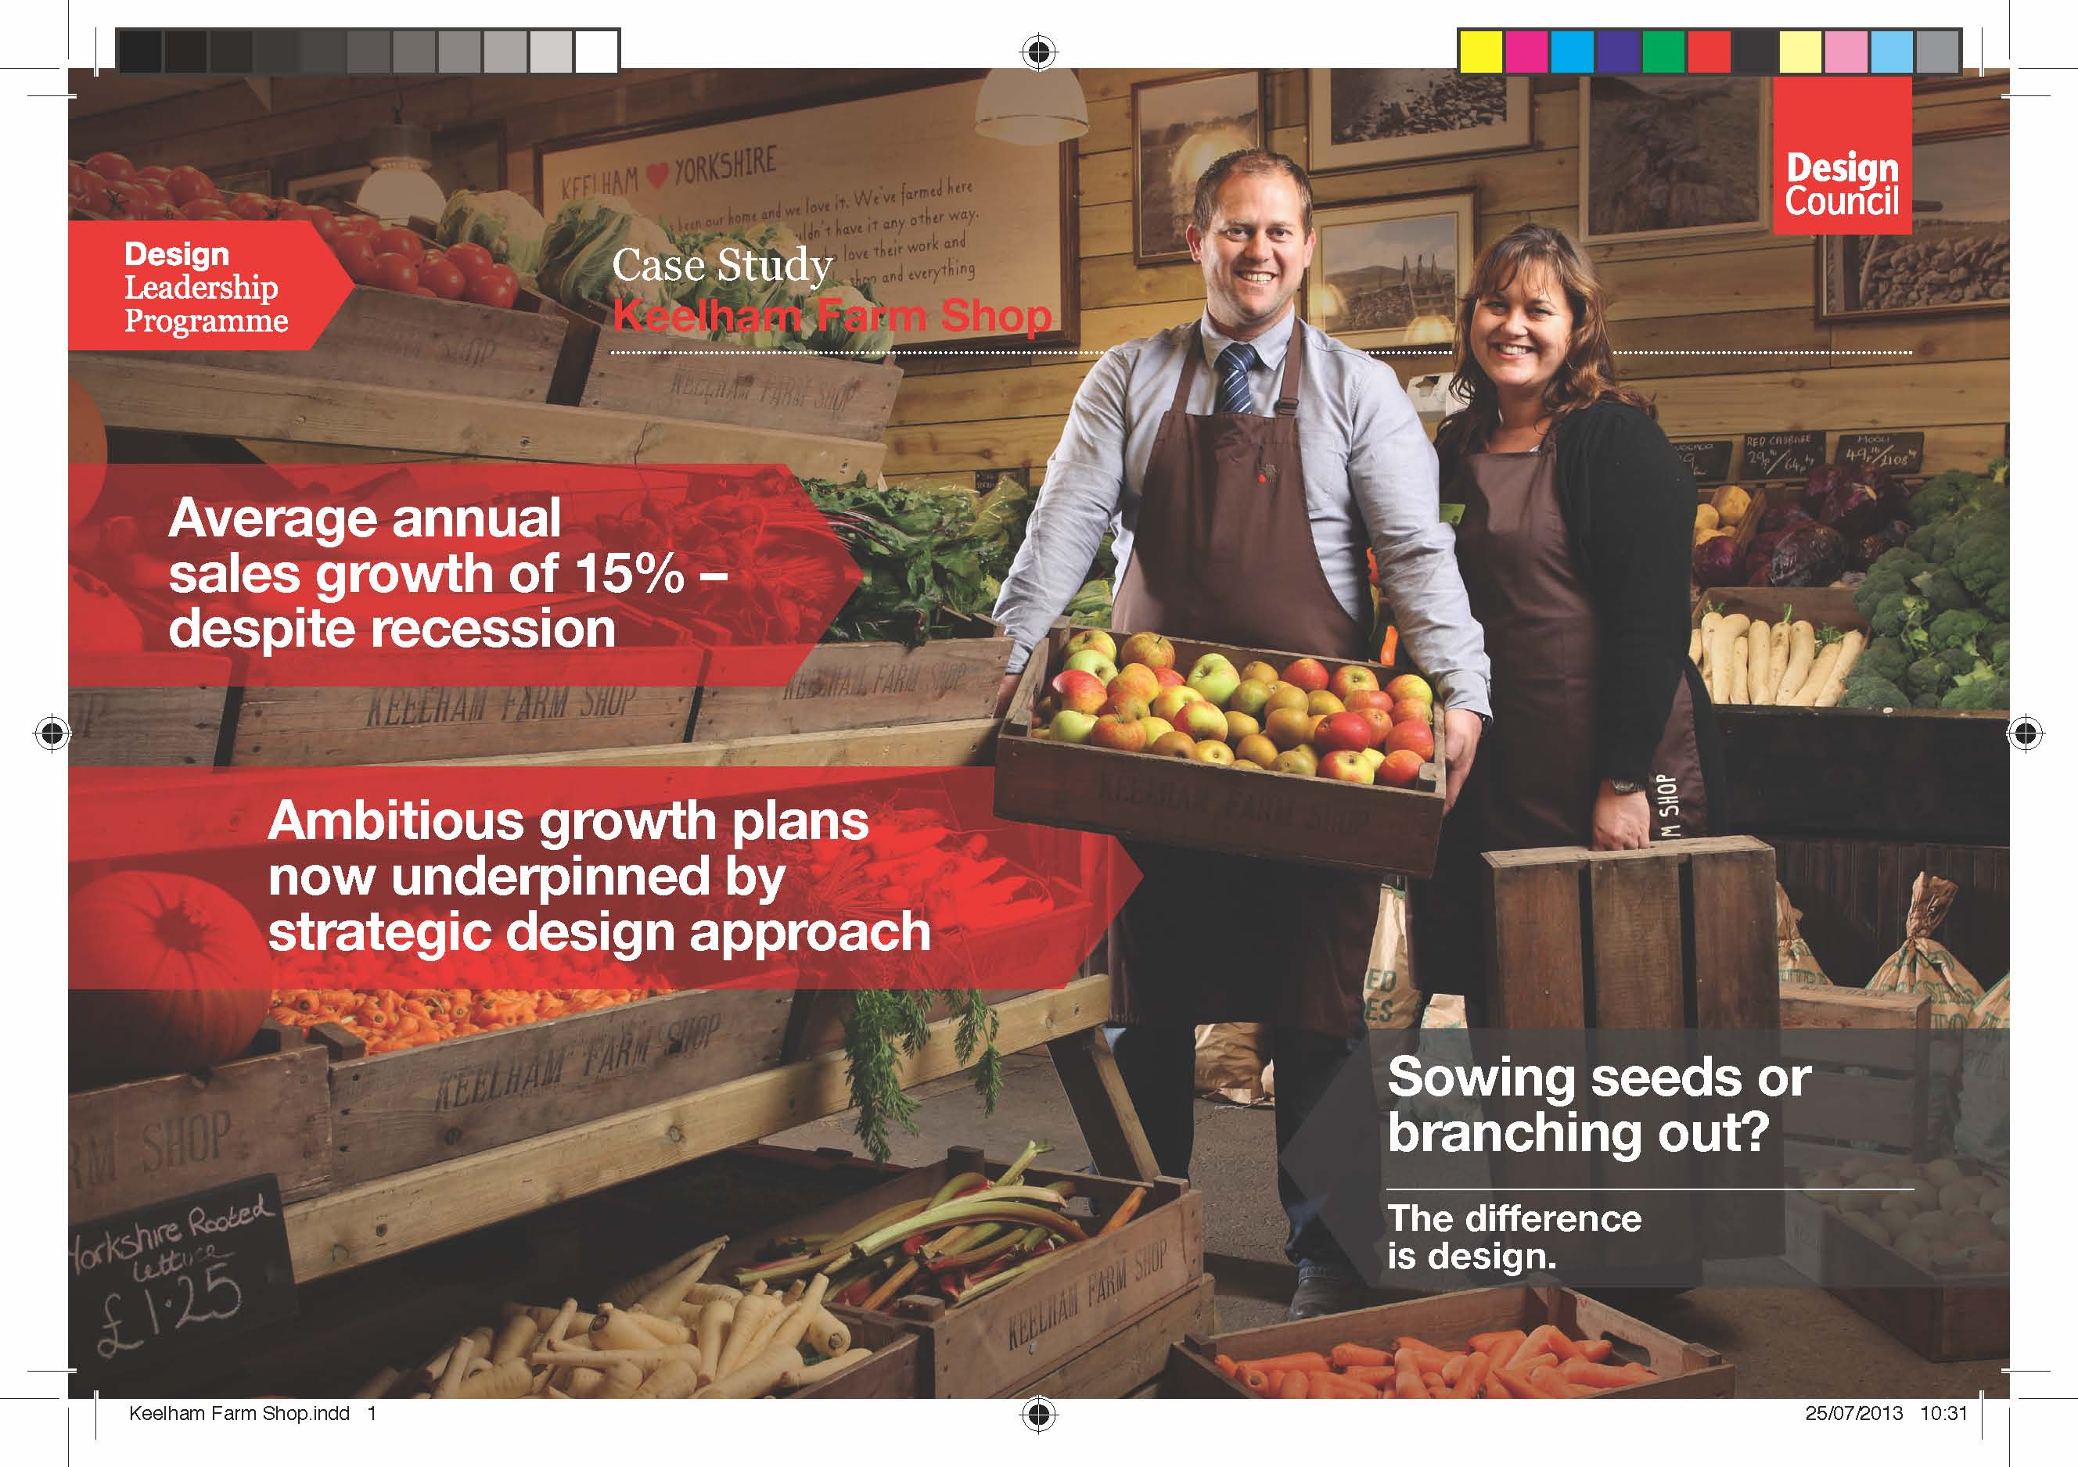

Slide 26
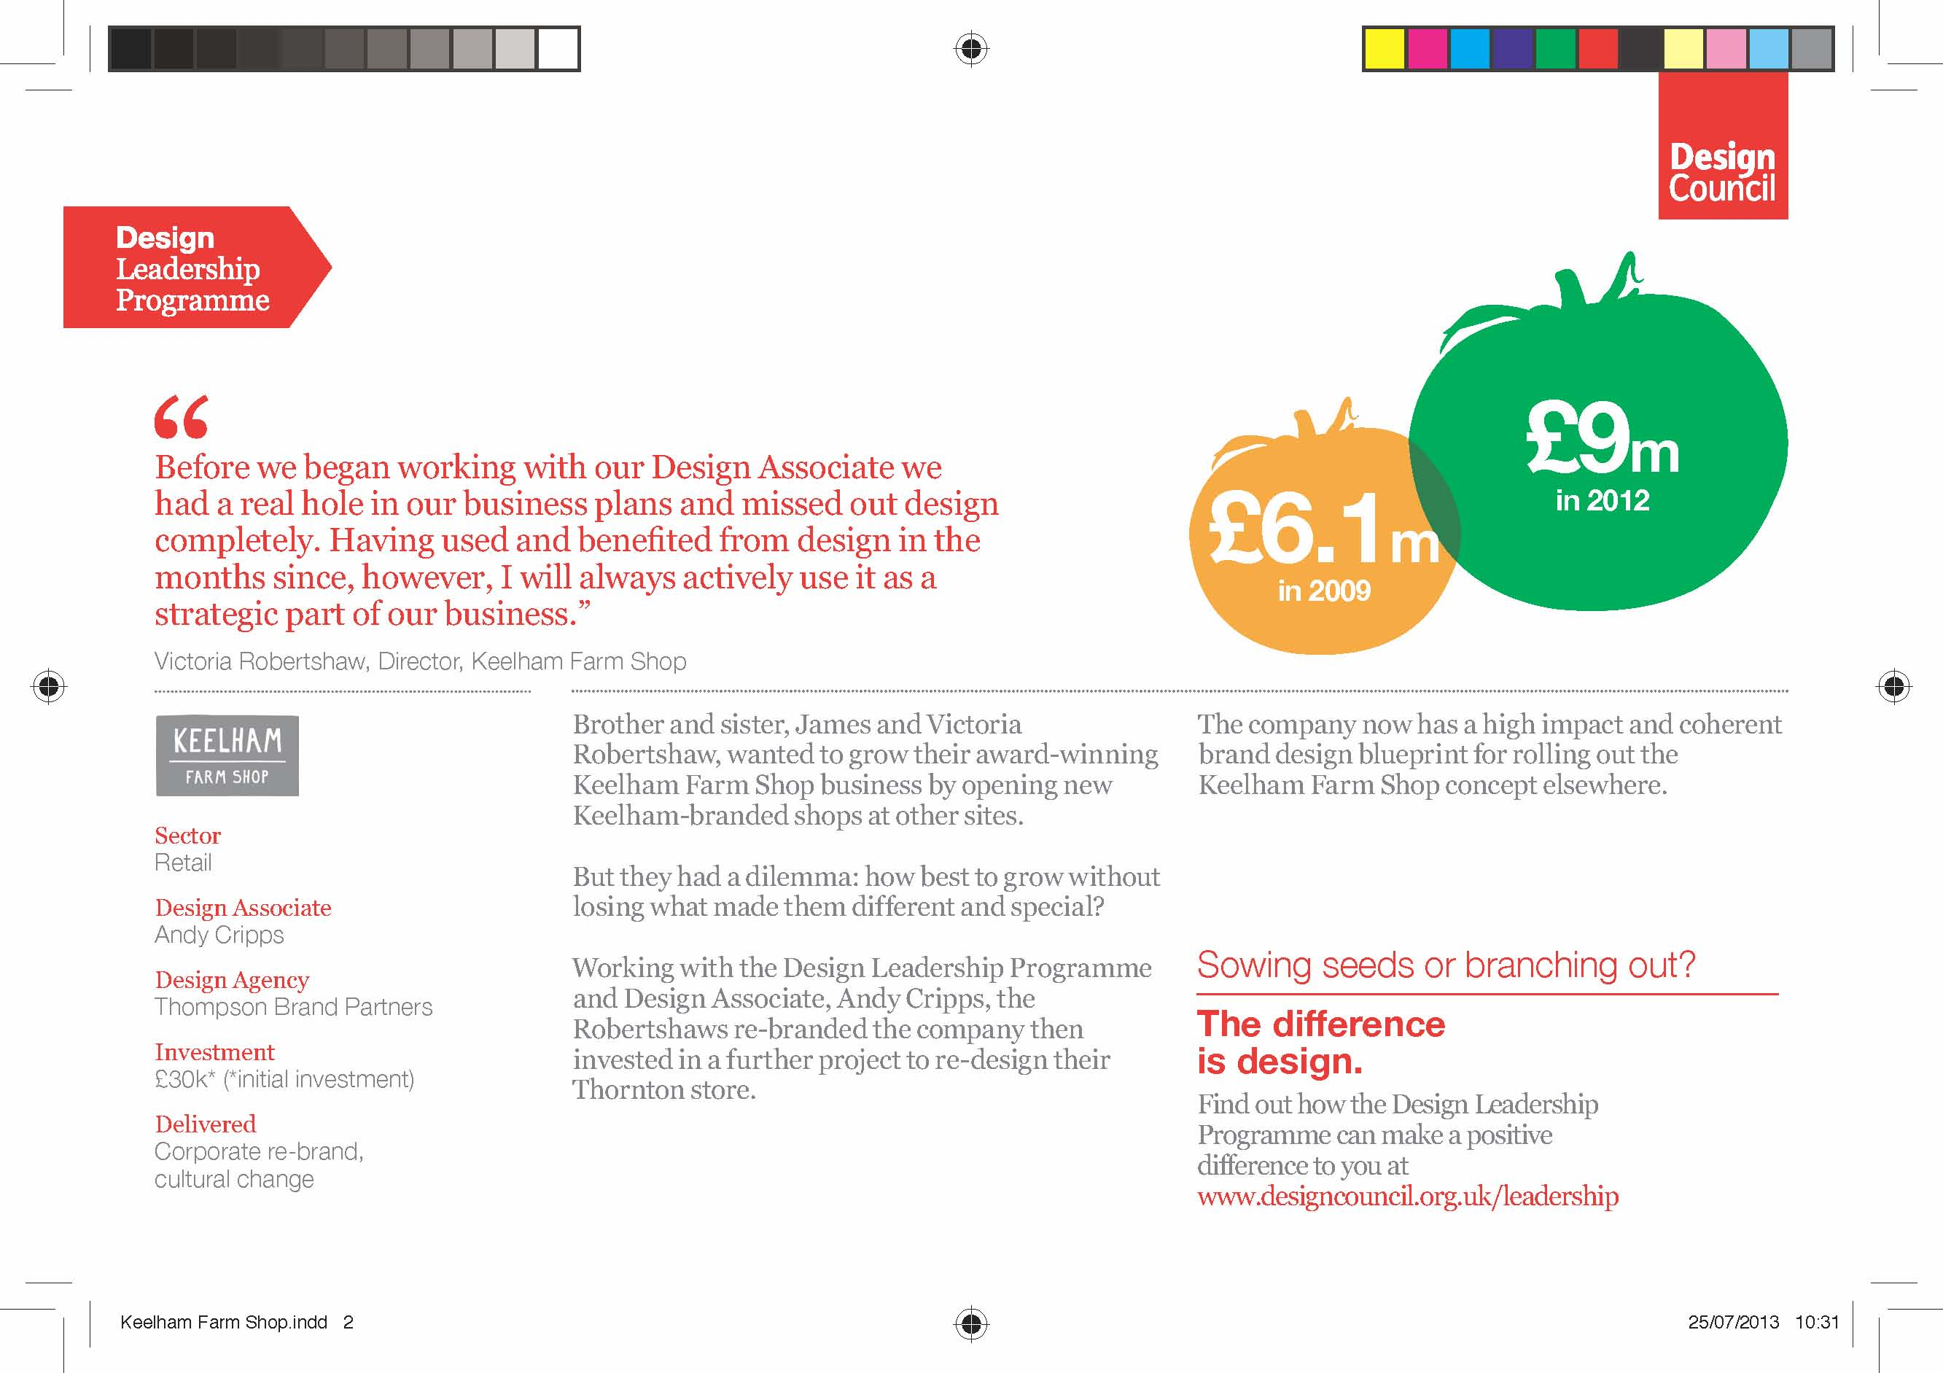

Slide 27
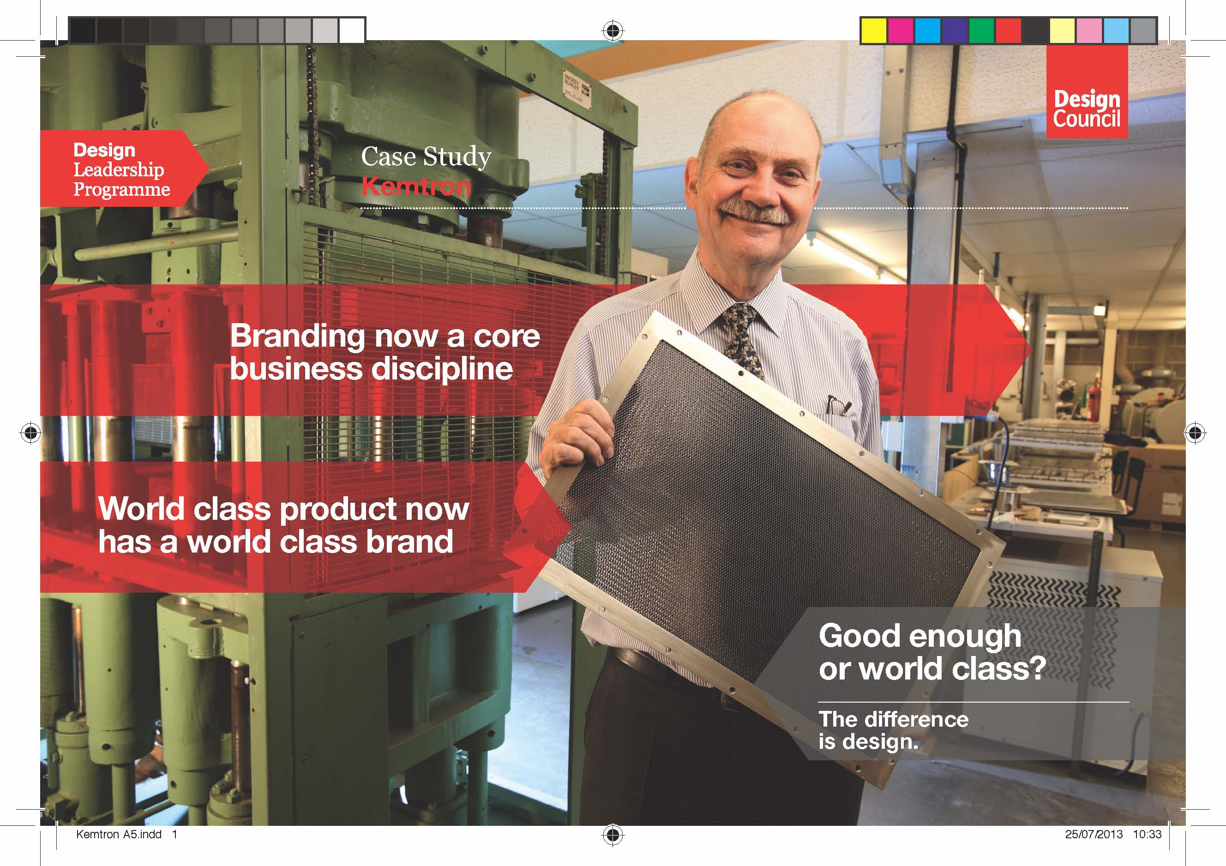

Slide 28
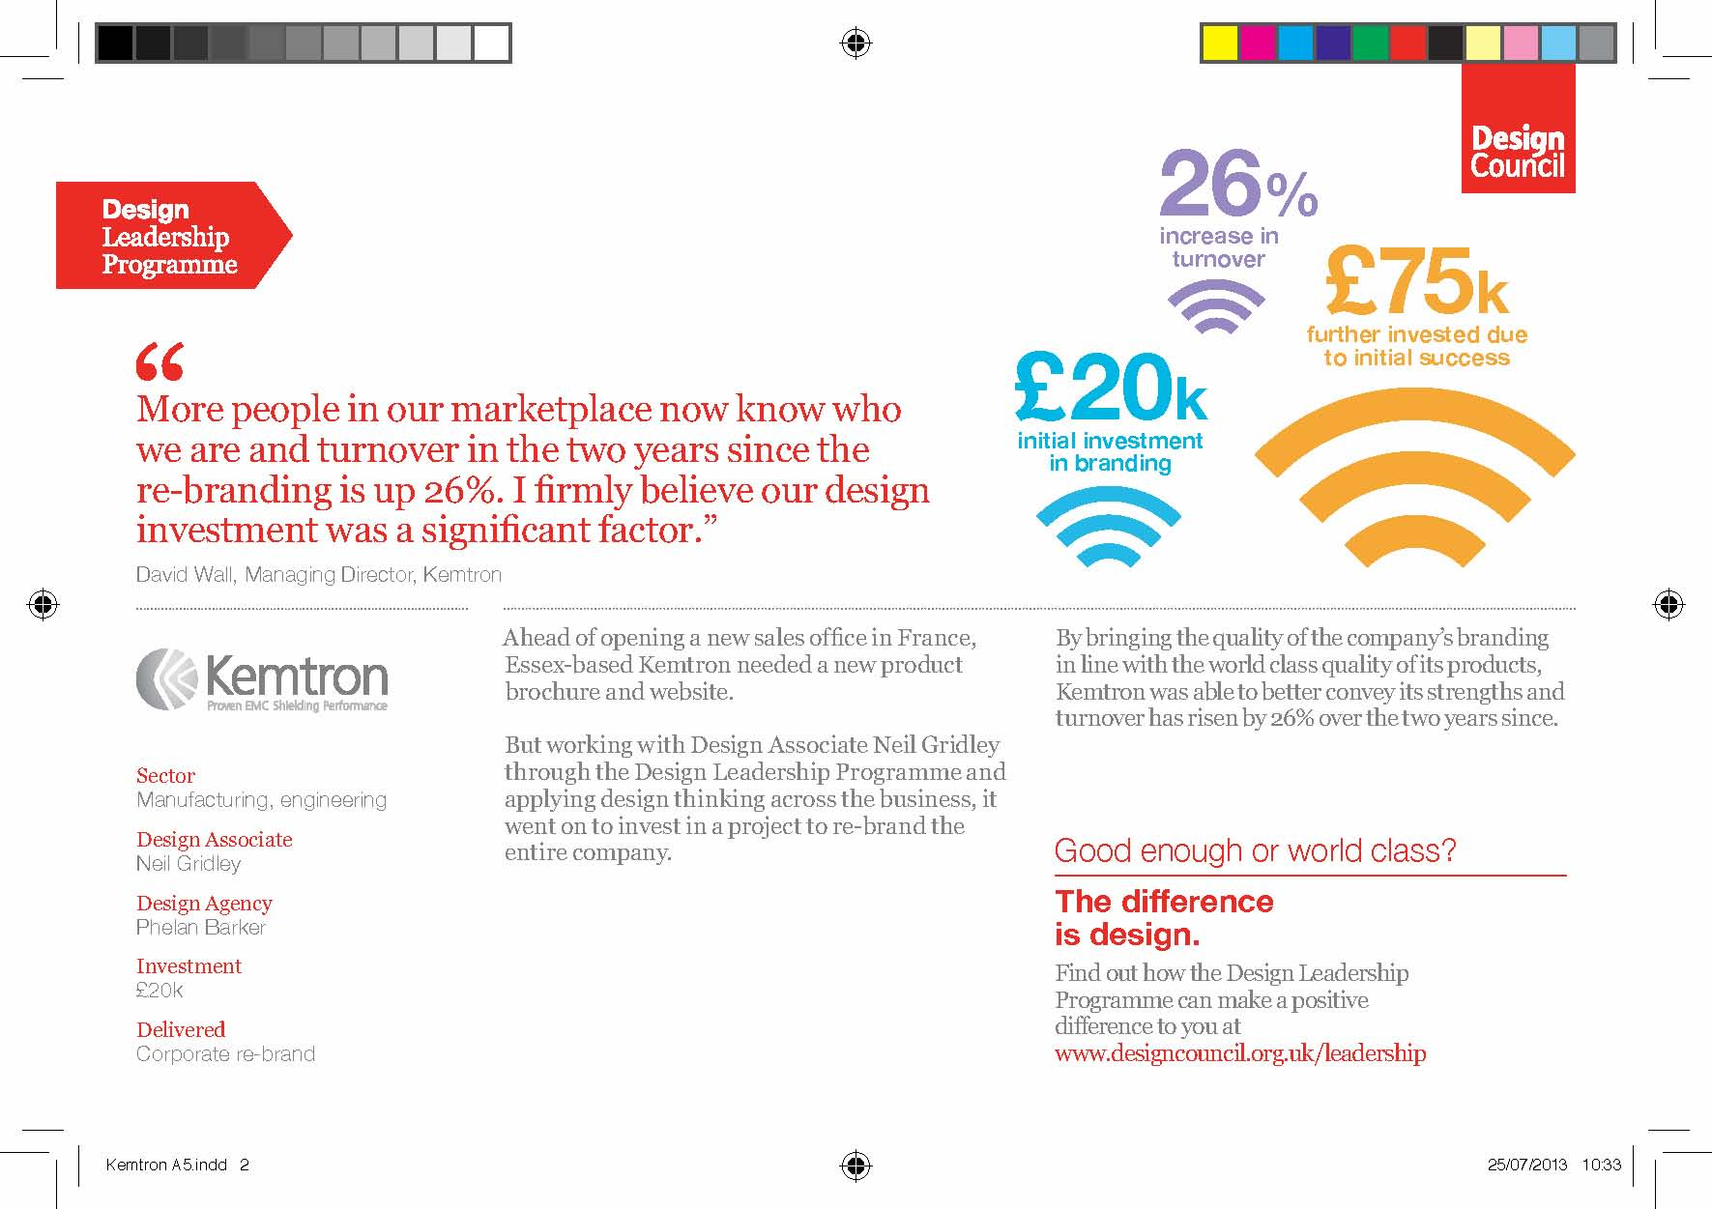

Slide 29
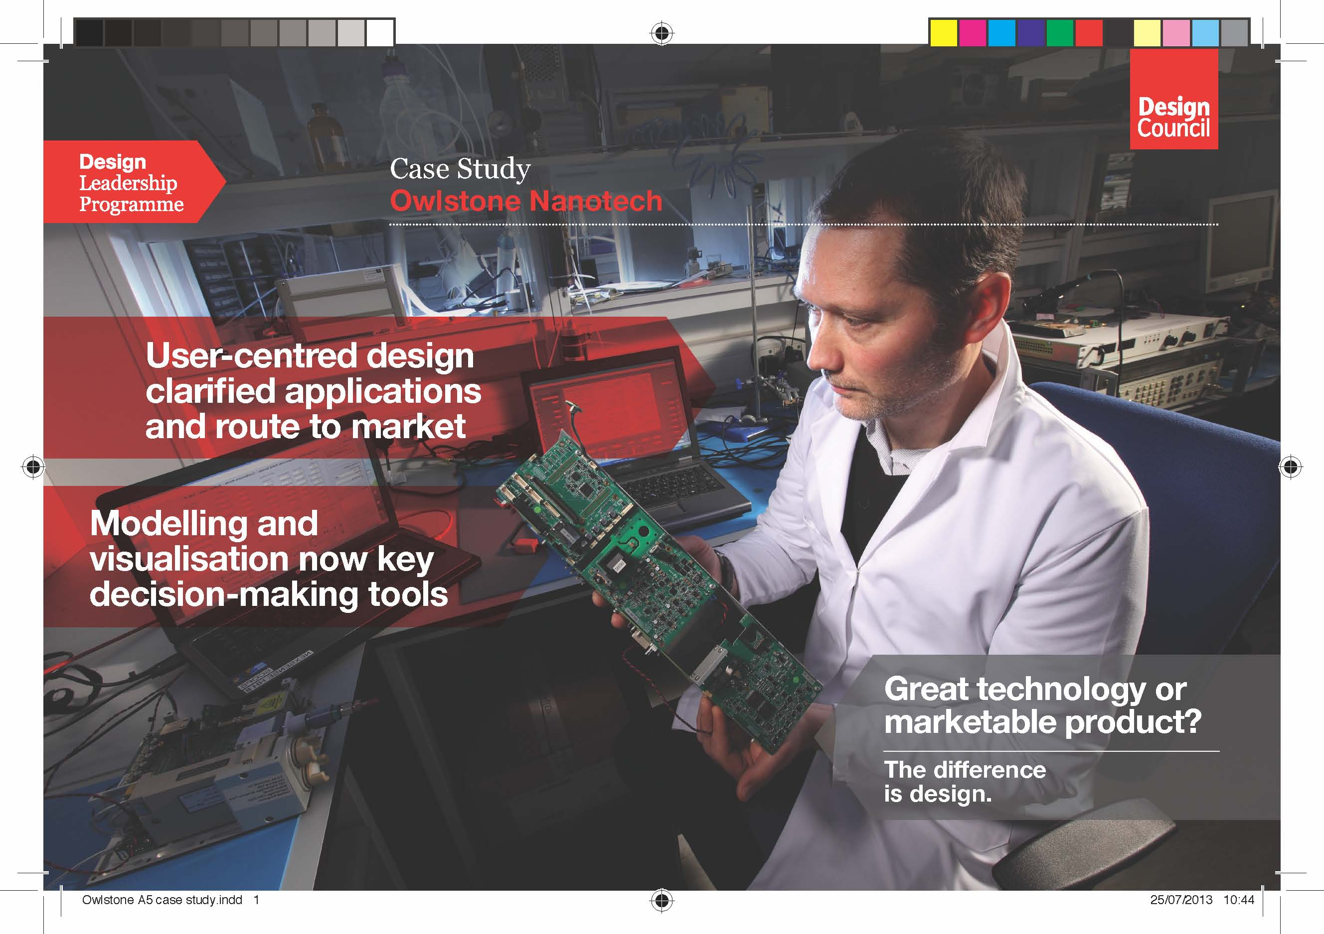

Slide 30
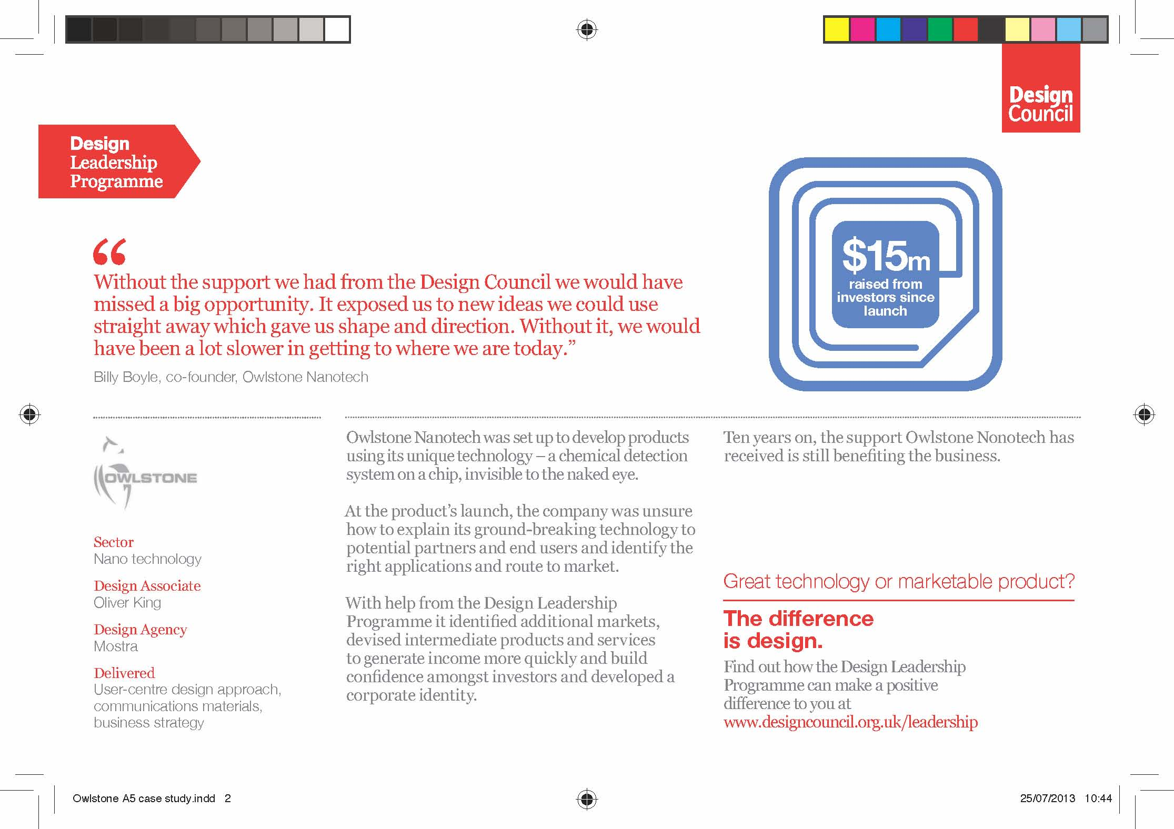

Slide 31
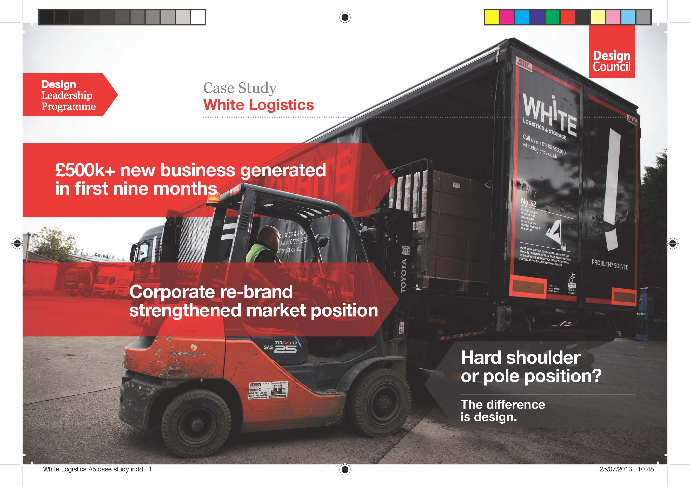

Slide 32
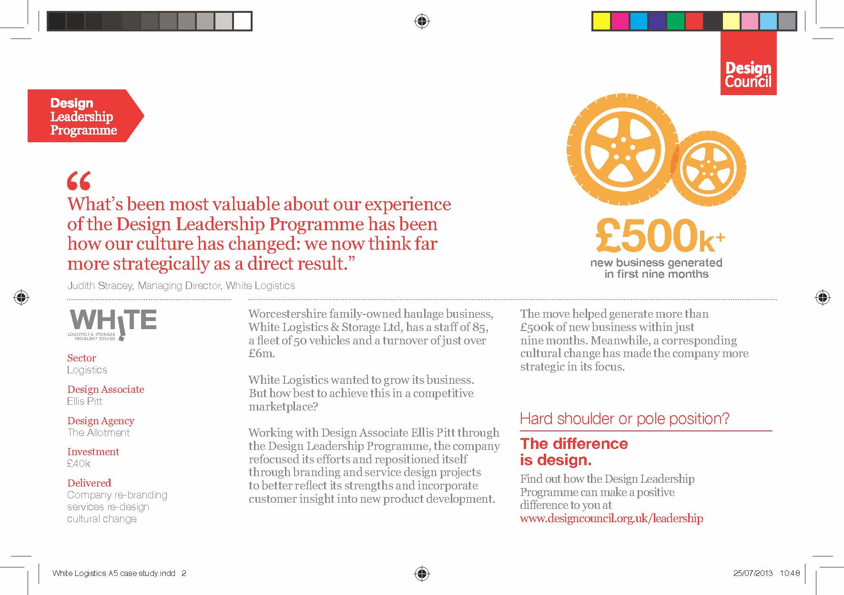

Slide 33
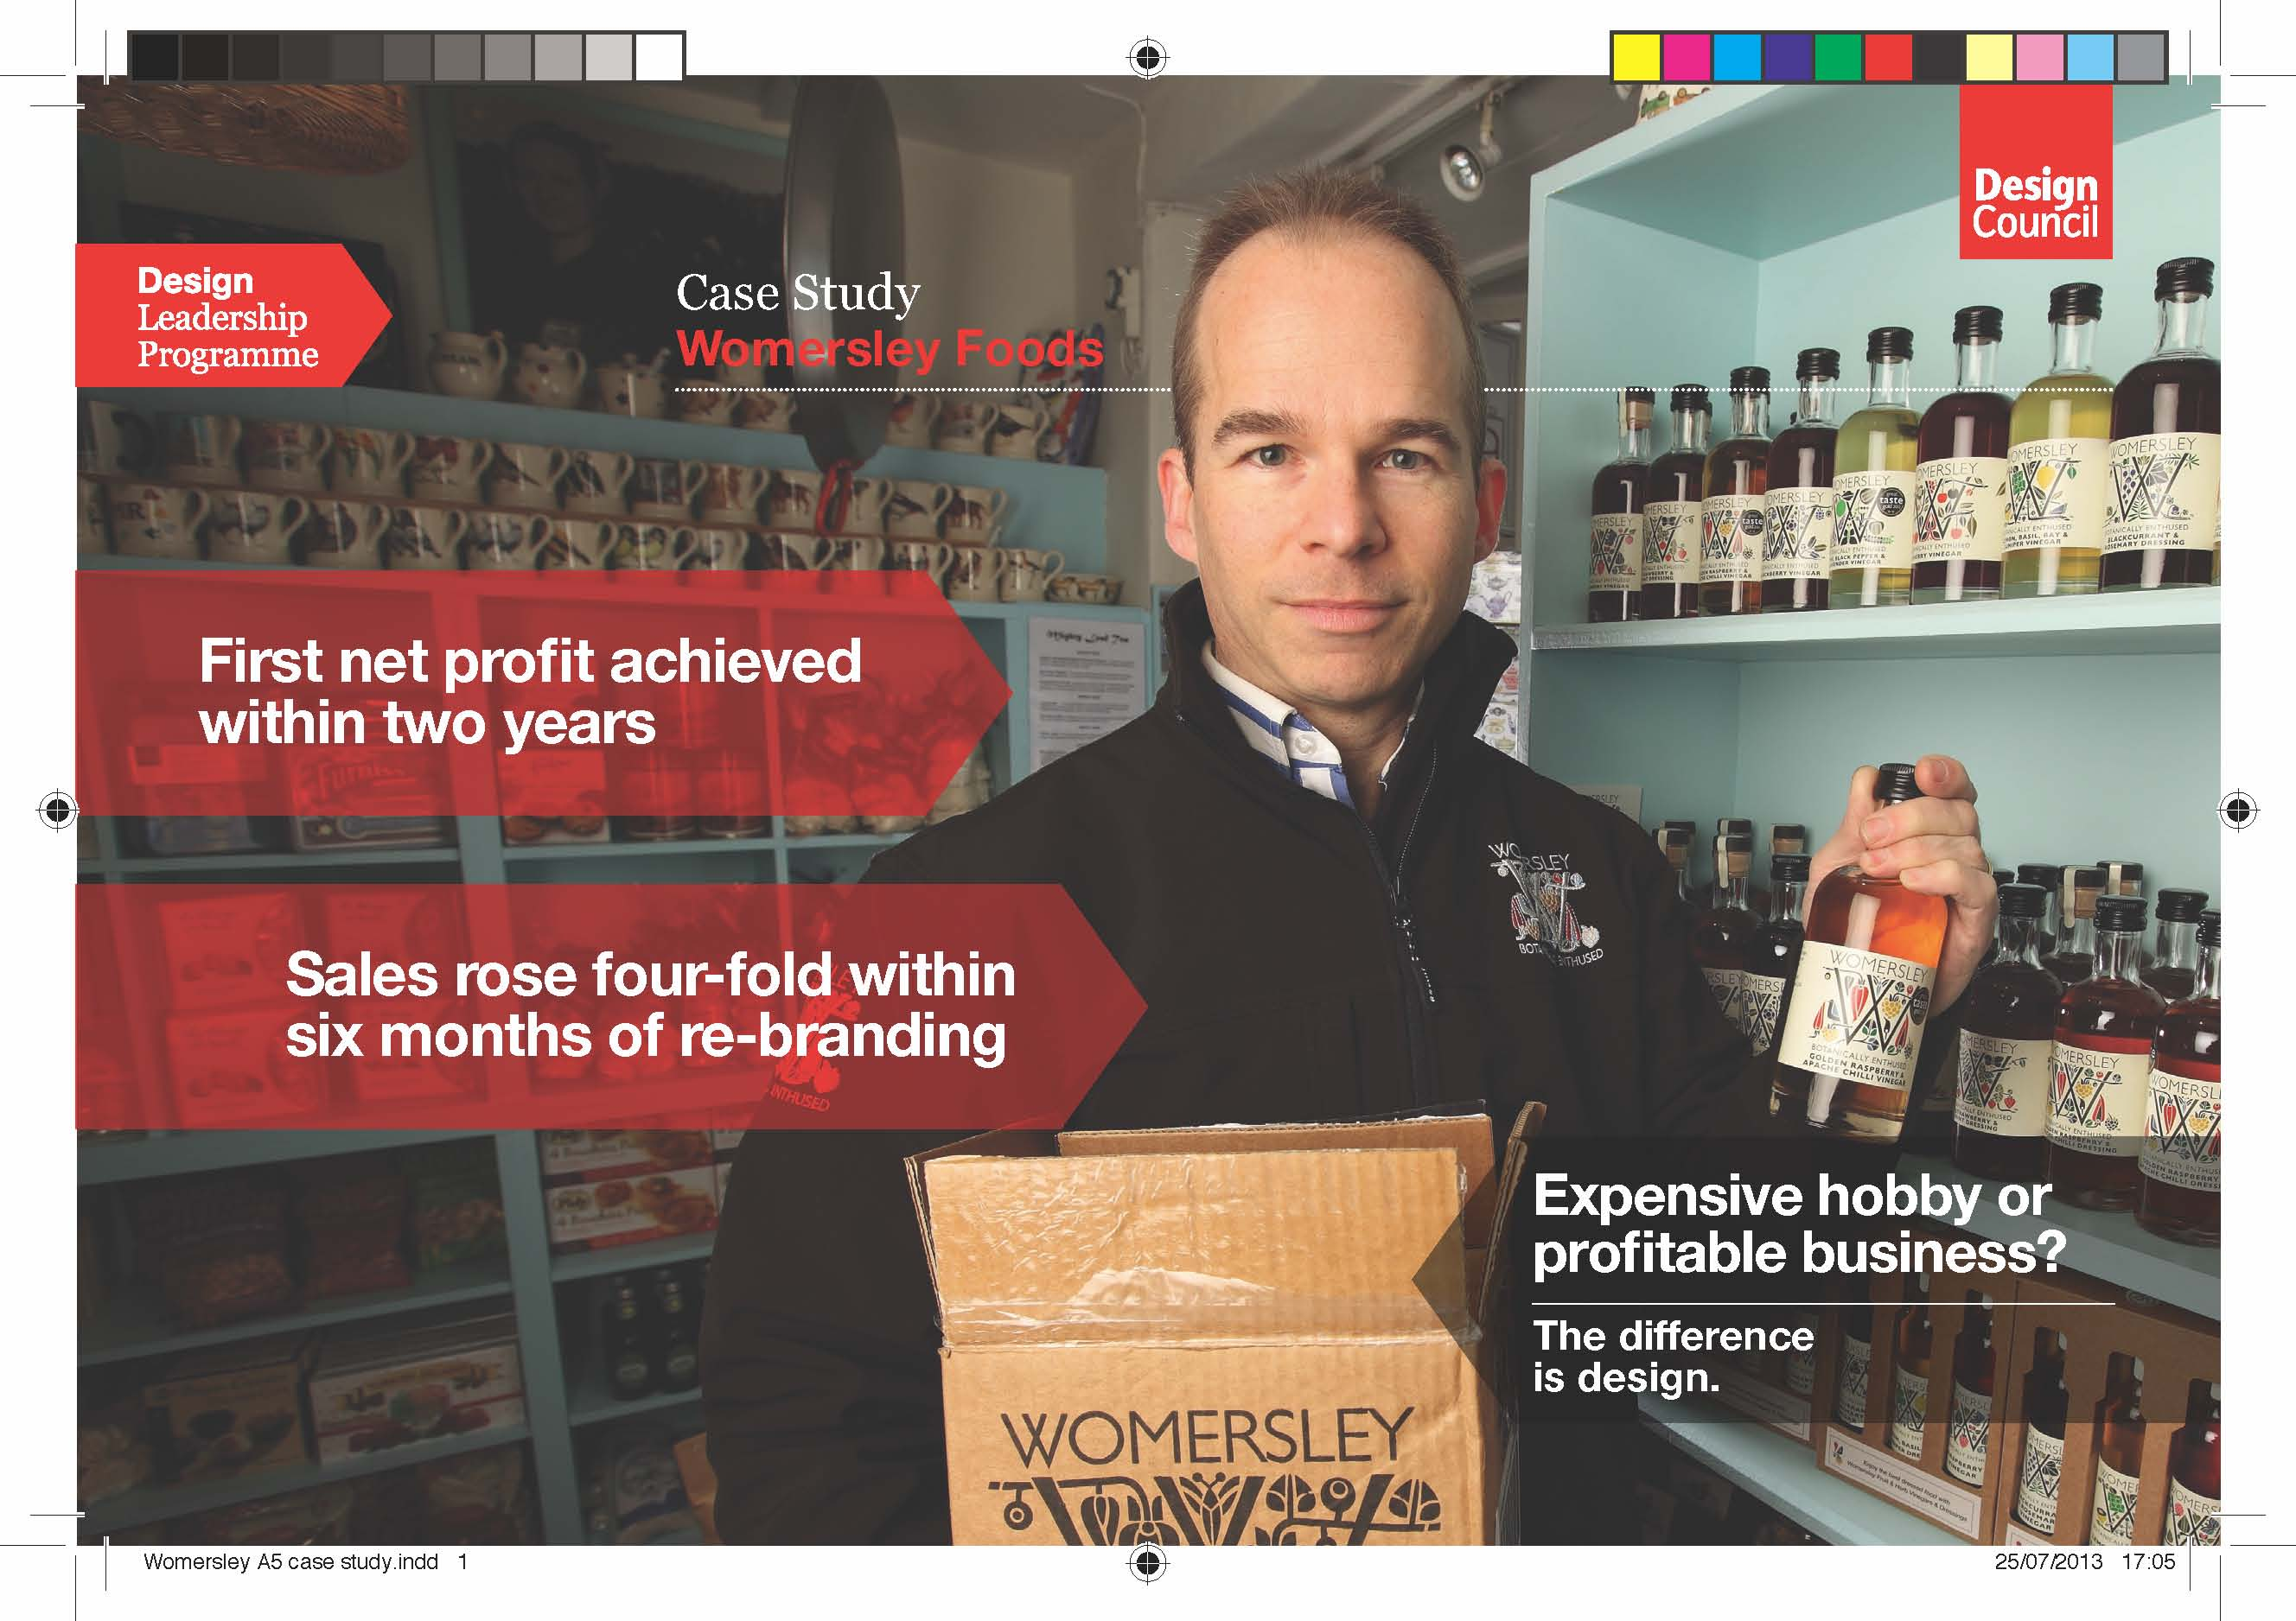

Slide 34
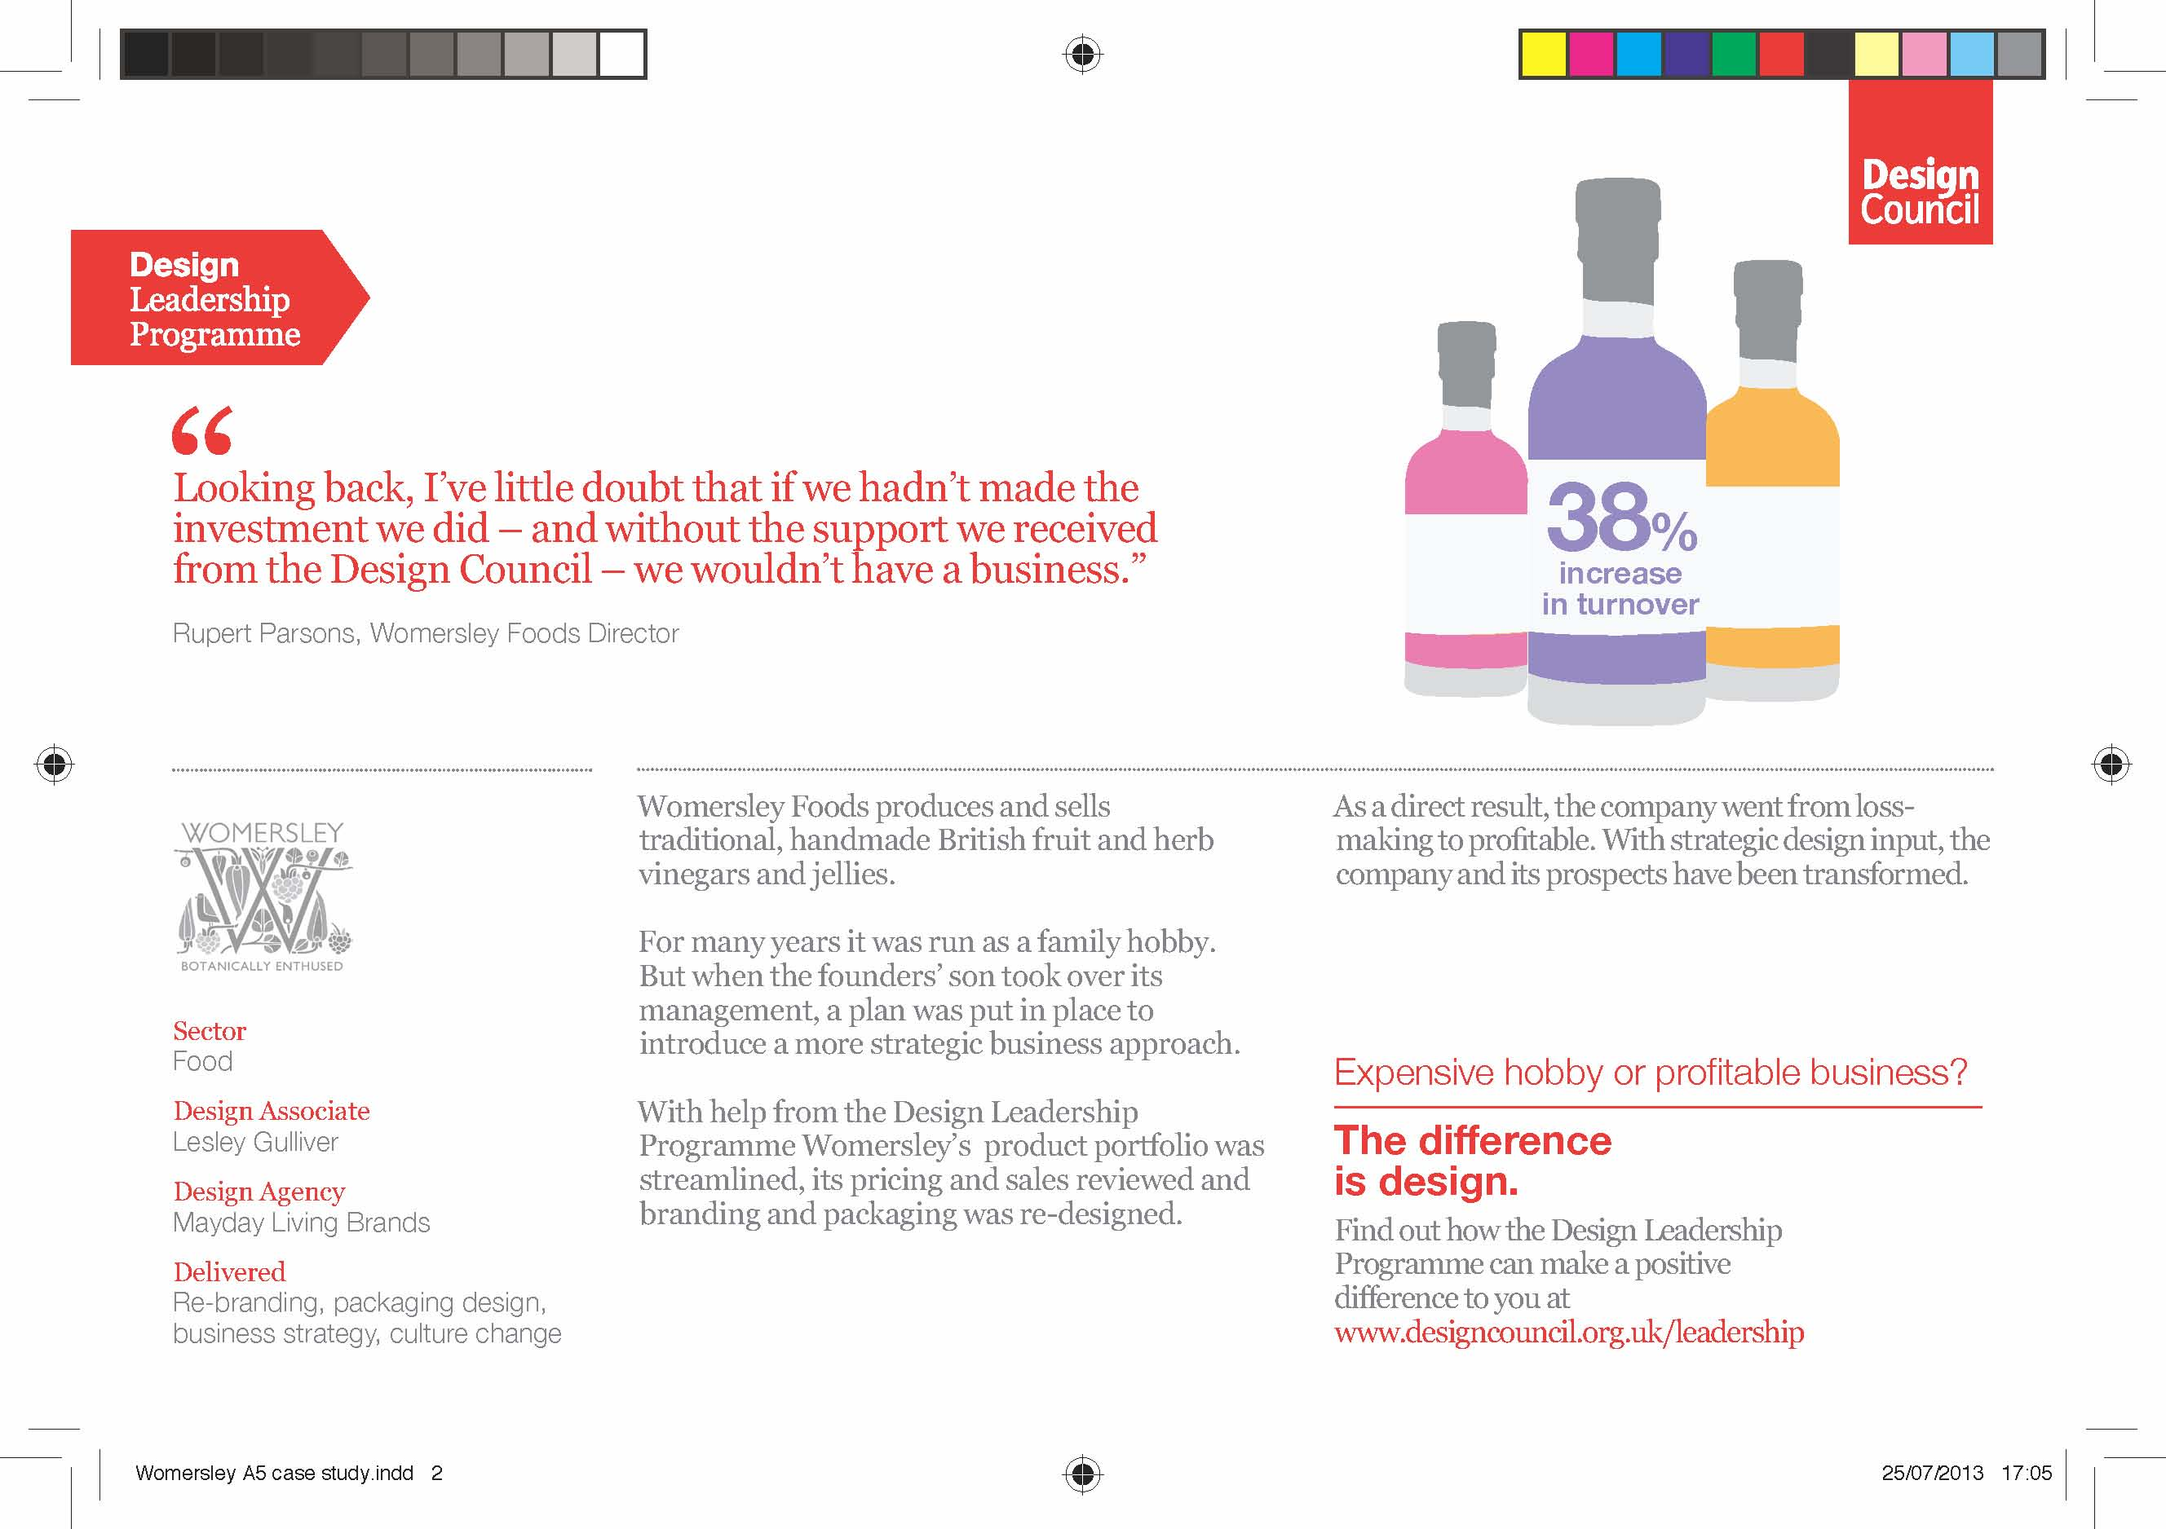

Slide 35
Design = Growth

Slide 36
2014
How we got here…

Slide 37
Policy Context
… & more to come?
2009: Political commitment at European level
2013: Action-Plan for Design-Driven Innovation
2014: European Design Innovation Platform
2011: European Design Innovation Initiative
2012: Role of European Design Leadership Board

Slide 38
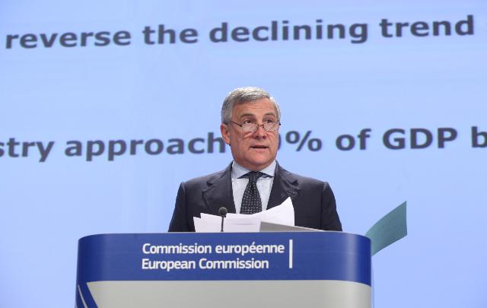
Wider use of design, as well as other non-technological innovations, is one of the key drivers for developing high value products, increasing productivity and improving resource efficiency
Industrial Policy Communication Update 2012
Antonio Tajani, Vice-President (Industry and Entrepreneurship), European Commission

Slide 39
Action Plan for Design-Driven Innovation
Aims to accelerate the take-up of design in innovation policy, with 3 strategic areas for action:
Promoting understanding of design's
impact on innovation
Promoting design-driven innovation in industries to strengthen Europe's competitiveness
Promoting the adoption of design to
drive renewal in the public sector

Slide 40
Delivering the Action Plan
The European Design Innovation Platform (EDIP) is one of the key mechanisms for delivering the vision of the Action Plan. It will deliver:
A web-based platform to support peer-learning, networking and partnerships
A programme of engagement…
  Advocating design-driven innovation to policymakers
  Supporting the design capabilities in enterprises
  Supporting the design capabilities in the public sector

Slide 41
2014 and beyond…
European Design Innovation Platform (EDIP)

Slide 42
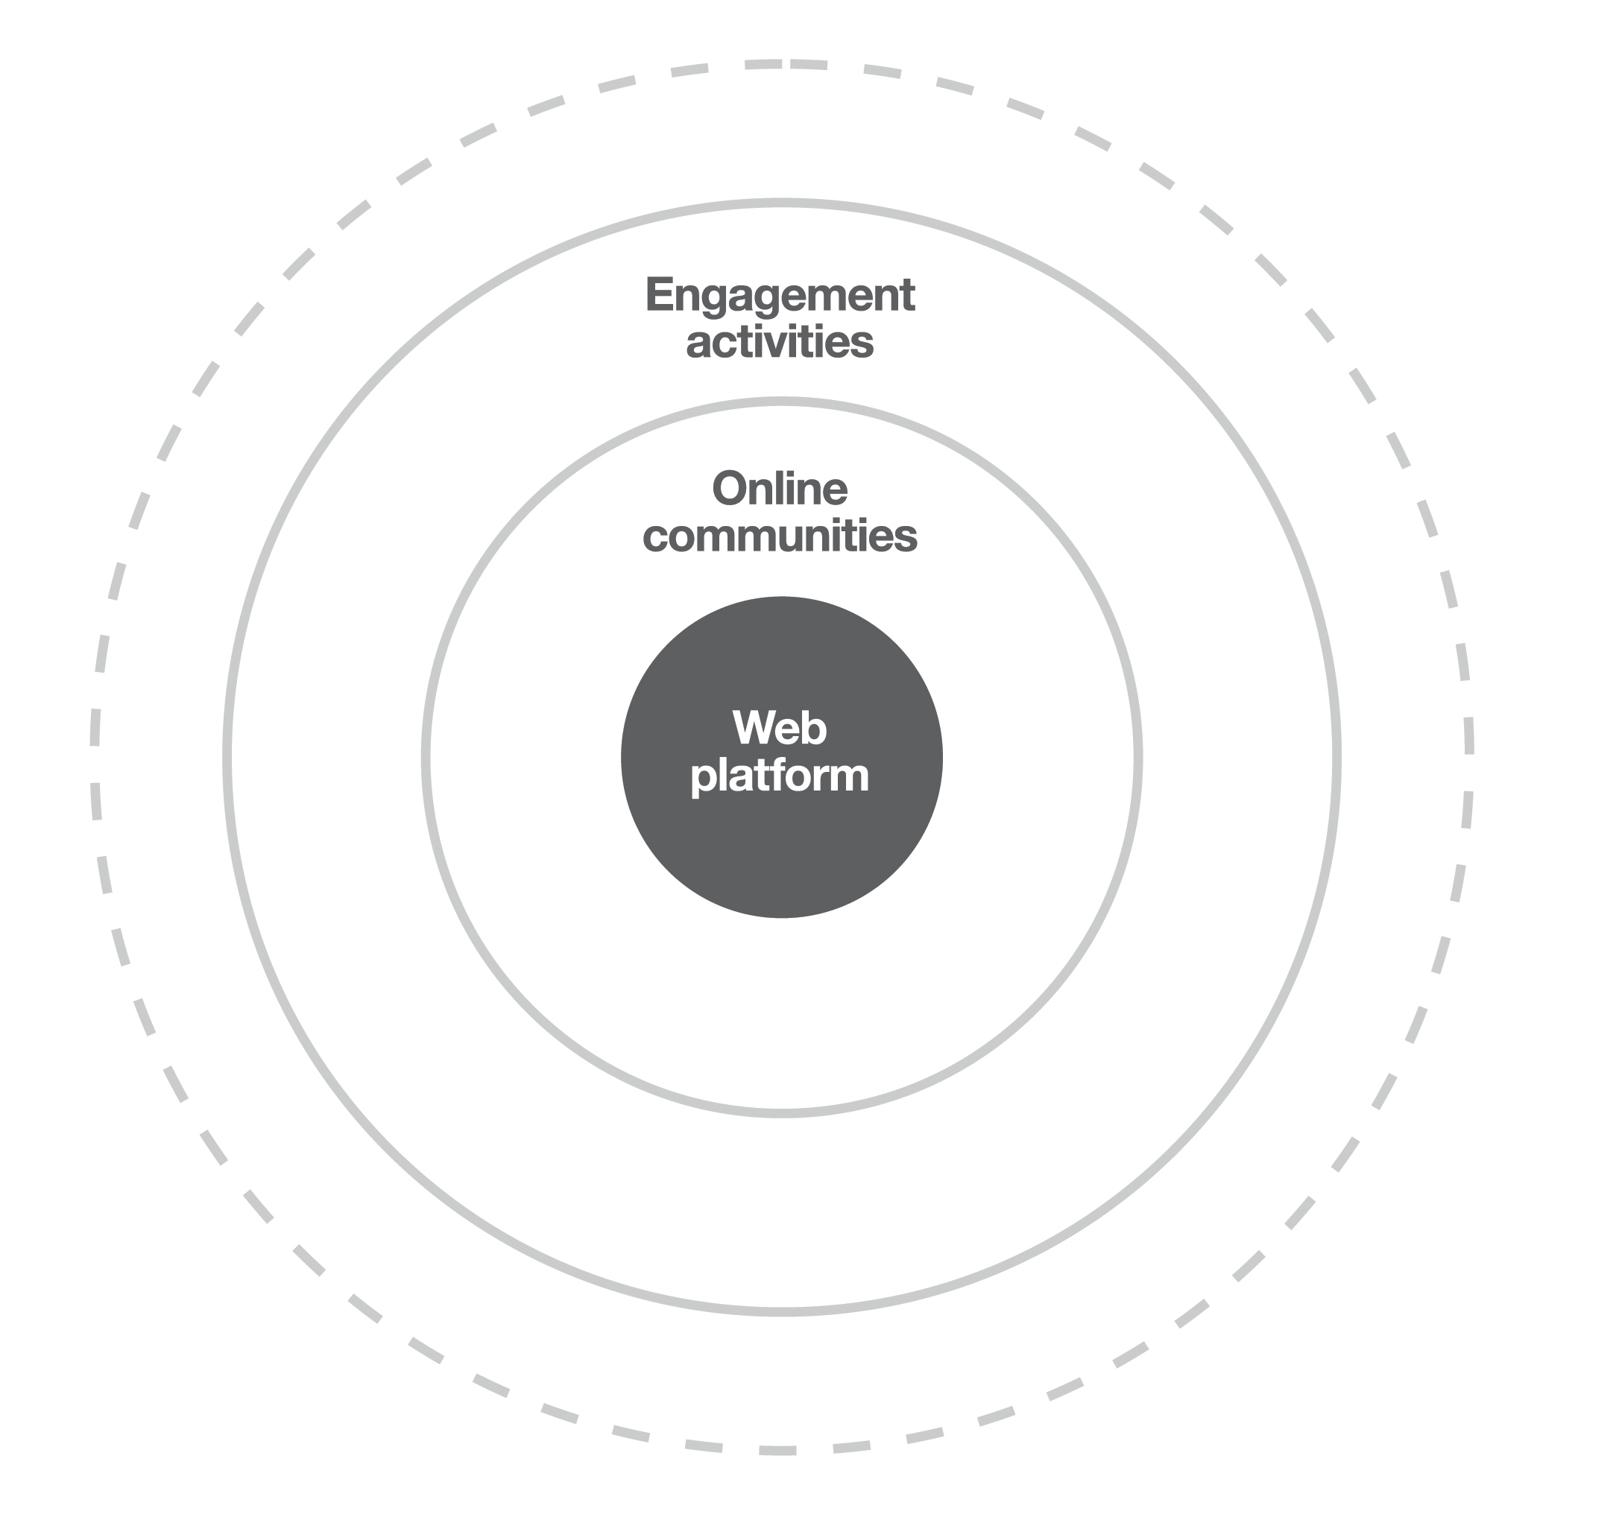
The EDIP concept
EDIP’s vision is to connect and raise awareness across
the EU, of the potential
of design to drive innovation in business and the public sector.

Slide 43
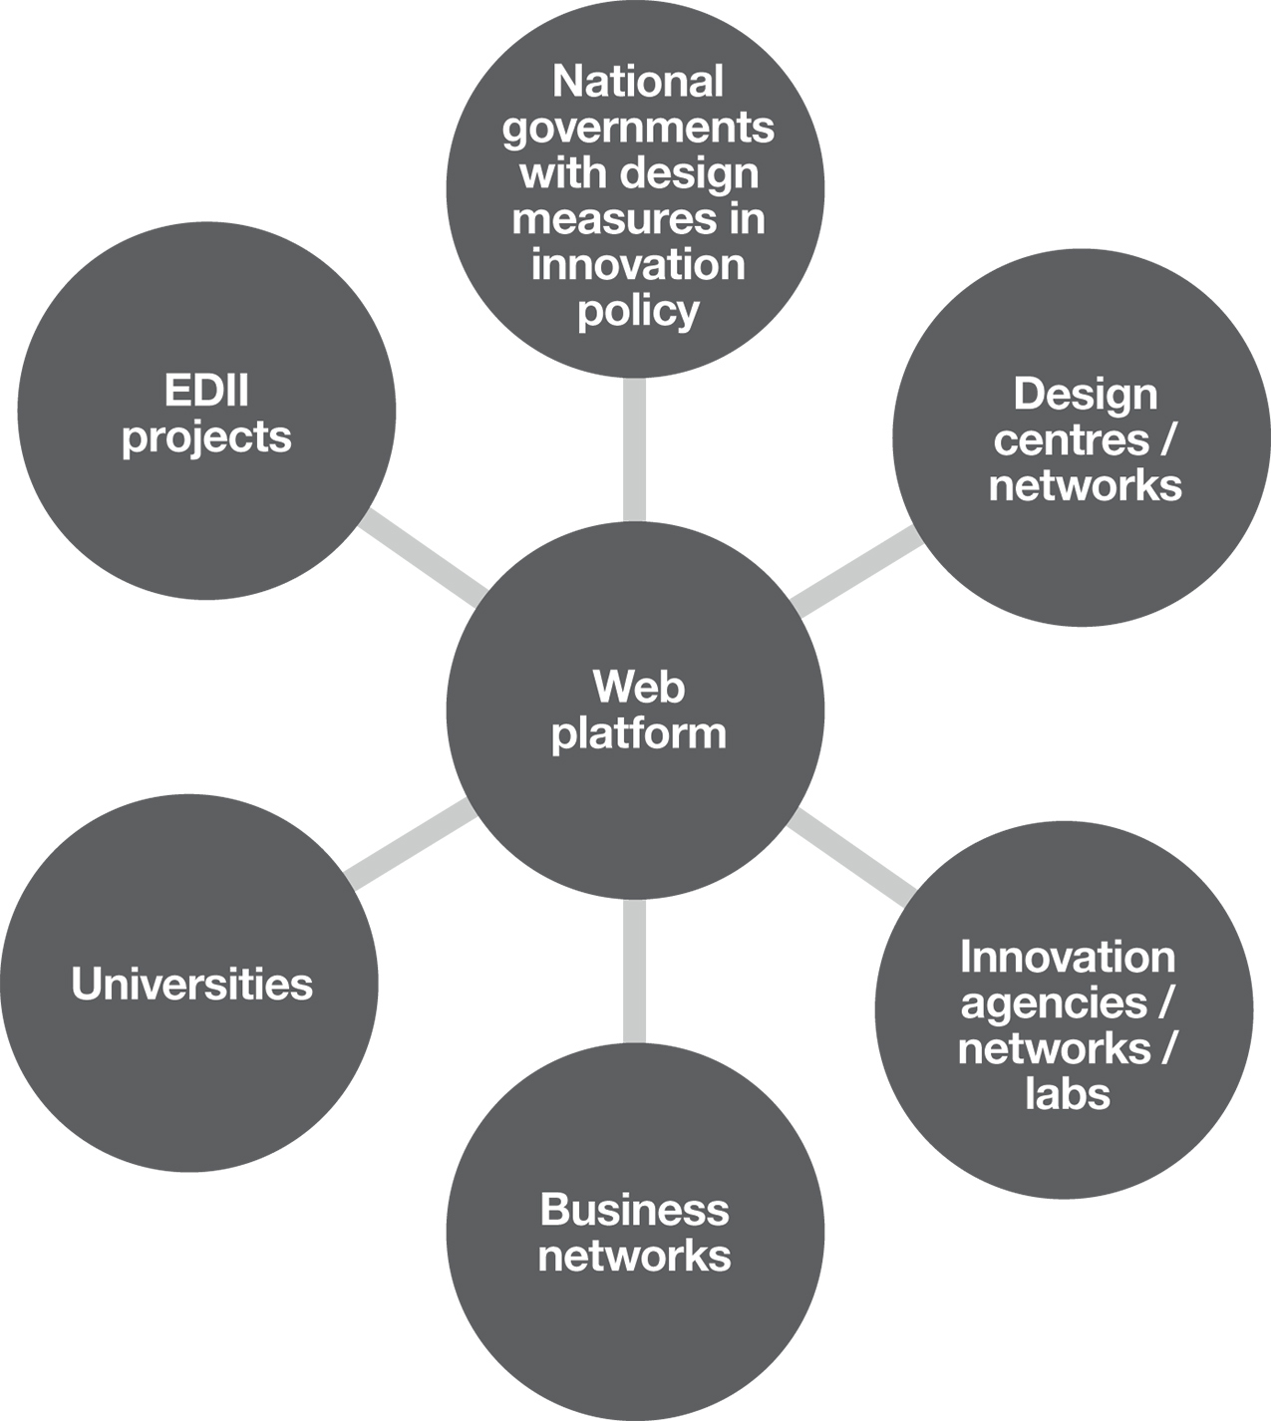
Pockets of interest and expertise
The platform will bring together those across the EU interested in design-driven innovation.

Slide 44
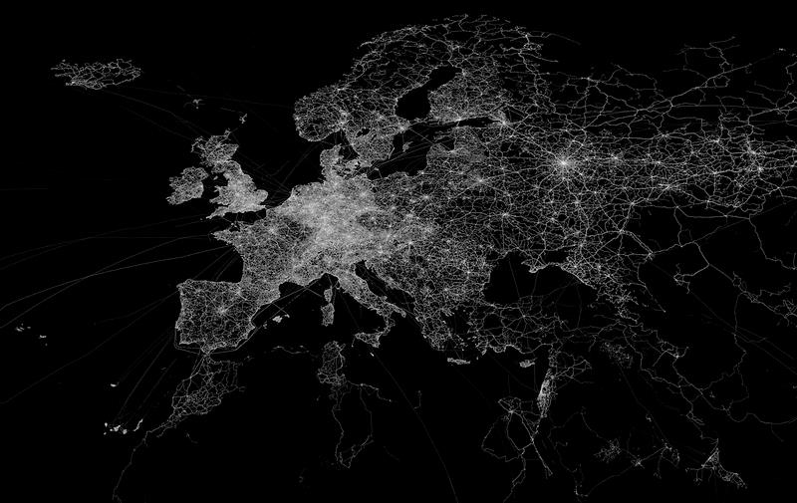
The EDIP consortium
Consortium Lead:
Design Council, UK
Work Package Leads:
Lancaster University, UK
Birmingham City University, UK
Politecnico di Milano, Italy
Danish Design Centre, Denmark
Nesta, UK
Supporting Partners:
KEPA, Greece
Invest Northern Ireland, UK
Estonian Design Centre, Estonia
ARC Fund, Bulgaria
Luxinnovation, Luxembourg
La 27e Region, France
dSola, Slovenia
Dissemination Partner:
European Network of Living Labs
© Eric Fischer (Creative Commons)
Register your interest at www.designplatform.eu

Slide 45














Slide 46
What will EDIP deliver?
Host a minimum of 46 events
1,130 people attending events
4 online Forums
600 users registered on the web platform
30 case studies
80 resources in the online repository
1 online module
9 reports

Slide 47
How will EDIP deliver?
Building the audience
Register
Existing networks
Analyse
Registrations analysed and gaps identified
Strategy
Strategic plan to address gaps
Research
Use these people to test ideas
Develop
Based on insights
Using the growing audience to build the Platform
Register your interest on www.designplatform.eu

Slide 48
What next?
Register your interest through the mailing list
Suggest resources for inclusion
Next iteration of site to be launched (end of May)
To be known as Design for Europe
Bi-monthly e-newsletter (end of May)
Register your interest on www.designplatform.eu

Slide 49
Contact
Claire Fennelow
Programme Lead, European Design Innovation Platform (EDIP)
Claire.fennelow@designcouncil.org.uk
www.designplatform.eu
Thank you

