Slide 1
DONEAT
When extra calories are doing good…

Slide 2
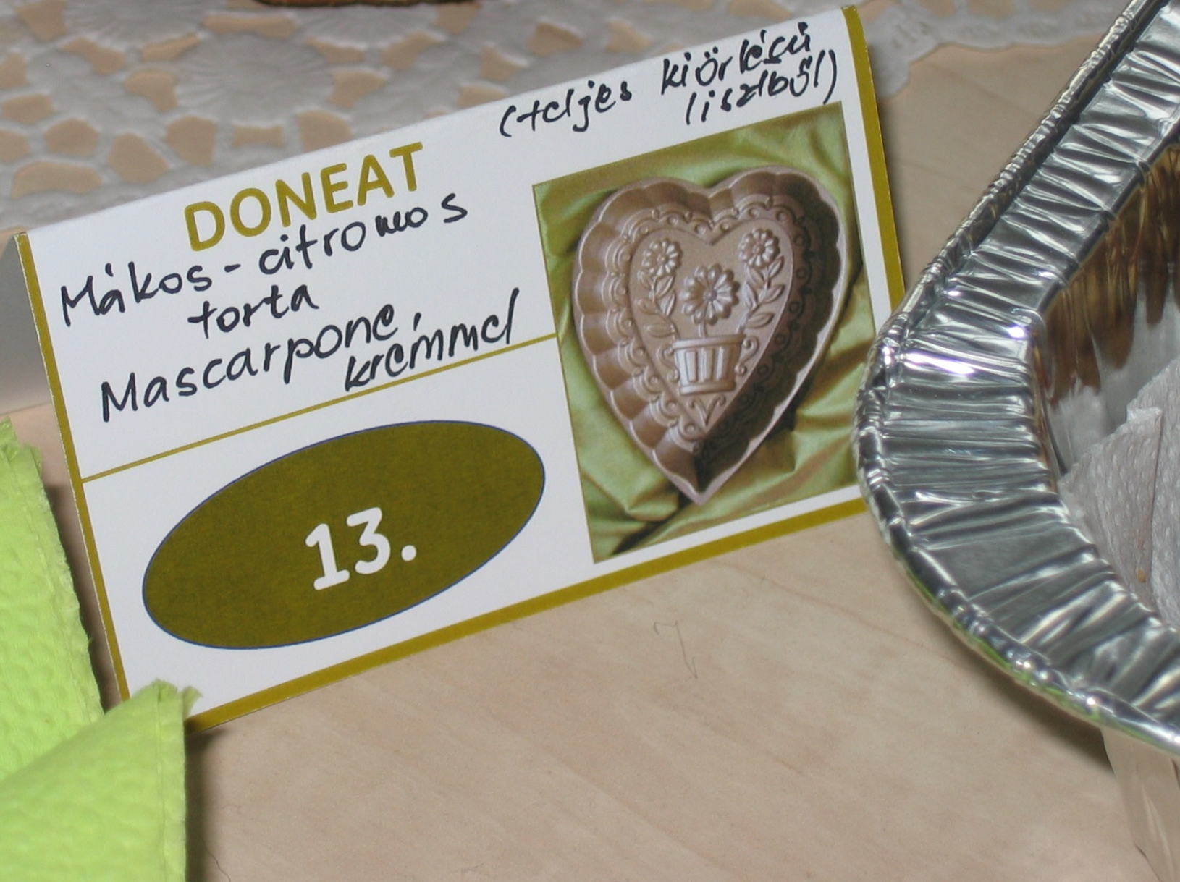
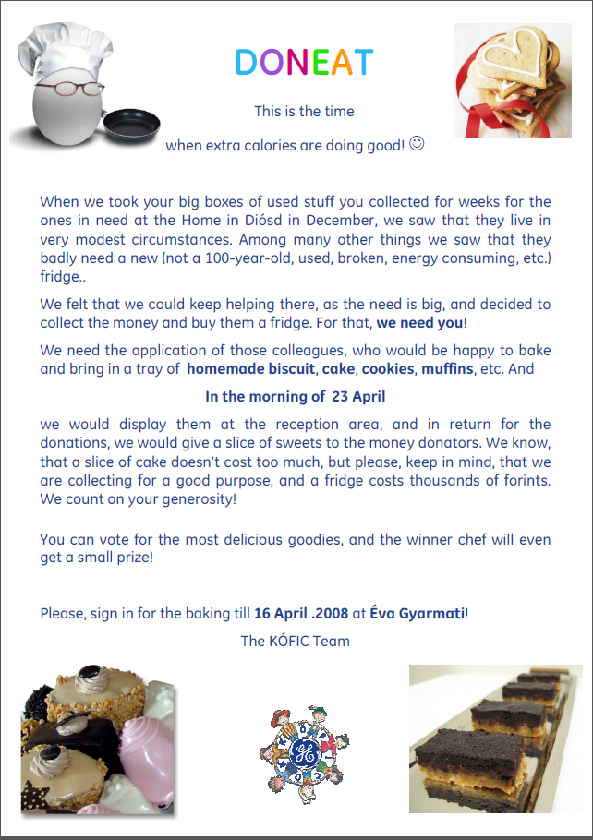

Slide 3
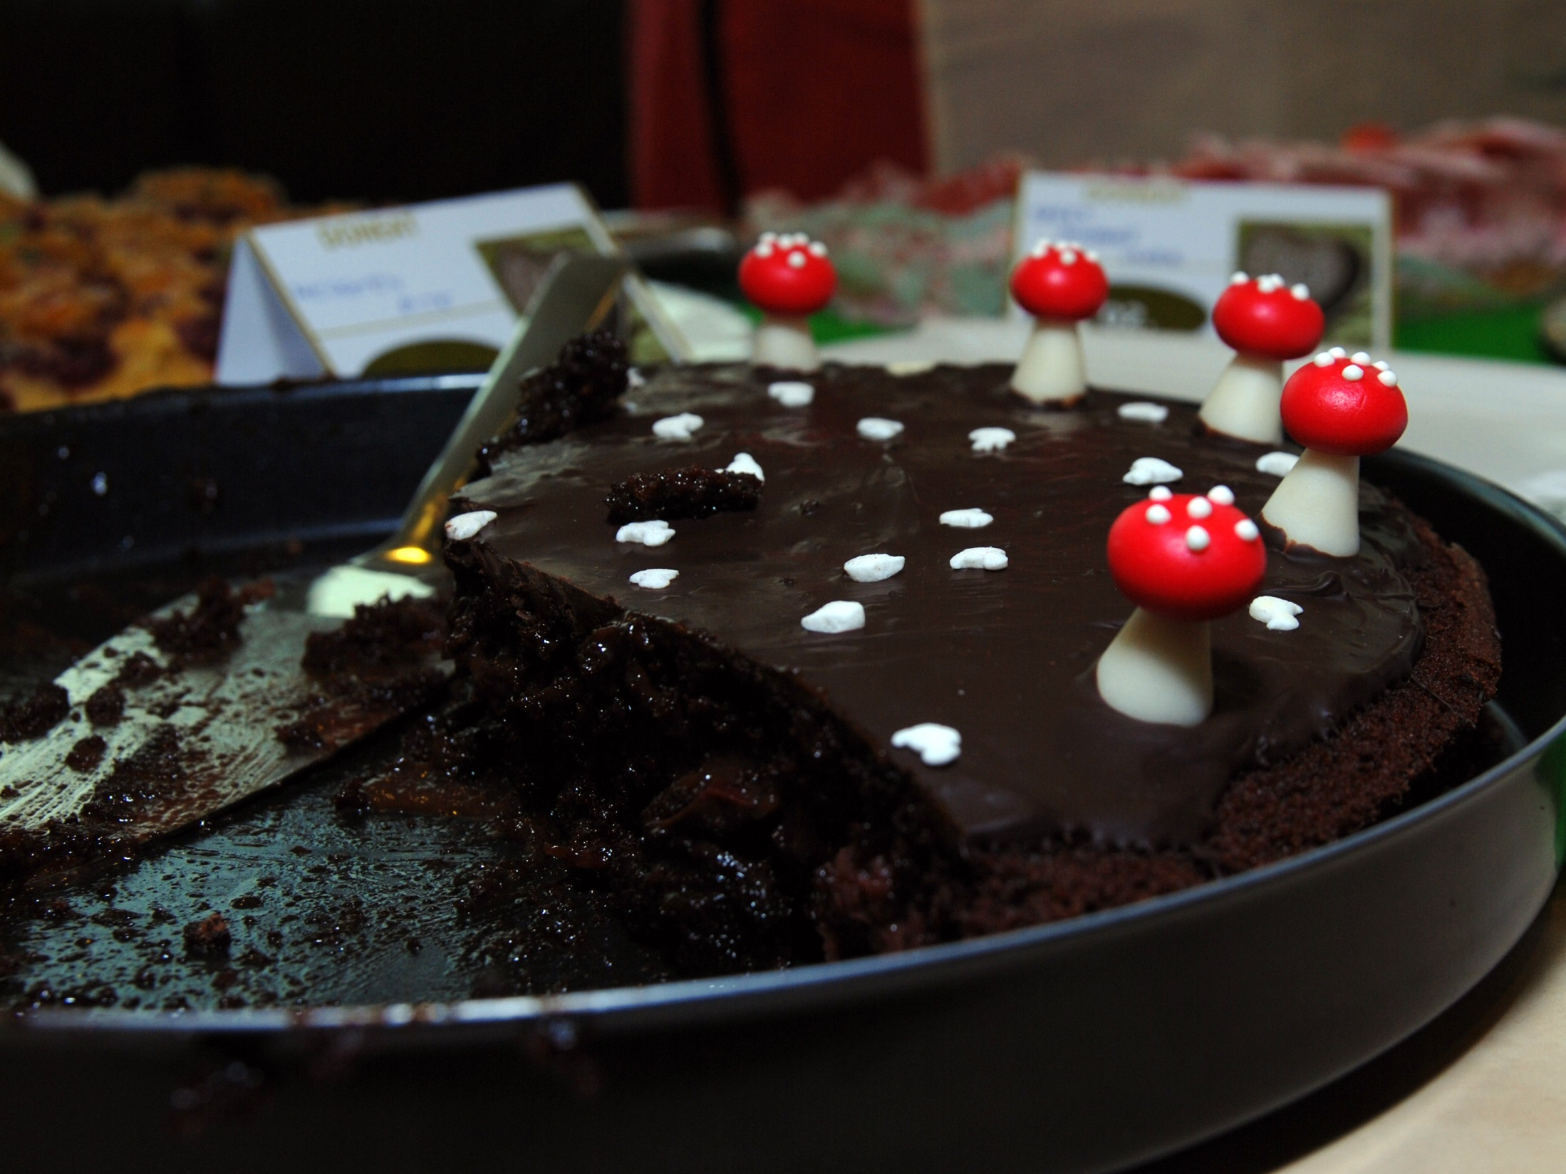
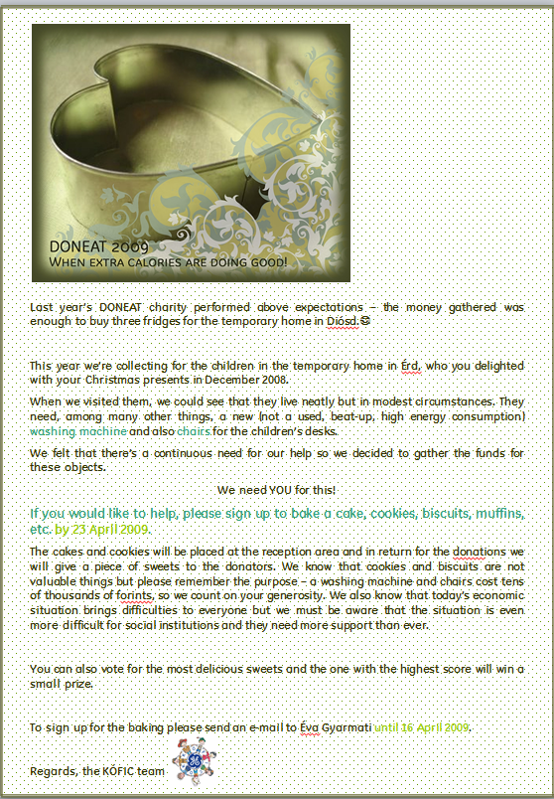

Slide 4

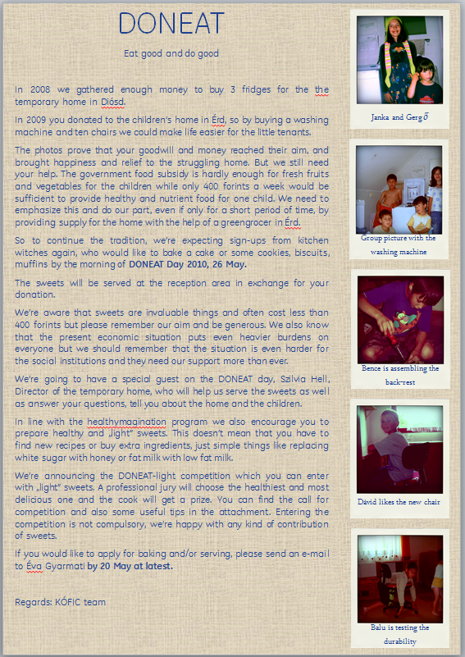

Slide 5
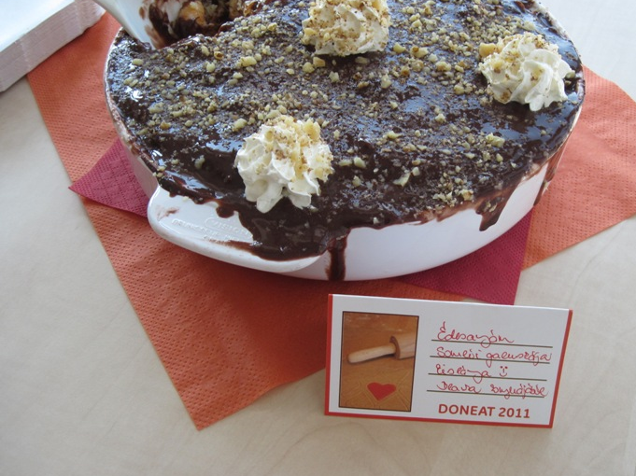
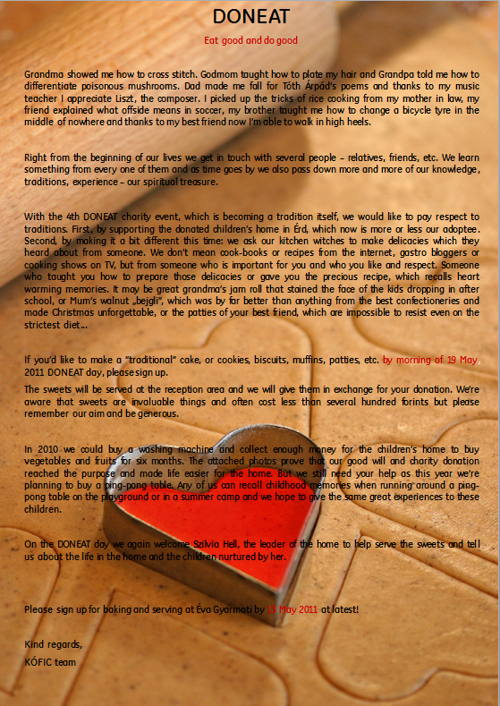

Slide 6
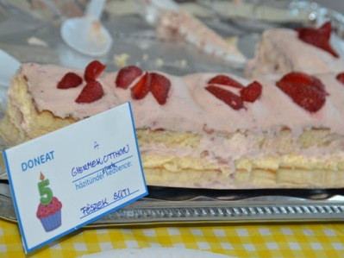
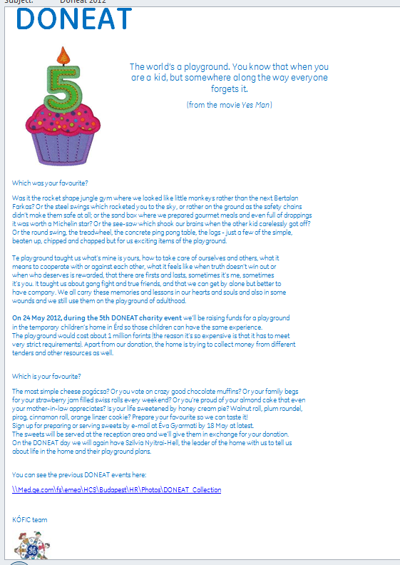

Slide 7
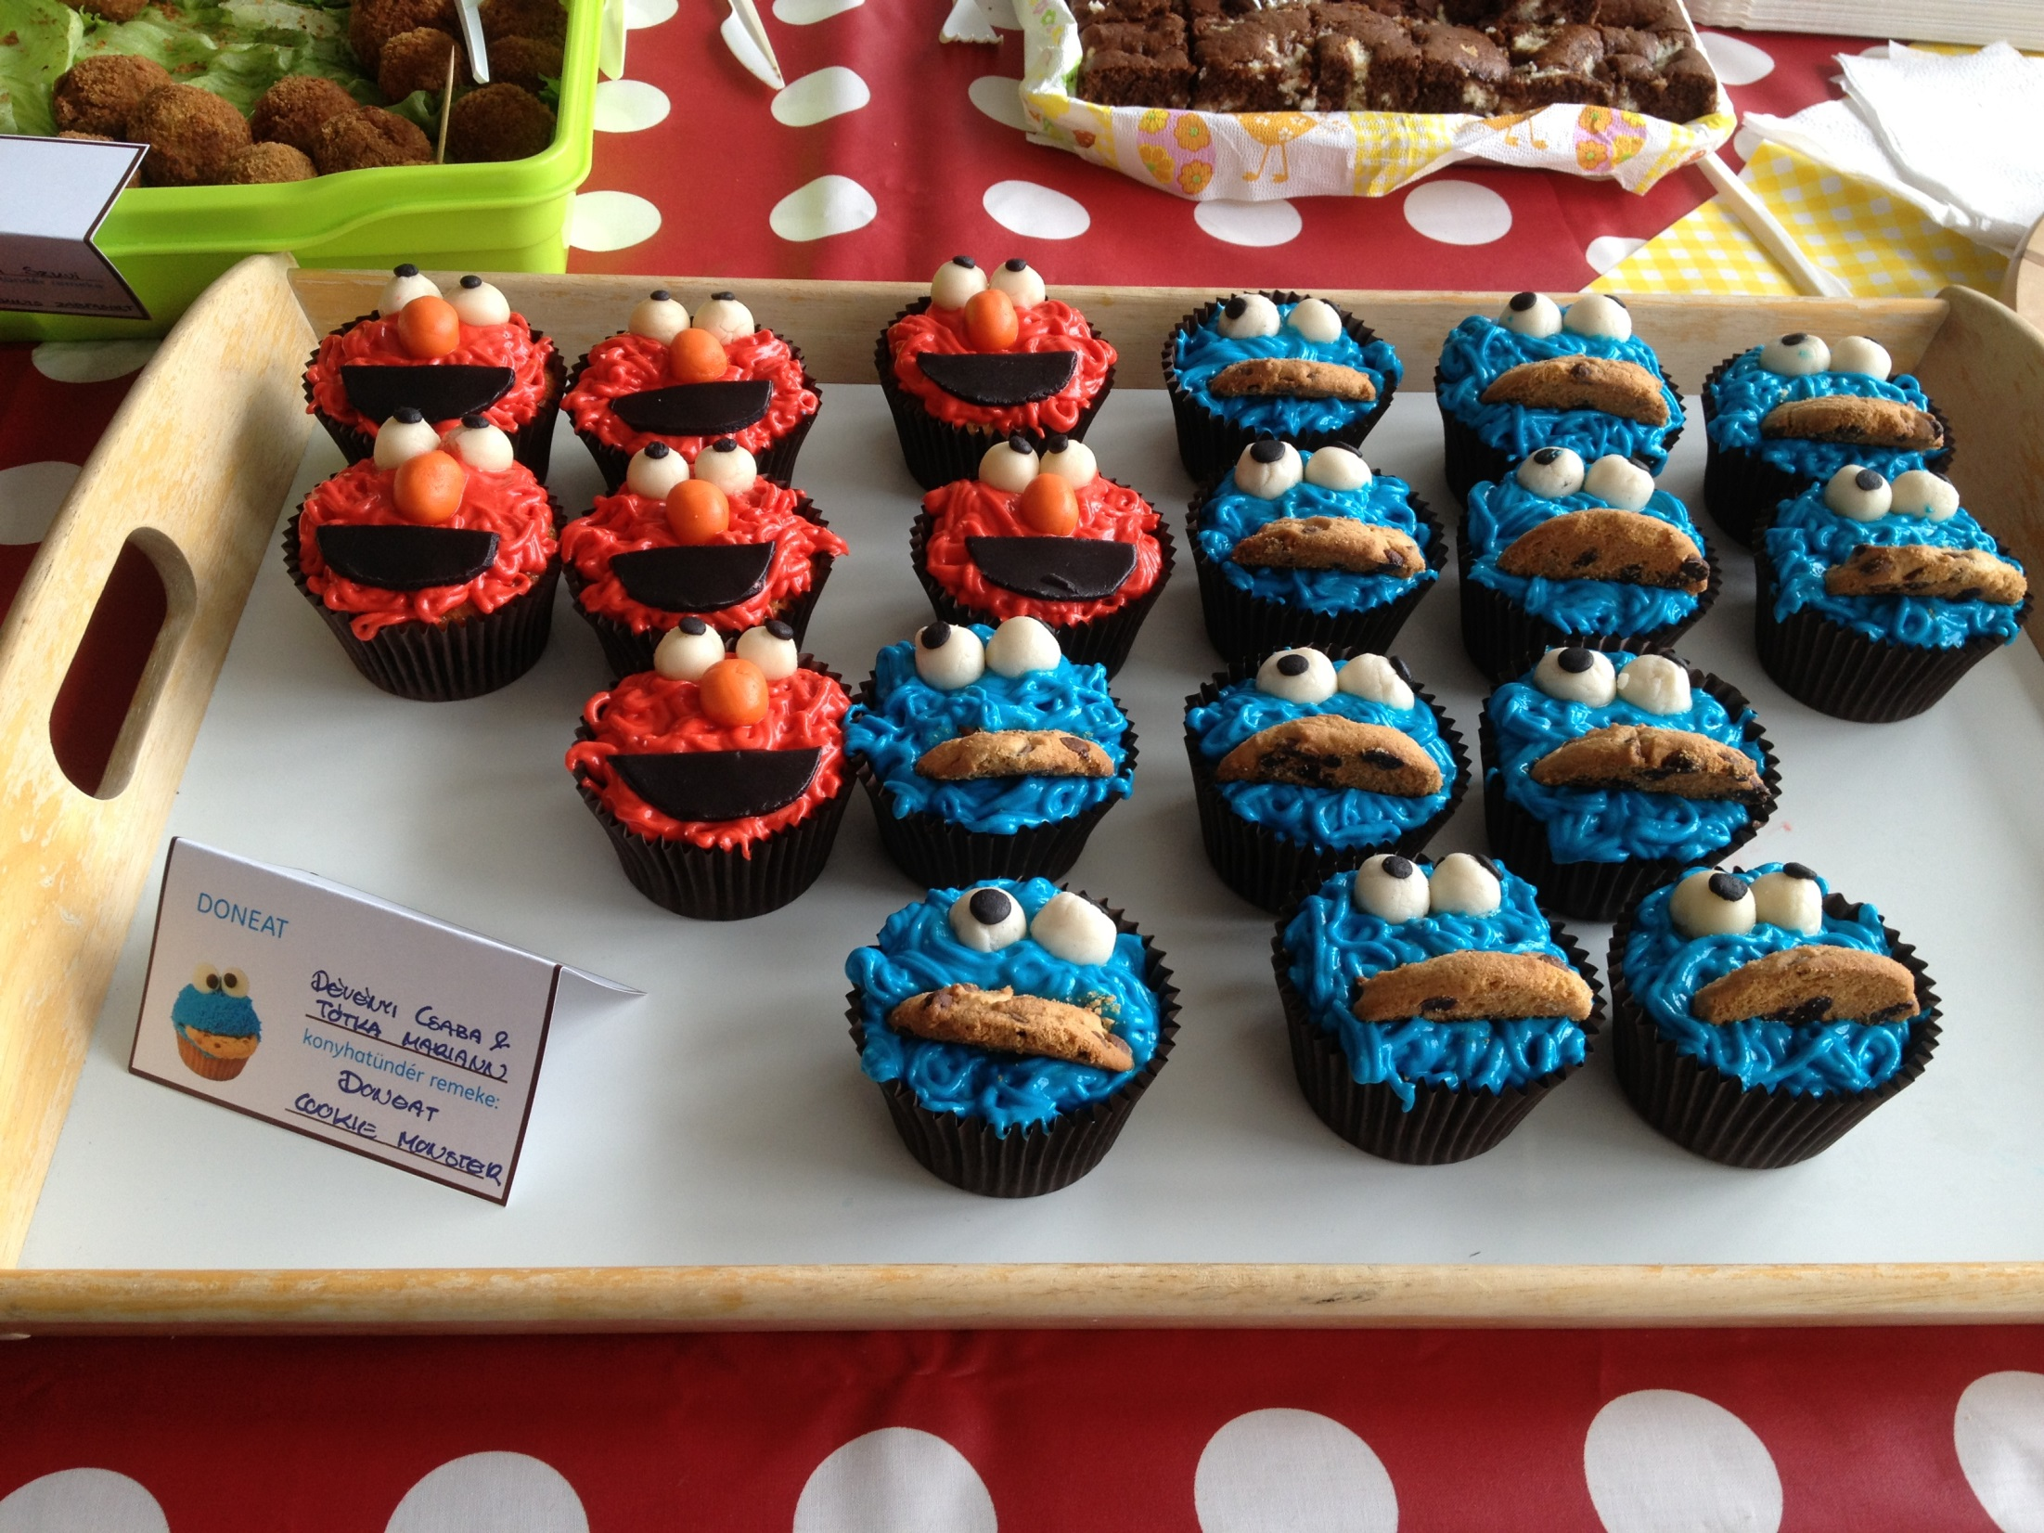
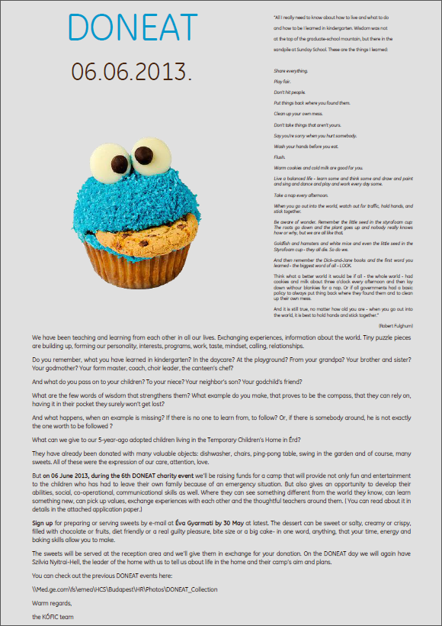

Slide 8
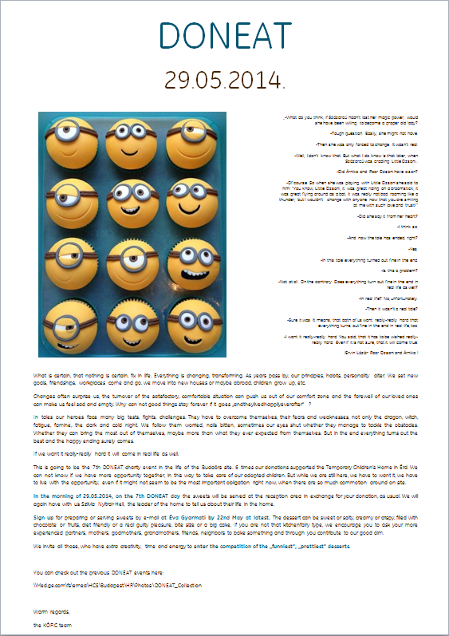
-And now the tale has ended, right?
-Yes.
-In this tale everything turned out fine in the end.
-Is this a problem?
-Not at all. On the contrary. Does everything turn out fine in the end in real life as well?
-In real life? No, unfortunately.
-Then it wasn’t a real tale?
-Sure it was. It means, that both of us want really-really hard that everything turns out fine in the end in real life, too.
-I want it really-really hard. You said, that it has to be wished really-really hard. Even if it is not sure, that it will come true.
(Ervin Lázár: Poor Dzsoni and Árnika )

