Slide 1

How to run fun loyalty programs to engage your customers
brought to you by: András Nemes
head of sales @Antavo loyalty & contest software

Slide 2
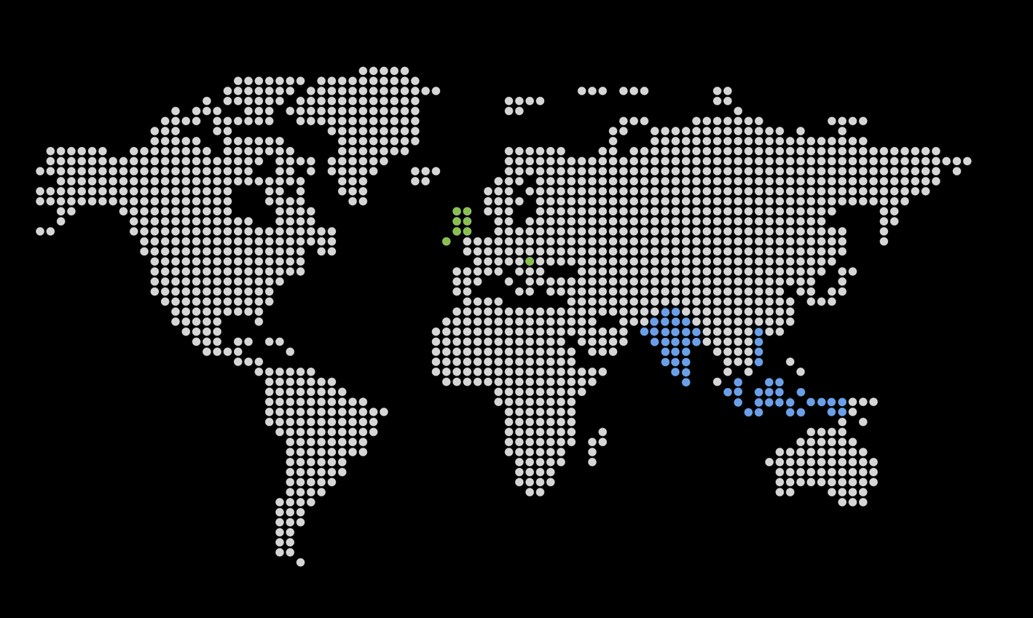

22k customers in 180 countries worldwide
András Nemes
Head of Sales
andy@antavo.com
www.antavo.com
Antavo Offices:
United Kingdom
Hungary
Resellers
India
Indonesia
Malaysia
Singapore
Vietnam

Slide 3

What drives loyalty?

Slide 4

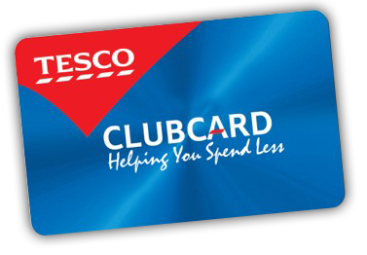
Loyalty cards…
Do they really drive loyalty?
Most companies just throw a loyalty card at their customers and expect their loyalty in exchange for some discount coupons and cash-back vouchers.

Slide 5

The wow effect & REWARDS
20%
34%
CUSTOMER SUPPORT
REWARDS
13%
10%
EXCLUSIVENESS
FAMILIARITY
12%
11%
PERSONALIZATION
OTHER
Source: e-marketer

Slide 6
Social referrals
Customers want social recommendations and word of mouth
Conversion Rates
400%
320%
Recommendation
Newspaper ad
Online Reviews and Recommendations
Social Media Ad
Source: Deloitte

Slide 7
Social beats seo
Traffic Source to Brand’s Websites
Source | Jul-13 | Aug-13 | Sep-13 | Okt-13 | Nov-13 | Dec-13 | Jan-14 | Feb-14 | Mar-14 | Apr-14 | May-14 | Jun-14 | Jul-14 | 13-month average | Growth from Jul'13-Jul'14
Organic Search Traffic | 40.39% | 43.84% | 42.77% | 43.10% | 39.37% | 40.18% | 37.27% | 38.19% | 32.92% | 33.64% | 32.89% | 29.40% | 29.22% | 37.17% | -27.65% | -11.17 pp
Social Referrals | 14.43% | 14.24% | 16.04% | 18.28% | 23.69% | 22.42% | 23.87% | 23.58% | 30.69% | 27.57% | 27.31% | 30.93% | 28.50% | 23.20% | 97.47% | 14.07 pp
Social Media Traffic Referrals to Brand’s Websites
Source | Dec-11 | Dec-12 | Dec-13 | Dec-14 | Change from Dec'11-Dec'14
Facebook | 6.53% | 7.76% | 15.44% | 24.63% | 277.26% | 18.10 pp
Pinterest | 0.65% | 2.84% | 4.79% | 5.06% | 684.86% | 4.41 pp
Twitter | 1.08% | 1.08% | 1.12% | 0.82% | -24.41% | -0.26 pp
StumbleUpon | 1.63% | 0.69% | 0.86% | 0.50% | -69.41% | -1.13 pp
Reddit | 0.28% | 0.33% | 0.21% | 0.15% | -47.71% | -0.13 pp
Google+ | 0.06% | 0.05% | 0.05% | 0.04% | -34.68% | -0.02 pp
LinkedIn | 0.05% | 0.06% | 0.05% | 0.03% | -34.31% | -0.02 pp
YouTube | 0.24% | 0.18% | 0.19% | 0.01% | -94.76% | -0.23 pp
Source: Shareaholic

Slide 8

The Solution

Slide 9

Build loyalty not repeat purchases
OLD-FASHIONED LOYALTY PROGRAMS
LOYALTY SOFTWARE BUILT FOR ONLINE MERCHANTS
‘Spend a dollar, earn a point’
Single interaction
‘Point-based actions and rewards’
Multiple interactions

Slide 10
Actions you can incentivize
In your
store
On your
homepage
On social
channels
On your Loyalty
Hub
In emails
Purchase
Video view
Connect social profile
Content download
Sign-up
Review
Homepage return
Share
Personal information
Open
Reach a certain basket value
Content quiz
Customer referral
Subpage visit
Click-through
And many more...

Slide 11
Forget the traditional
‘spend a dollar, earn a point’ loyalty programs
^{Traditional loyalty programs}
Engagement-type loyalty programs
reward all kinds of customer actions which lead to purchases
reward purchases only
pushy
non-salesy, fun
no influencer identification
detailed customer profiles

Slide 12

Introducing our loyalty solution
Loyalty Hub
Activity & Reward Editor
Review Module
Intelligent Social Share
Insights & Analytics

Slide 13
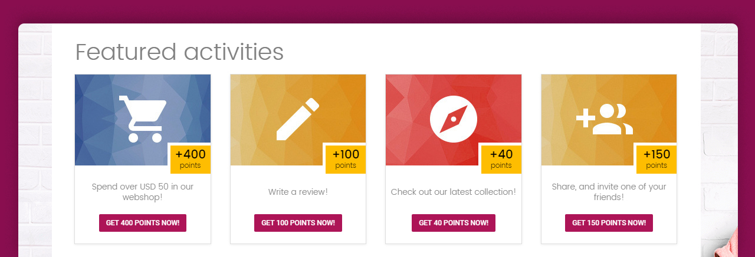
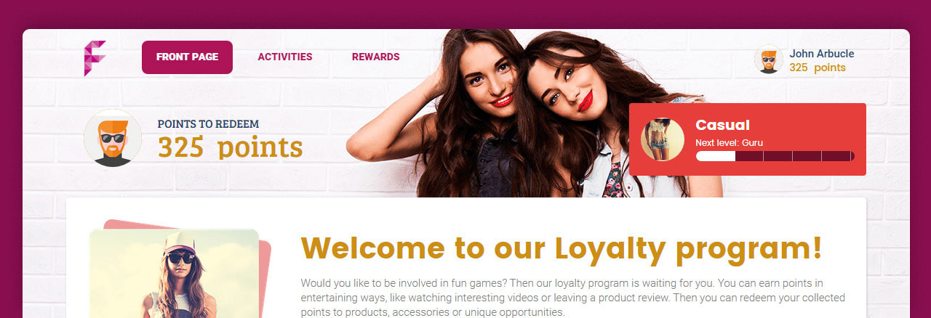
Loyalty Hub
A Loyalty Hub is a customizable landing page linked to your homepage where customers can earn and redeem points by completing activities and claiming rewards.

Slide 14
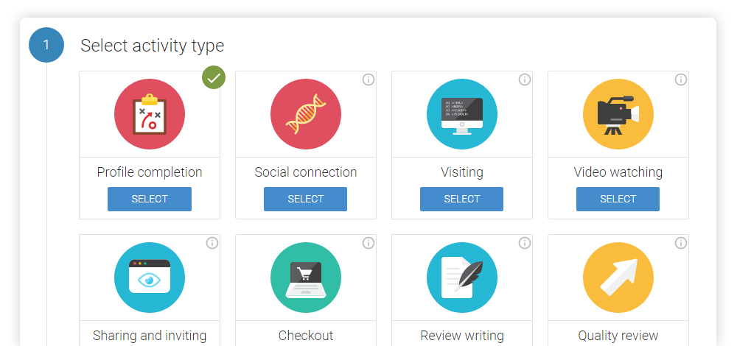
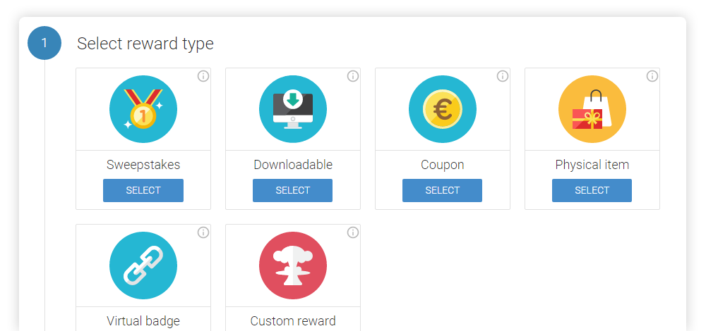
Activity & Reward Editor
We provide a user friendly backend that helps to create activities and rewards.

Slide 15
Smart Review Module
Ratings, up-votes, down-votes, moderation, and contributor profiling to build real trust around your brand and identify opinion leaders.

Slide 16
Intelligent Social Share
With this cutting-edge solution you can reward customers who actually attract new visitors through email, chat, and other social channels.
John brought 6 visitors from email
and 12 from chat applications
John brought 31 visitors from Facebook
John brought 14 visitors from Twitter

Slide 17
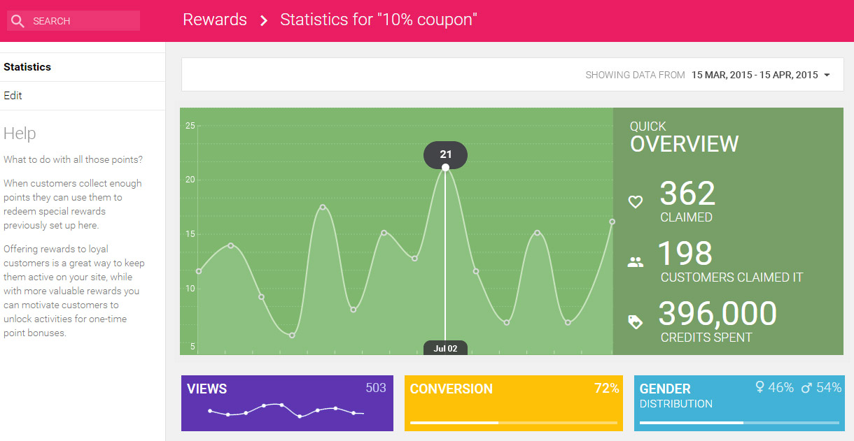
Insights & Analytics
It’s not just simple statistics. It gives you real answers how to improve your loyalty program by understanding its actual performance, the customers attracted and their engagement level.

Slide 18

We believe today’s customers want to shop at online merchants
they
love.
Antavo is a software-as-a-service solution for loyalty programs to …
1. Increase purchases
2. Deepen engagement
3. Create a lovable brand

Slide 19

Thank you!
András Nemes
Head of Sales
andy@antavo.com
www.antavo.com
Notes:
Lowercase a?

