Slide 1


Slide 2
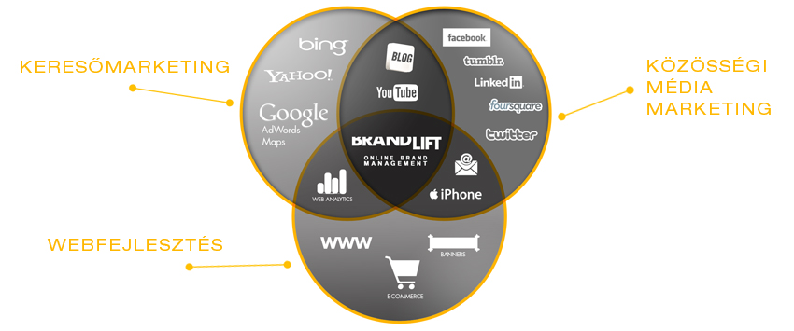
Brandlift │ +36 30 970 7008 │ info@brandlift.eu │ www.brandlift.eu

Slide 3

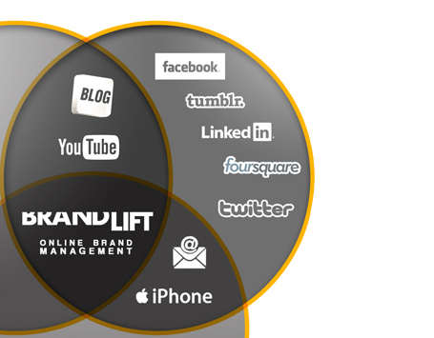
KÖZÖSSÉGI MÉDIA MARKETING
Brandlift │ +36 30 970 7008 │ info@brandlift.eu │ www.brandlift.eu
Notes:
Adam Jankovits │ SEO/SEM Specialist │ 36.30.378.1710 │ adam.jankovits@gmail.com

Slide 4
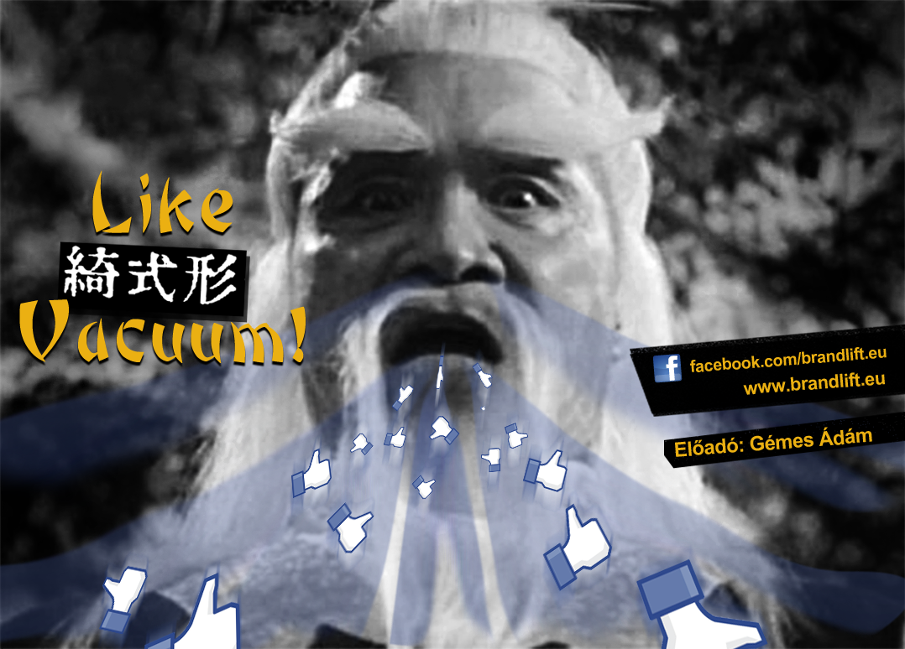
Brandlift │ +36 30 970 7008 │ info@brandlift.eu │ www.brandlift.eu
Notes:
Adam Jankovits │ SEO/SEM Specialist │ 36.30.378.1710 │ adam.jankovits@gmail.com

Slide 5
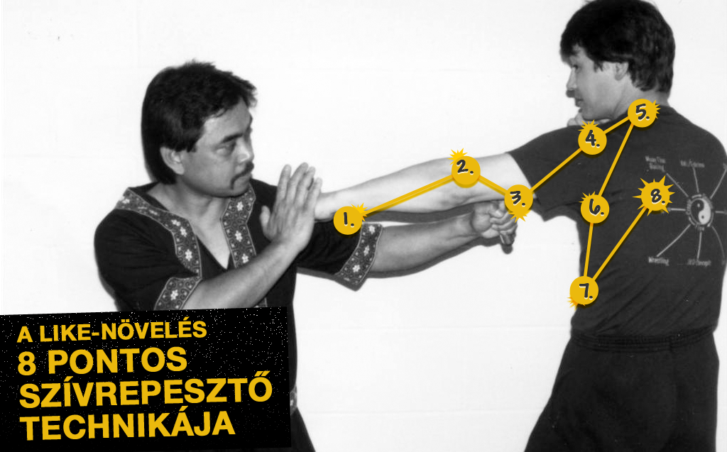

Brandlift │ +36 30 970 7008 │ info@brandlift.eu │ www.brandlift.eu
Notes:
Adam Jankovits │ SEO/SEM Specialist │ 36.30.378.1710 │ adam.jankovits@gmail.com

Slide 6
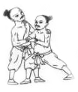

Brandlift │ +36 30 970 7008 │ info@brandlift.eu │ www.brandlift.eu
Notes:
Adam Jankovits │ SEO/SEM Specialist │ 36.30.378.1710 │ adam.jankovits@gmail.com

Slide 7

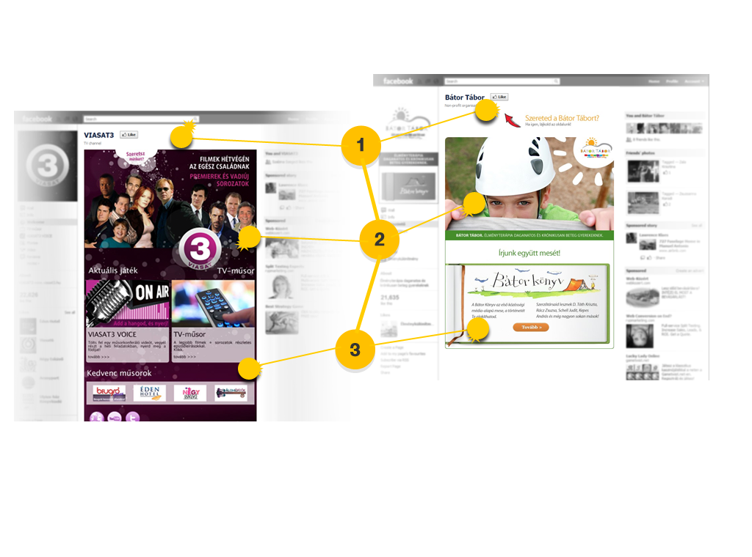
Brandlift │ +36 30 970 7008 │ info@brandlift.eu │ www.brandlift.eu
Notes:
Adam Jankovits │ SEO/SEM Specialist │ 36.30.378.1710 │ adam.jankovits@gmail.com

Slide 8



68,4 %
Brandlift │ +36 30 970 7008 │ info@brandlift.eu │ www.brandlift.eu
Notes:
Adam Jankovits │ SEO/SEM Specialist │ 36.30.378.1710 │ adam.jankovits@gmail.com

Slide 9
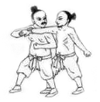

Brandlift │ +36 30 970 7008 │ info@brandlift.eu │ www.brandlift.eu
Notes:
Adam Jankovits │ SEO/SEM Specialist │ 36.30.378.1710 │ adam.jankovits@gmail.com

Slide 10
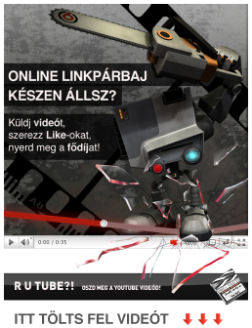



1.
2.
3.
Brandlift │ +36 30 970 7008 │ info@brandlift.eu │ www.brandlift.eu
Notes:
Adam Jankovits │ SEO/SEM Specialist │ 36.30.378.1710 │ adam.jankovits@gmail.com

Slide 11


Brandlift │ +36 30 970 7008 │ info@brandlift.eu │ www.brandlift.eu
Notes:
Adam Jankovits │ SEO/SEM Specialist │ 36.30.378.1710 │ adam.jankovits@gmail.com

Slide 12

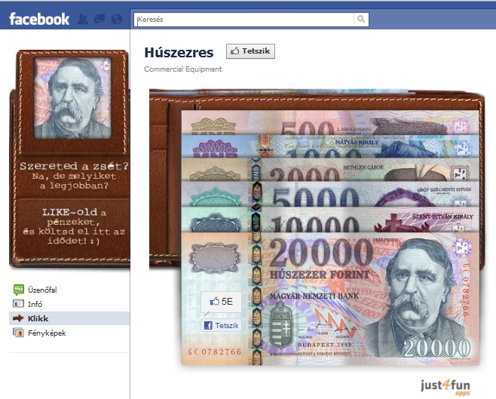
0,01 $
Brandlift │ +36 30 970 7008 │ info@brandlift.eu │ www.brandlift.eu
Notes:
Adam Jankovits │ SEO/SEM Specialist │ 36.30.378.1710 │ adam.jankovits@gmail.com

Slide 13


Brandlift │ +36 30 970 7008 │ info@brandlift.eu │ www.brandlift.eu
Notes:
Adam Jankovits │ SEO/SEM Specialist │ 36.30.378.1710 │ adam.jankovits@gmail.com

Slide 14

Brandlift │ +36 30 970 7008 │ info@brandlift.eu │ www.brandlift.eu
Notes:
Adam Jankovits │ SEO/SEM Specialist │ 36.30.378.1710 │ adam.jankovits@gmail.com

Slide 15
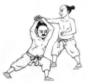

Brandlift │ +36 30 970 7008 │ info@brandlift.eu │ www.brandlift.eu
Notes:
Adam Jankovits │ SEO/SEM Specialist │ 36.30.378.1710 │ adam.jankovits@gmail.com

Slide 16





Brandlift │ +36 30 970 7008 │ info@brandlift.eu │ www.brandlift.eu
Notes:
Adam Jankovits │ SEO/SEM Specialist │ 36.30.378.1710 │ adam.jankovits@gmail.com

Slide 17


Brandlift │ +36 30 970 7008 │ info@brandlift.eu │ www.brandlift.eu
Notes:
Adam Jankovits │ SEO/SEM Specialist │ 36.30.378.1710 │ adam.jankovits@gmail.com

Slide 18


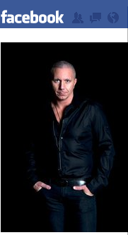
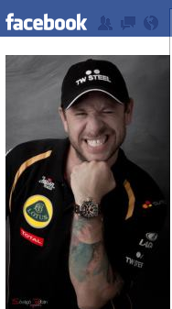
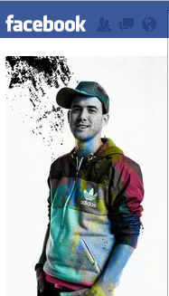
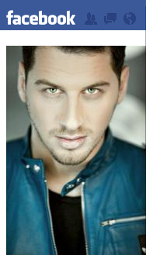

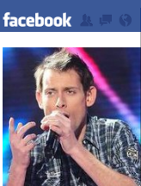
Brandlift │ +36 30 970 7008 │ info@brandlift.eu │ www.brandlift.eu
Notes:
Adam Jankovits │ SEO/SEM Specialist │ 36.30.378.1710 │ adam.jankovits@gmail.com

Slide 19


Brandlift │ +36 30 970 7008 │ info@brandlift.eu │ www.brandlift.eu
Notes:
Adam Jankovits │ SEO/SEM Specialist │ 36.30.378.1710 │ adam.jankovits@gmail.com

Slide 20
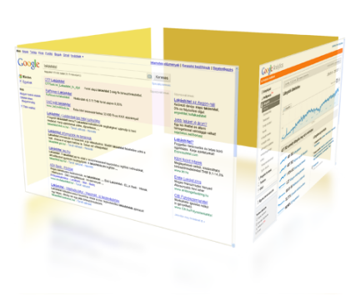


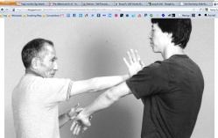

Brandlift │ +36 30 970 7008 │ info@brandlift.eu │ www.brandlift.eu
Notes:
Adam Jankovits │ SEO/SEM Specialist │ 36.30.378.1710 │ adam.jankovits@gmail.com

Slide 21


Brandlift │ +36 30 970 7008 │ info@brandlift.eu │ www.brandlift.eu
Notes:
Adam Jankovits │ SEO/SEM Specialist │ 36.30.378.1710 │ adam.jankovits@gmail.com

Slide 22
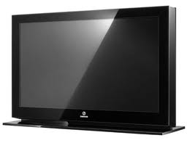


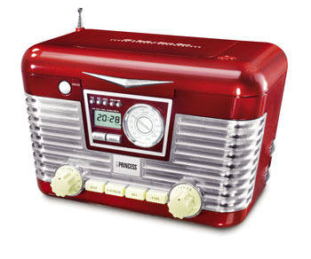

Brandlift │ +36 30 970 7008 │ info@brandlift.eu │ www.brandlift.eu
Notes:
Adam Jankovits │ SEO/SEM Specialist │ 36.30.378.1710 │ adam.jankovits@gmail.com

Slide 23
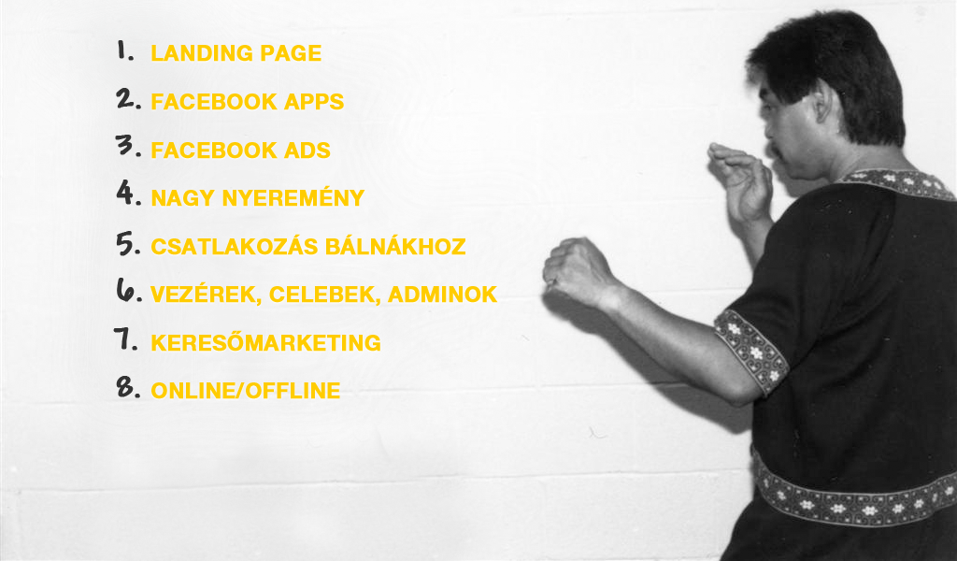
Tehát!
Brandlift │ +36 30 970 7008 │ info@brandlift.eu │ www.brandlift.eu
Notes:
Adam Jankovits │ SEO/SEM Specialist │ 36.30.378.1710 │ adam.jankovits@gmail.com

Slide 24
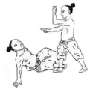

Brandlift │ +36 30 970 7008 │ info@brandlift.eu │ www.brandlift.eu
Notes:
Adam Jankovits │ SEO/SEM Specialist │ 36.30.378.1710 │ adam.jankovits@gmail.com

Slide 25

Brandlift │ +36 30 970 7008 │ info@brandlift.eu │ www.brandlift.eu

Slide 26

?
Brandlift │ +36 30 970 7008 │ info@brandlift.eu │ www.brandlift.eu
Notes:
Adam Jankovits │ SEO/SEM Specialist │ 36.30.378.1710 │ adam.jankovits@gmail.com

